Slide 1
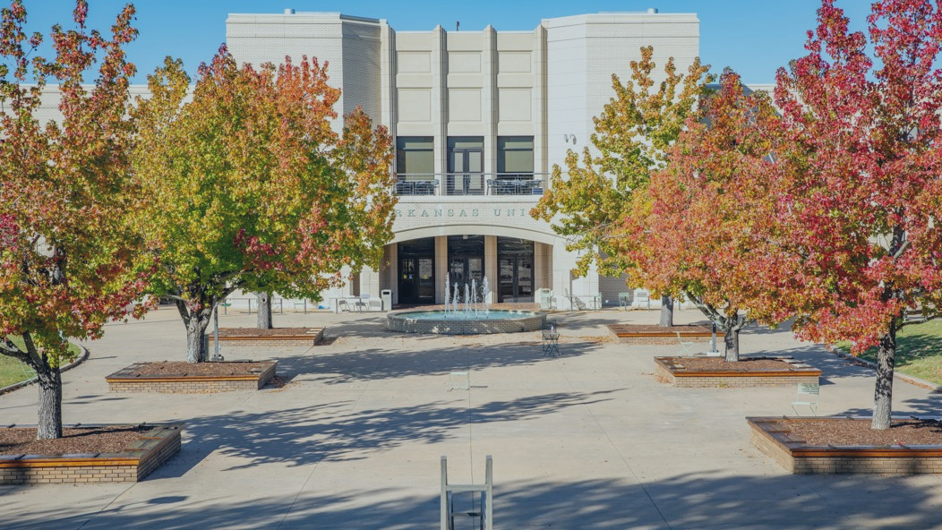
MONEY MATTERS
& TECHNOLOGY NEEDS

Slide 2
TREASURER’S OFFICE

Slide 3
TREASURER'S OFFICE & STUDENT ACCOUNTS
WHAT WE DO
CONNECT WITH US!
treasurernet.uark.edu
treainfo@uark.edu
479-575-5651
640 N. Garland Ave. Ste. 108
Student Invoices
Cashiering
Account Inquiries
Tuition Waivers
Collections
3rd Party Billing
Monday - Friday 8 a.m. to 5 p.m.

Slide 4
TODAY’S AGENDA
Tuition & Fee Costs
Navigating Workday Student
Parent Authorizations
Refunds
Help Centers
Withdrawing vs. Dropping
FAQs
Treasurer’s Office Checklist

Slide 5
HOW MUCH WILL IT COST
COSTS VARY EACH SEMESTER BASED ON
Credit Hours
College
Residency Status
Student Career Level
Type of Program
TUITION AND FEES ARE CHARGED
Per Credit Hour
MANDATORY STUDENT FEES
Network/Data Systems Fee
Library Fee
Health Fee
Student Media Fee
Transit Fee
Student Activity Fee
Facilities Fee
COLLEGE FEES
Arts & Sciences
Architecture
Engineering
Agriculture, Food & Life Sciences
Education & Health Professions
Business
Nursing
Housing and meal plan costs also vary based on student selection. Please visit housing.uark.edu.

Slide 6
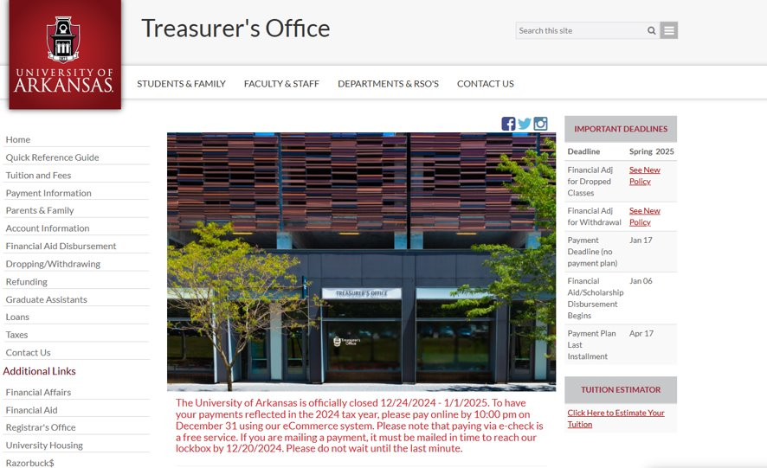
OUR WEBSITE

Slide 7
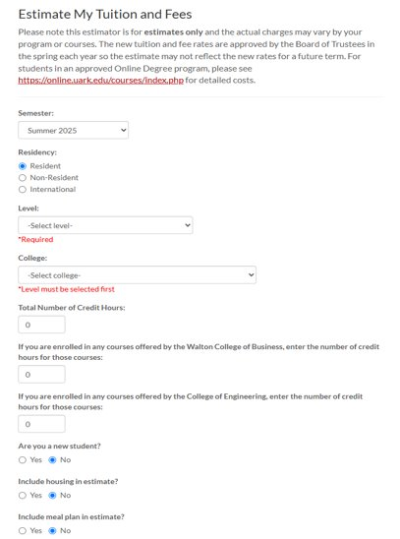
Visit treasurenet.uark.edu/estimator
TUITION CALCULATOR

Slide 8
NAVIGATING WORKDAY STUDENT

Slide 9
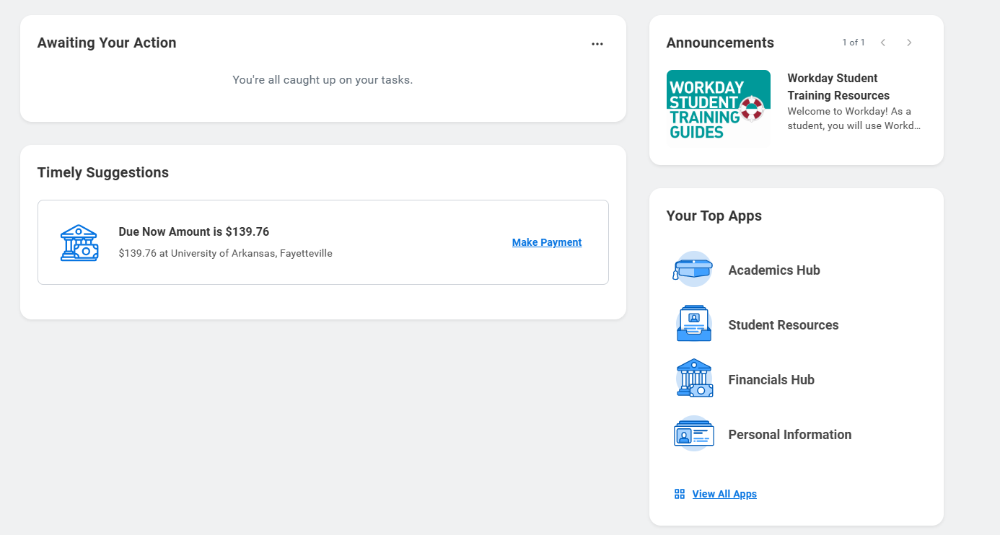
NAVIGATING WORKDAY STUDENT (CONT)
My Task
Active Holds
Action Items
Financials Hub
Account Balance
Recent Payments
Make a Payment
Payment Plans
Profile
Your Contact Information
FERPA 3rd Party Release
Parent/Family Access
Refunding Option

Slide 10
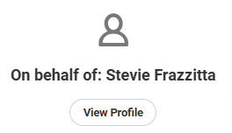
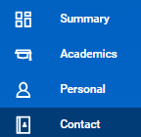
NAVIGATING WORKDAY STUDENT (CONT)
FERPA/3rd Party Release – Add Permissions for Friend or Family Member
View Profile (Upper Right Corner)
Contact (left hand side menu)
Friends and Family (Top Menu Bar)
Add if no contacts, edit for existing friends and Family under actions

Slide 11
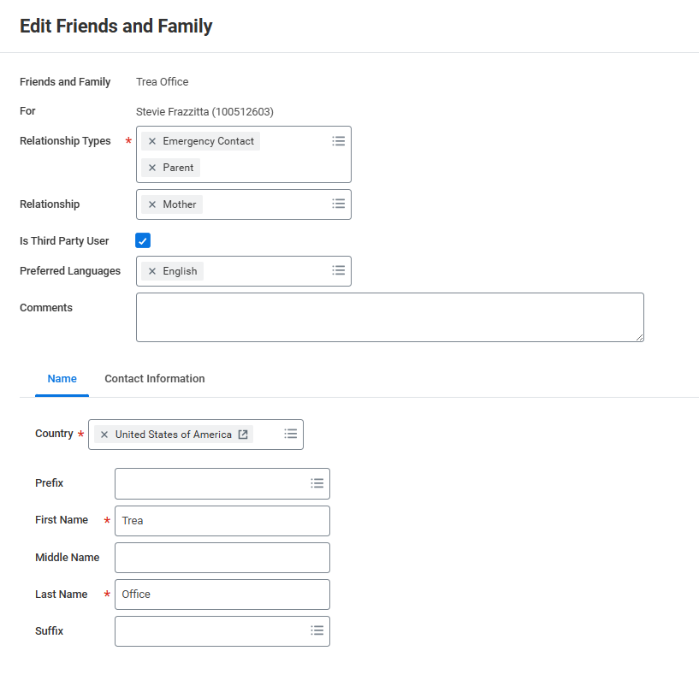
NAVIGATING WORKDAY STUDENT (CONT)
FERPA/3rd Party Release – Add Permissions for Friend or Family Member
Click Is Third Party User: Gives permission for the Treasurers Office to release account information to whomever is checked marked. Click OK at the bottom to save. If adding new friend/Family enter contact information in the lower part.
Click here for Third Party Access
Enter contact information for new Third Party Here

Slide 12
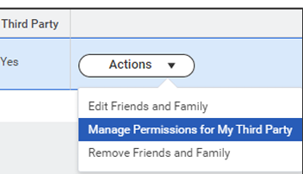
E-Commerce Payment Authorizations
(Workday Student– Profile – Contacts – Friends and
Family – Add –Done – Actions – Manage My
Permissions for My Third Party – Make a Payment)
Parent/Family Workday Student Access
(Workday Student – Profile – Contacts – Friends and
Family – Add –Done – Actions – Manage My
Permissions for My Third Party)
FERPA 3rd Party Release
(Workday Student – Profile – Contacts – Friends and
Family – Add – Is Third Party User)
PARENT AUTHORIZATIONS

Slide 13
If a refund preference has not been selected, your refund can be delayed up to four weeks. Even if you are not expecting to receive a refund, please set up a refunding preference.
Workday Student
Student Profile
Actions
Personal Data
Maintain Payment Elections
Student Refunds
Add
Your money, delivered your way!
Your school has partnered with BankMobile to deposit your money or refund quickly and securely.
You will have two electronic options to deposit your money. To avoid delays in accessing your money, you must select a refund option. The BankMobile Vibe Checking Account is one of you refund options but you are not required to open this account to receive your refund.
Visit refundselection.com for more information.
REFUNDS

Slide 14
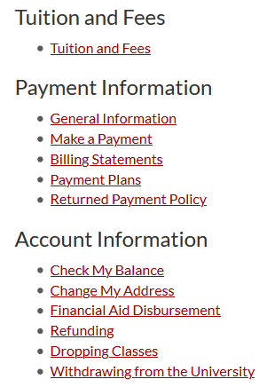
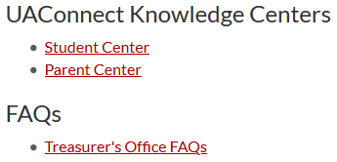
HELP CENTERS
TUTORIALS WITH STEP-BY-STEP ILLUSTRATIONS & HOW TOS
Make a Payment
Set Up Parent Authorizations
Add Authorizations
Set Refund Preferences
... and More!
Workday Student Knowledge Centers
Workday Student Knowledge Centers
Visit treasurernet.uark.edu/student_family for more information

Slide 15
The Registrar’s Office determines drop and withdrawal deadlines. Before dropping classes or withdrawing, refer to this calendar to be sure you understand the financial implications it could cause.
When in doubt, contact us!
The academic semester calendar can be found on the Registrar’s website. The Fall 2025 calendar is available now.
THERE IS A $45.00 WITHDRAWAL FEE
DROPPING & WITHDRAWING ARE DIFFERENT
KNOW THE FINANCIAL RELATED DEADLINES
WITHDRAWING CAN AFFECT FINANCIAL AID ELIGIBILITY
DROPPING & WITHDRAWING

Slide 16
FREQUENTLY ASKED QUESTIONS
When will I know how much I owe?
When is the payment deadline?
Will I get a late fee?
Why do I have a hold?
What types of payments do you take?
Be sure to check your account frequently for additional charges throughout the term.
Fall 2025:
Mid to Late July
Spring 2026:
Early to Mid December
August 22nd, 2025
Tuition and Fees are typically due on the 5th class day. You can review your due dates on Workday Student:
~Home Page/Timely
Suggestions or
~View Account Activity
~Due Now Details
YES! Pay your balance on time!
Late fees are applied twice per semester. You can avoid late fees by paying in full or enrolling into a payment plan and making payments as scheduled.
Auto-pay is also an option.
Various Reasons
You can find what type of hold/s you have on Workday Student:
~Profile
~Action Items and Holds
~Active Holds
*Some holds require you to complete a task. You can find tasks under “My Tasks”.
*Some holds will prevent future registration and your ability to get a transcript.
Online Payments
Preferred:
Electronic check (Free)
Credit card (1.8% Fee)
Also:
Paper check mailed to Lockbox
No Payments are accepted in our office!
Phone payments are not accepted!
*Beginning Spring 2021, payments will not be accepted in-office.

Slide 17
FREQUENTLY ASKED QUESTIONS
Where do I mail a personal check?
Where do I mail a 529 college savings payment?
Where do I mail an outside scholarship?
How do I enroll into a payment plan?
When are payment plan installments due?
University of Arkansas
Department 1238
Oklahoma City, OK.
73196
Please include student’s name and student’s ID# on the
memo line!
University of Arkansas
Department 1238
Oklahoma City, OK.
73196
Please have them include the student’s name and ID# on the check, stub or other documentation.
University of Arkansas
Treasurer’s Office
640 N Garland Ave
Suite #108
Fayetteville, AR
72701
Please have them include the student’s name and ID# along with a scholarship letter.
On Workday Student
~Financials Hub
~ Payment Plan
~ Follow all directions
~ Auto-pay is optional
Payment plans are optional. You must enroll every semester and there is a flat fee of $40.00 per semester.
4 Month Plan
Balance divided into 4 equal installments
(due Aug, Sept, Oct and Nov)
Please see Treasurer's Office Website for exact date for final enrollment in this plan.
3 Month Plan
Balance divided into 3 equal installments
(due Sept, Oct and Nov)
Please see Treasurer's Office Website for exact date for final enrollment in this plan.

Slide 18
FREQUENTLY ASKED QUESTIONS
When will my federal aid disburse?
When will my scholarships disburse?
What about my outside scholarships?
How do I get the NRTA applied to my account?
Will I get a refund?
Grants and Loans
These typically disburse approx. 10 days before classes start.
The Treasurer’s Office disburses aid according to instructions from the Financial Aid Office.
Scholarships
These typically disburse approx. 10 days before classes start including AR Challenge.
Tuition waivers, 3rd party deferments and some state scholarships will not post until after census date which is the 11th class day.
Scholarships from organizations -
These can take longer to process. Please allow two weeks for processing beginning from the date the funds are received.
(Examples: high schools, churches, clubs, etc.)
New Arkansan Non-Resident Tuition Award
The NRTA is awarded through the scholarship office and is system calculated.
Perhaps!
If your account is overpaid by financial aid, scholarships, other types of payments or adjustments, you may get a refund. Be prepared & set up your refund preference in advance!
Office of Financial Aid
finaid@uark.edu | 479-575-3806
Office of Academic Scholarships
scholars@uark.edu | 479-575-3806
Bank Mobile Refunds
refundselection.com

Slide 19
CHECKLIST
REQUIRED
Financial Aid Agreement
(Workday Student – My Tasks - Onboarding)
HIGHLY RECOMMENDED
Select Refunding Preference
(Workday Student – Profile – Actions – Personal Data – Maintain
Payment Elections – Student Refunds - Add)
Parent/Family Workday Student Authorizations
(Workday Student – Profile – Contacts – Friends and Family – Add –Done
– Actions – Manage My Permissions for My Third Party)
FERPA 3rd Party Release
(Workday Student – Profile – Contacts – Friends and
Family – Add – Is Third Party User)
E-Commerce Payment Authorizations
(Workday Student – Profile – Contacts – Friends and
Family – Add –Done – Actions – Manage My Permissions for My Third Party – Make a Payment)
Student Permissions for Title IV Aid
(Workday Student – My Tasks - Onboarding)
IRS 1098-T E-Consent Form
(Workday Student – My Tasks - Onboarding)

Slide 20
CONNECT WITH US!
CONTACT INFORMATION
ON SOCIAL MEDIA
treasurernet.uark.edu
University of Arkansas-Fayetteville
Treasurer's Office
@UofATreasurer
& via chat online
treainfo@uark.edu
479-575-5651
640 N. Garland Ave. Ste. 108
Monday - Friday 8 a.m. to 5 p.m.

Slide 21
TECHNOLOGY STORE & SERVICE CENTER

Slide 22
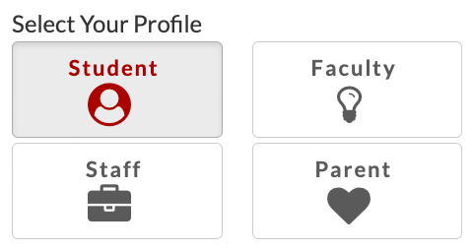
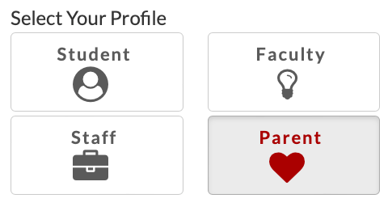
GET STARTED WITH TECH
VISIT TECH.UARK.EDU
UARK Account
Wi-Fi
Email
UAConnect
Blackboard
Software
Printing

Slide 23
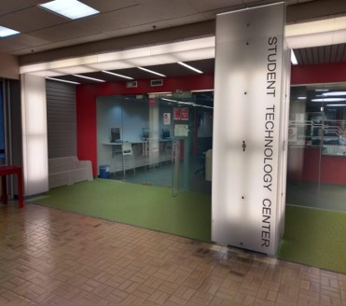
3RD FLOOR ARKANSAS UNION
Monday - Friday 8 a.m. to 10 p.m.
YOU CAN BORROW...
Laptops
Calculators
Cameras
Recorders
Green Screen Kits
Gaming Consoles
Audio Recorders & Microphones
Projectors
YOU CAN RESERVE...
Audio Production Studio
3D Printing
Alienware PC
Console Stations
STUDENT TECHNOLOGY CENTER

Slide 24
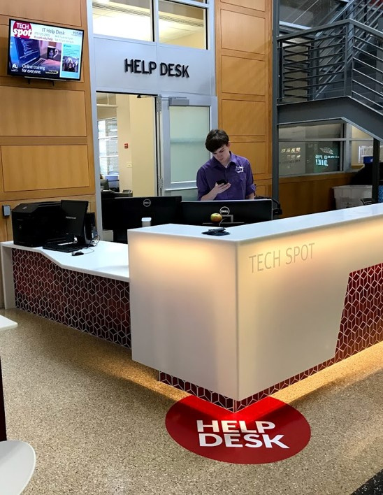
GET HELP
Tech Help is available 7 days a week!
In person at the IT Help Desk in the Union
Online chat at help.uark.edu
By phone at 479-575-HELP
Visit help.uark.edu to learn more

Slide 25
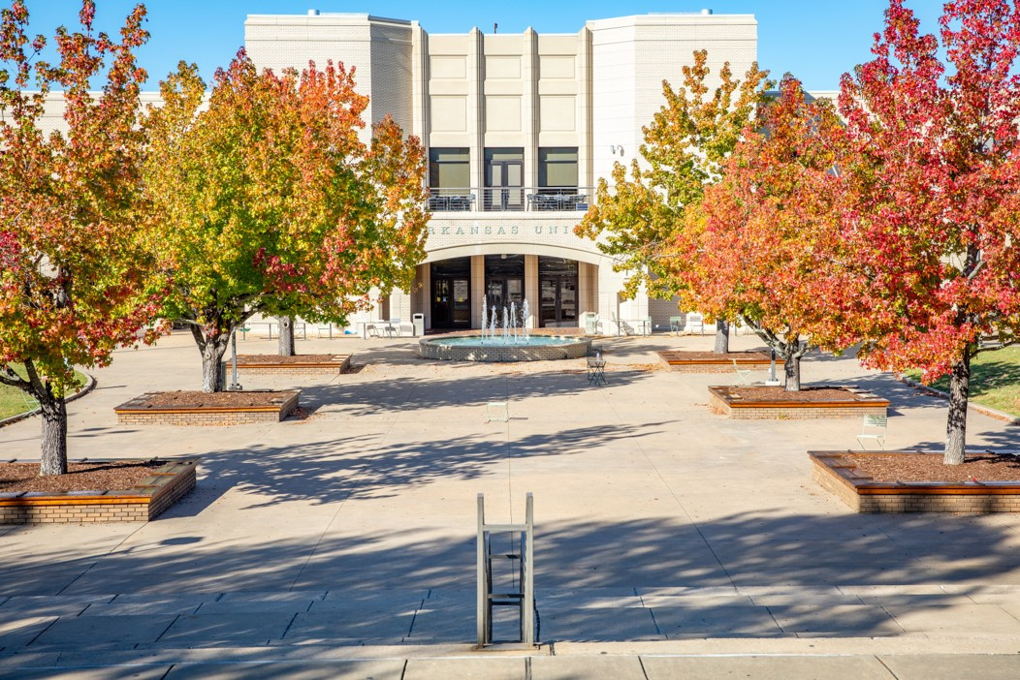
TECH STORE & SERVICE CENTER
WHY THE TECH STORE?
Friendly, knowledgeable staff
Campus academic/contractual pricing
Knowledge of campus & college unique technology requirements and/or recommendations
Not for profit, owned and operated by the University of Arkansas
Apple & Dell authorized warranty provider
Visit techstore.uark.edu to learn more
UARK Bookstore & 3rd Floor of Arkansas Union
Monday - Friday 8 a.m. to 5 p.m.

Slide 26
MINIMUM UNIVERSITY TECHNOLOGY RECOMMENDATIONS
Processor: i5 or M1
Memory/RAM: 8GB
Hard Drive/Storage: 250GB
Webcam
3-Year Accidental damage warranty
Microsoft Office
The following colleges must meet MINIMUM University Technology Requirements:
Fulbright College of Arts and Sciences
Walton College of Business
College of Education and Health Professions
School of Law

Slide 27
WHAT TECH TO BUY FOR YOUR MAJOR
Recommends a Mac:
Requires a Mac:
School of Journalism & Strategic Media
School of Art
Music
Bachelor of Science in Data Science
Bachelor of Fine Arts in Graphic Design
Requires Windows:
Fay Jones School of Architecture & Design
Recommends Windows or the ability
to run Windows:
For minimum university standards & other requirements, visit:
techstore.uark.edu/student-reccs
College of Engineering
Walton College of Business
Dale Bumpers College of Agriculture, Food & Life Sciences

Slide 28
COLLEGE SPECIFIC REQUIREMENTS
Fay Jones School of Architecture & Design
Dale Bumpers College of Agriculture, Food & Life Sciences
College of Engineering
Intel i7 series, XEON or AMD Ryzen +​
16GB + RAM min – prefer 32GB​
Nvidia GeForce RTX 3070 or Quadra RTX 5000+ or AMD Radeon RX 6700XT+ video card​
512GB solid state drive​
1920x1200 or higher non-touch display​
64-bit Windows Pro​
802.11ac or later standard​
Software requirements: Office 365, Rhino, Lumion, Revit, Grasshopper
Intel i5 series, Xeon or AMD series +​
16GB of RAM​
Integrated Video card +​
1TB solid state drive​
1920x1200 or higher non-touch display​
64- bit Windows​
802.11ac or later standard​
USB A port or adapter​
USB C port
Intel i5 series, Xeon or AMD series +​
16GB of RAM​
Integrated Video card +​
256BG solid state drive
1920x1200 or higher non-touch display​
64- bit Windows​
802.11ac or later standard​

Slide 29
TECH STORE 2024 DELL BTS BUNDLE
BTS 2024 Inspiron 14” Intel Core 7 Processor/16GB RAM/1TB SSD HD/3 Year ADP Warranty + New Device Set-up
$1148.00
BTS 2024 ARCH Inspiron 16” Plus Intel Core 7 Processor/16GB RAM/8GB Video/1TB SSD HD/4 Year ADP Warranty + New Device Set-Up
$1848.00
BTS 2024 ARCH Inspiron 16” Plus Intel Core 7 Processor/32GB RAM/8GB Video/2TB SSD HD/4 Year ADP Warranty + New Device Set-Up
$2148.00
BTS 2024 XPS 13” Intel Core 7 Processor/16GB RAM/1TB SSD HD/Touch Screen/3 Year ADP Warranty + New Device Set-Up
$2048.00
BTS 2024 XPS 14” Intel Core 7/16GB RAM/6GB Video/512GB SSD HD/4 Year ADP Warranty + New Device Set-Up $2948.00

Slide 30
TECH STORE 2024 APPLE BTS BUNDLE
BTS 2024
MacBook Air 13” M2 Processor/8GB RAM/512GB SSD HD/3 Year ADP Warranty + Free New Device Set-up
$1392.00
BTS 2024 MacBook Pro 13” M2 Processor/8GB RAM/256GB SSD HD/3 Year ADP Warranty + Free New Device Set-Up
$1078.00
BTS 2024 MacBook Air 15” M3 Processor/8GB RAM/256GB or 512GB SSD HD/3 Year ADP Warranty + New Device Set-Up
$1477-$1677
BTS 2024 MacBook Pro 14” M3 Pro Processor/18GB RAM/512GB or 1TB SSD HD/3 Year ADP Warranty + New Device Set-Up
$2177- $2527
BTS 2024 MacBook Pro 16” M3 Pro/18GBor 32GB RAM/512GB SSD HD/3 Year ADP Warranty + New Device Set-Up
$2747 - $3147

Slide 31
SERVICE CENTER SERVICES
ACCIDENTAL DAMAGE PROTECTION
New Device Setup: $49
Operating System Updates
Bios and Driver Updates
Install Microsoft 365
eCommerce Site
Ship or In-Store Pick Up
New Device Setup
Add a laptop case/flash drive/surge protector/pocket charger/iPad
Smart Bar
Walk-in help for your technology issues
Apple iPhone Repair
As the on-campus authorized repair center, we strongly recommend accidental damage protection for your unit.
Apple units have a 1-year warranty which does NOT include coverage for drops or spills
When you purchase a BTS labeled unit from the Tech Store AppleCare+ is included and extends the 1-year warranty to a 3-year accidental damage protection warranty with deductible​
Dell BTS units have ProSupport Plus extended accidental damage protection warranty. No deductibles and repairable by the Tech Store Service Center.

Slide 32
CONNECT WITH US!
CONTACT INFORMATION
In the Garland Bookstore
Monday - Friday 8 a.m. to 5 p.m.
Sales: 479-575-5414 | comstore@uark.edu
Service: 479-575-3811 | uasc@uark.edu
In the Union, room 381
by the bus depot entrance
Monday - Friday 8 a.m. to 5 p.m.
Sales: 479-718-3320 | comstore@uark.edu
Online
techstore.uark.edu

