Slide 1
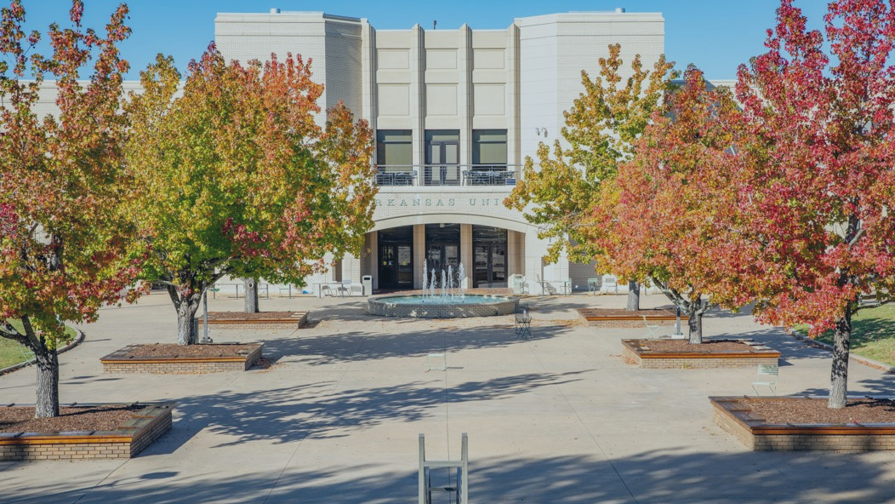

MONEY MATTERS
& TECHNOLOGY NEEDS

Slide 2
TREASURER’S OFFICE

Slide 3





TREASURER'S OFFICE & STUDENT ACCOUNTS
WHAT WE DO
CONNECT WITH US!
treasurernet.uark.edu
treainfo@uark.edu
479-575-5651
640 N. Garland Ave. Ste. 108
  Student Invoices
  Cashiering
  Account Inquiries
  Tuition Waivers
  Collections
  3rd Party Billing
Monday - Friday 8 a.m. to 5 p.m.

Slide 4

TODAY’S AGENDA
Tuition & Fee Costs
Navigating Workday Student
Parent Authorizations
Refunds
Help Centers
Withdrawing vs. Dropping
FAQs
Treasurer’s Office Checklist

Slide 5
HOW MUCH WILL IT COST
COSTS VARY EACH SEMESTER BASED ON
  Credit Hours
  College
  Residency Status
  Student Career Level
  Type of Program
TUITION AND FEES ARE CHARGED
  Per Credit Hour
MANDATORY STUDENT FEES
  Network/Data Systems Fee
  Library Fee
  Health Fee
  Student Media Fee
  Transit Fee
  Student Activity Fee
  Facilities Fee
COLLEGE FEES
  Arts & Sciences
  Architecture
  Engineering
  Agriculture, Food & Life Sciences
  Education & Health Professions
  Business
  Nursing
Housing and meal plan costs also vary based on student selection. Please visit housing.uark.edu.

Slide 6
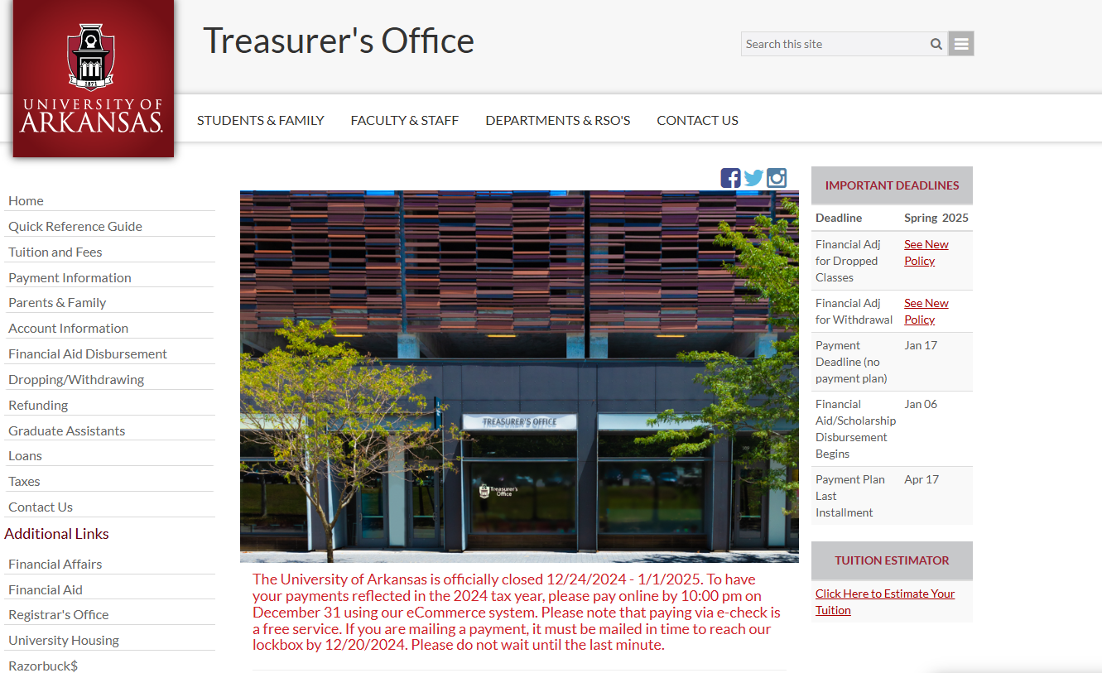
OUR WEBSITE

Slide 7
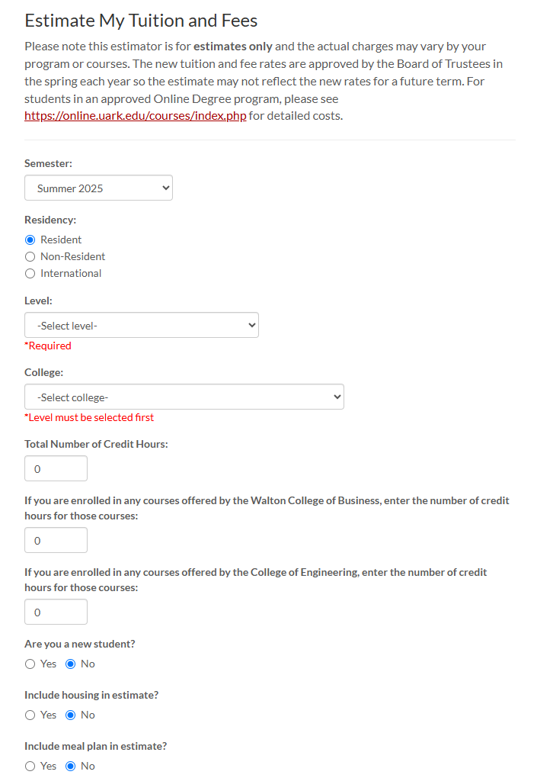

Visit treasurenet.uark.edu/estimator
TUITION CALCULATOR

Slide 8

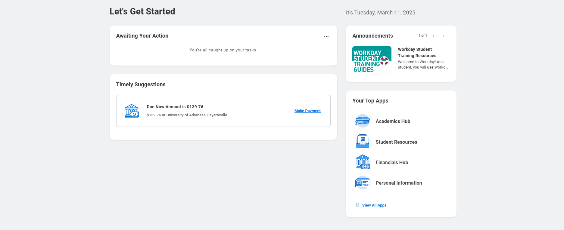
NAVIGATING WORKDAY STUDENT

Slide 9

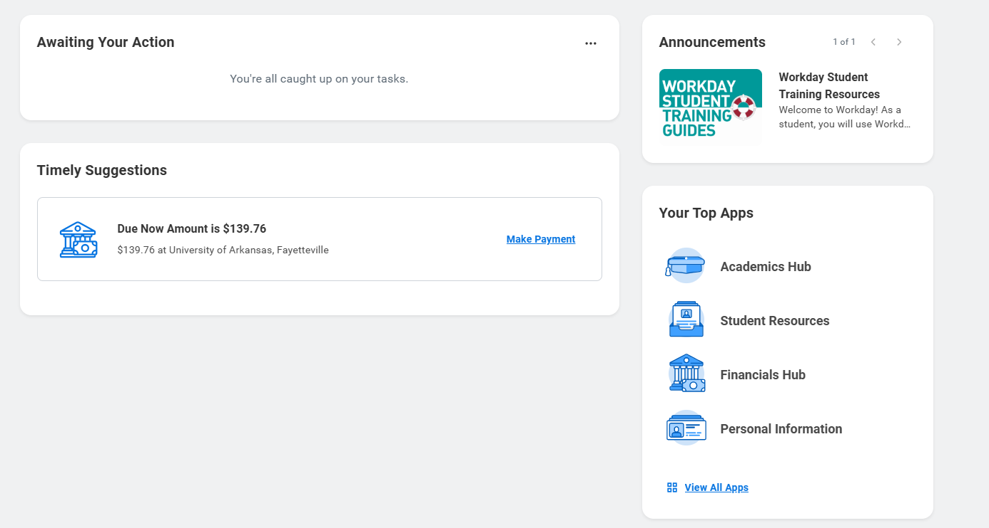
NAVIGATING WORKDAY STUDENT (CONT)
My Task
Active Holds
Action Items
Financials Hub
Account Balance
Recent Payments
Make a Payment
Payment Plans
Profile
Your Contact Information
FERPA 3rd Party Release
Parent/Family Access
Refunding Option

Slide 10
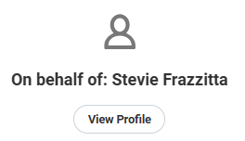

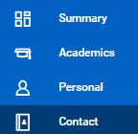
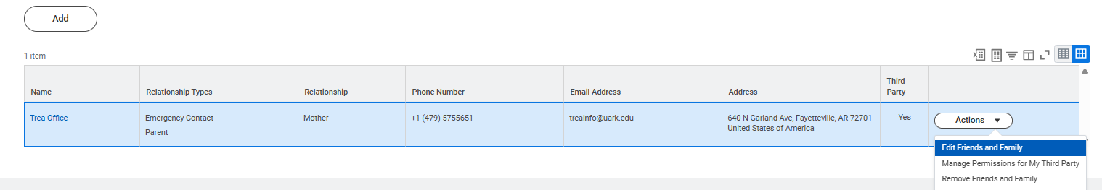
NAVIGATING WORKDAY STUDENT (CONT)
FERPA/3rd Party Release – Add Permissions for Friend or Family Member
View Profile (Upper Right Corner)
Contact (left hand side menu)
Friends and Family (Top Menu Bar)
Add if no contacts, edit for existing friends and Family under actions

Slide 11
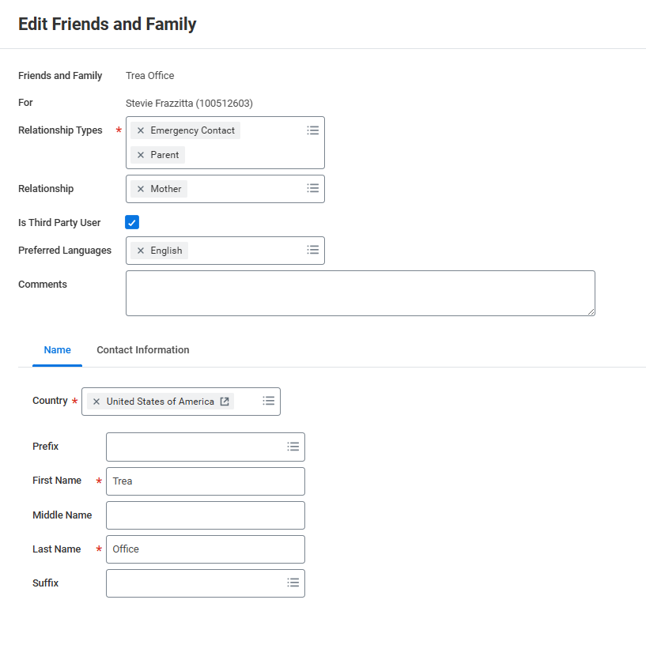
NAVIGATING WORKDAY STUDENT (CONT)
FERPA/3rd Party Release – Add Permissions for Friend or Family Member
Click Is Third Party User: Gives permission for the Treasurers Office to release account information to whomever is checked marked. Click OK at the bottom to save. If adding new friend/Family enter contact information in the lower part.
Click here for Third Party Access
Enter contact information for new Third Party Here

Slide 12

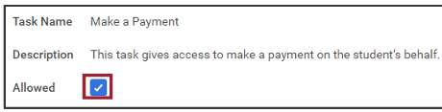
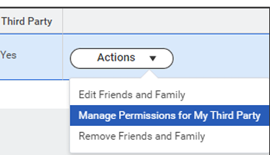

E-Commerce Payment Authorizations
(Workday Student– Profile – Contacts – Friends and
Family – Add –Done – Actions – Manage My
Permissions for My Third Party – Make a Payment)
Parent/Family Workday Student Access
(Workday Student – Profile – Contacts – Friends and
Family – Add –Done – Actions – Manage My
Permissions for My Third Party)
FERPA 3rd Party Release
(Workday Student – Profile – Contacts – Friends and
Family – Add – Is Third Party User)
PARENT AUTHORIZATIONS

Slide 13



If a refund preference has not been selected, your refund can be delayed up to four weeks. Even if you are not expecting to receive a refund, please set up a refunding preference.
Workday Student
  Student Profile
  Actions
  Personal Data
  Maintain Payment Elections
  Student Refunds
  Add
Your money, delivered your way!
Your school has partnered with BankMobile to deposit your money or refund quickly and securely.
You will have two electronic options to deposit your money. To avoid delays in accessing your money, you must select a refund option. The BankMobile Vibe Checking Account is one of you refund options but you are not required to open this account to receive your refund.
Visit refundselection.com for more information.
REFUNDS

Slide 14



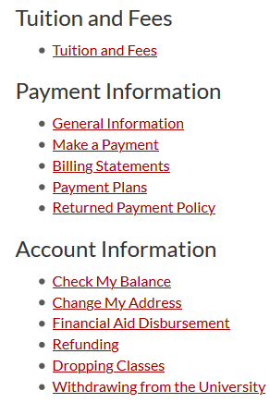

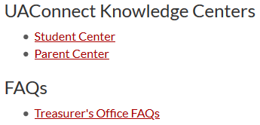
HELP CENTERS
TUTORIALS WITH STEP-BY-STEP ILLUSTRATIONS & HOW TOS
  Make a Payment
  Set Up Parent Authorizations
  Add Authorizations
  Set Refund Preferences
  ... and More!
Workday Student Knowledge Centers
Workday Student Knowledge Centers
Visit treasurernet.uark.edu/student_family for more information

Slide 15
The Registrar’s Office determines drop and withdrawal deadlines. Before dropping classes or withdrawing, refer to this calendar to be sure you understand the financial implications it could cause.
When in doubt, contact us!
The academic semester calendar can be found on the Registrar’s website. The Fall 2025 calendar is available now.
THERE IS A $45.00 WITHDRAWAL FEE
DROPPING & WITHDRAWING ARE DIFFERENT
KNOW THE FINANCIAL RELATED DEADLINES
WITHDRAWING CAN AFFECT FINANCIAL AID ELIGIBILITY
DROPPING & WITHDRAWING

Slide 16
FREQUENTLY ASKED QUESTIONS
When will I know how much I owe?
When is the payment deadline?
Will I get a late fee?
Why do I have a hold?
What types of payments do you take?
Be sure to check your account frequently for additional charges throughout the term.
Fall 2025:
Mid to Late July
Spring 2026:
Early to Mid December
August 22nd, 2025
Tuition and Fees are typically due on the 5th class day. You can review your due dates on Workday Student:
~Home Page/Timely
Suggestions or
~View Account Activity
~Due Now Details
YES! Pay your balance on time!
Late fees are applied twice per semester. You can avoid late fees by paying in full or enrolling into a payment plan and making payments as scheduled.
Auto-pay is also an option.
Various Reasons
You can find what type of hold/s you have on Workday Student:
~Profile
~Action Items and Holds
~Active Holds
*Some holds require you to complete a task. You can find tasks under “My Tasks”.
*Some holds will prevent future registration and your ability to get a transcript.
Online Payments
Preferred:
Electronic check (Free)
Credit card (1.8% Fee)
Also:
Paper check mailed to Lockbox
No Payments are accepted in our office!
Phone payments are not accepted!
*Beginning Spring 2021, payments will not be accepted in-office.

Slide 17
FREQUENTLY ASKED QUESTIONS
Where do I mail a personal check?
Where do I mail a 529 college savings payment?
Where do I mail an outside scholarship?
How do I enroll into a payment plan?
When are payment plan installments due?
University of Arkansas
Department 1238
Oklahoma City, OK.
73196
Please include student’s name and student’s ID# on the
memo line!
University of Arkansas
Department 1238
Oklahoma City, OK.
73196
Please have them include the student’s name and ID# on the check, stub or other documentation.
University of Arkansas
Treasurer’s Office
640 N Garland Ave
Suite #108
Fayetteville, AR
72701
Please have them include the student’s name and ID# along with a scholarship letter.
On Workday Student
~Financials Hub
~ Payment Plan
~ Follow all directions
~ Auto-pay is optional
Payment plans are optional. You must enroll every semester and there is a flat fee of $40.00 per semester.
4 Month Plan
Balance divided into 4 equal installments
(due Aug, Sept, Oct and Nov)
Please see Treasurer's Office Website for exact date for final enrollment in this plan.
3 Month Plan
Balance divided into 3 equal installments
(due Sept, Oct and Nov)
Please see Treasurer's Office Website for exact date for final enrollment in this plan.

Slide 18
FREQUENTLY ASKED QUESTIONS
When will my federal aid disburse?
When will my scholarships disburse?
What about my outside scholarships?
How do I get the NRTA applied to my account?
Will I get a refund?
Grants and Loans
These typically disburse approx. 10 days before classes start.
The Treasurer’s Office disburses aid according to instructions from the Financial Aid Office.
Scholarships
These typically disburse approx. 10 days before classes start including AR Challenge.
Tuition waivers, 3rd party deferments and some state scholarships will not post until after census date which is the 11th class day.
Scholarships from organizations -
These can take longer to process. Please allow two weeks for processing beginning from the date the funds are received.
(Examples: high schools, churches, clubs, etc.)
New Arkansan Non-Resident Tuition Award
The NRTA is awarded through the scholarship office and is system calculated.
Perhaps!
If your account is overpaid by financial aid, scholarships, other types of payments or adjustments, you may get a refund. Be prepared & set up your refund preference in advance!
Office of Financial Aid
finaid@uark.edu | 479-575-3806
Office of Academic Scholarships
scholars@uark.edu | 479-575-3806
Bank Mobile Refunds
refundselection.com

Slide 19
CHECKLIST
REQUIRED
Financial Aid Agreement
(Workday Student – My Tasks - Onboarding)
HIGHLY RECOMMENDED
Select Refunding Preference
(Workday Student – Profile – Actions – Personal Data – Maintain
Payment Elections – Student Refunds - Add)
Parent/Family Workday Student Authorizations
(Workday Student – Profile – Contacts – Friends and Family – Add –Done
– Actions – Manage My Permissions for My Third Party)
FERPA 3rd Party Release
(Workday Student – Profile – Contacts – Friends and
Family – Add – Is Third Party User)
E-Commerce Payment Authorizations
(Workday Student – Profile – Contacts – Friends and
Family – Add –Done – Actions – Manage My Permissions for My Third Party – Make a Payment)
Student Permissions for Title IV Aid
(Workday Student – My Tasks - Onboarding)
IRS 1098-T E-Consent Form
(Workday Student – My Tasks - Onboarding)

Slide 20


CONNECT WITH US!
CONTACT INFORMATION
ON SOCIAL MEDIA
treasurernet.uark.edu
University of Arkansas-Fayetteville
Treasurer's Office
@UofATreasurer
& via chat online
treainfo@uark.edu
479-575-5651
640 N. Garland Ave. Ste. 108
Monday - Friday 8 a.m. to 5 p.m.

