Slide 1
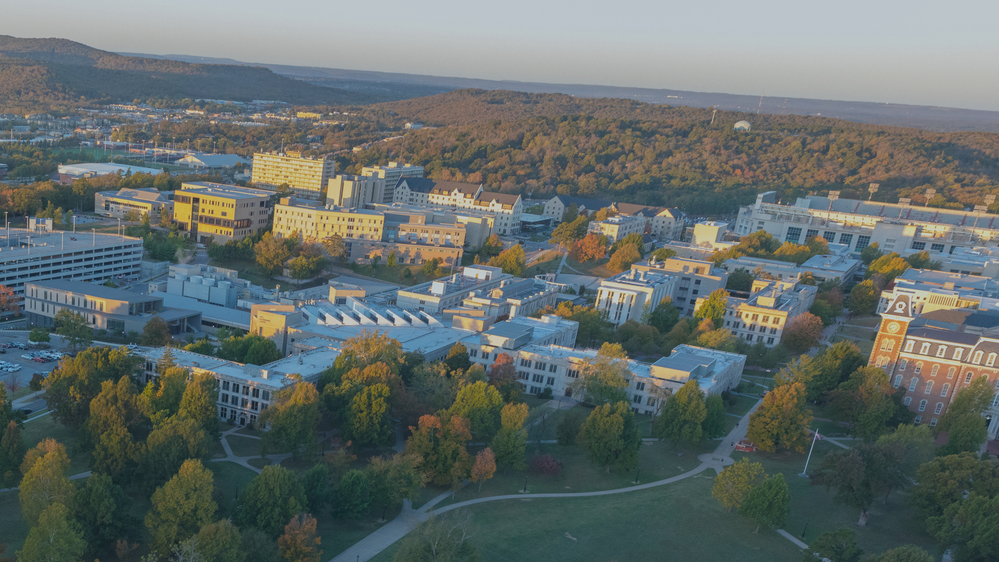
DESTINATION
FAYETTEVILLE

Slide 2
UNIVERSITY HOUSING

Slide 3
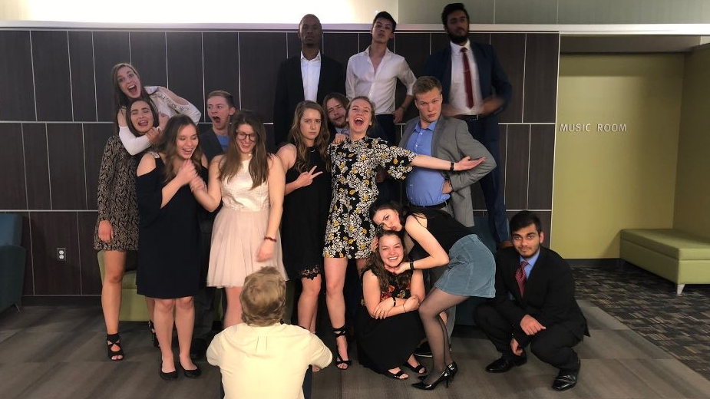
WELCOME TO YOUR NEW HOME!
College friends are like a family. You eat together, take naps together, fight, laugh, cry, and do everything together until you can’t remember how you lived without them.
-
Unknown

Slide 4
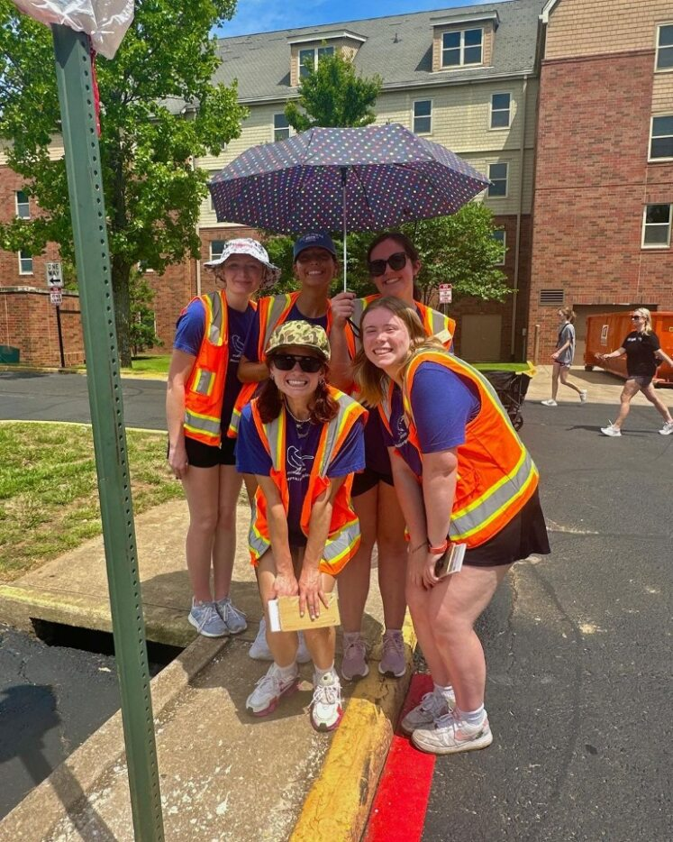
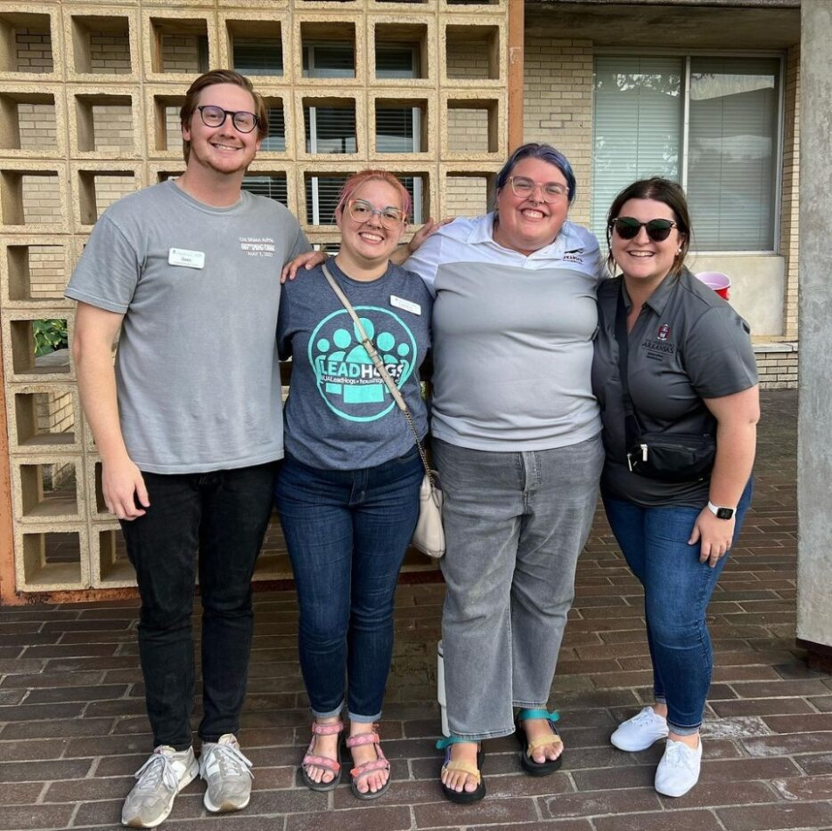
INTRODUCING OUR RESIDENCE HALL STAFF
Hall Director
Resident Assistant (RA)
Residence Hall Administrators
Maintenance Team Members
Institutional Service Assistants (ISA)
Embedded Mental Health Team

Slide 5
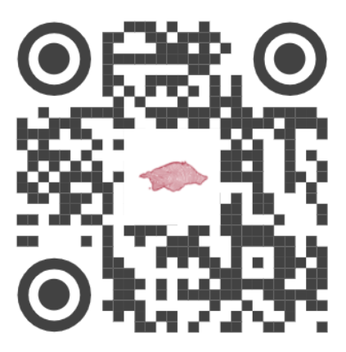
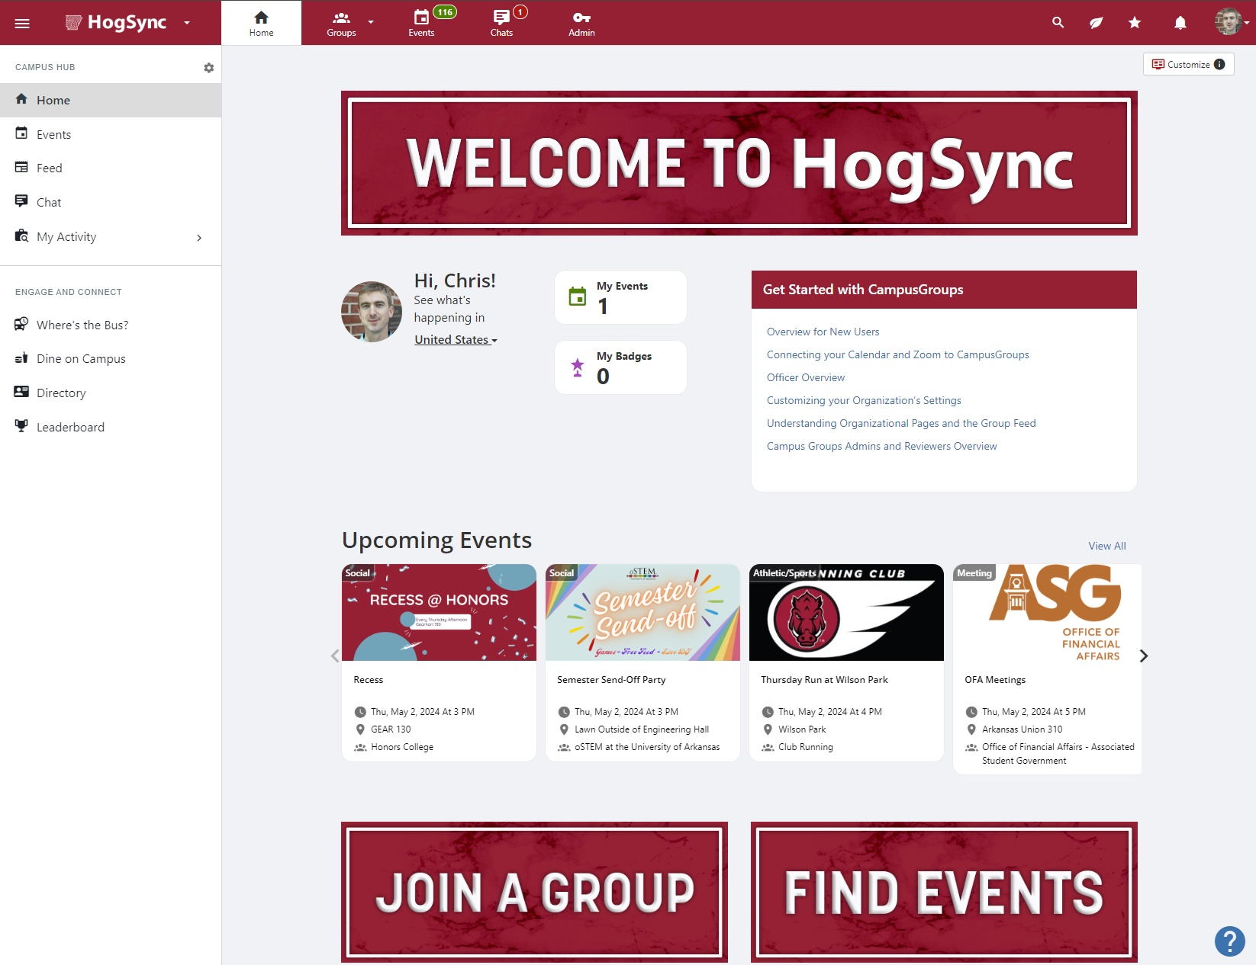
HOGSYNC
Check out HOGSync!
hogsync.uark.edu

Slide 6
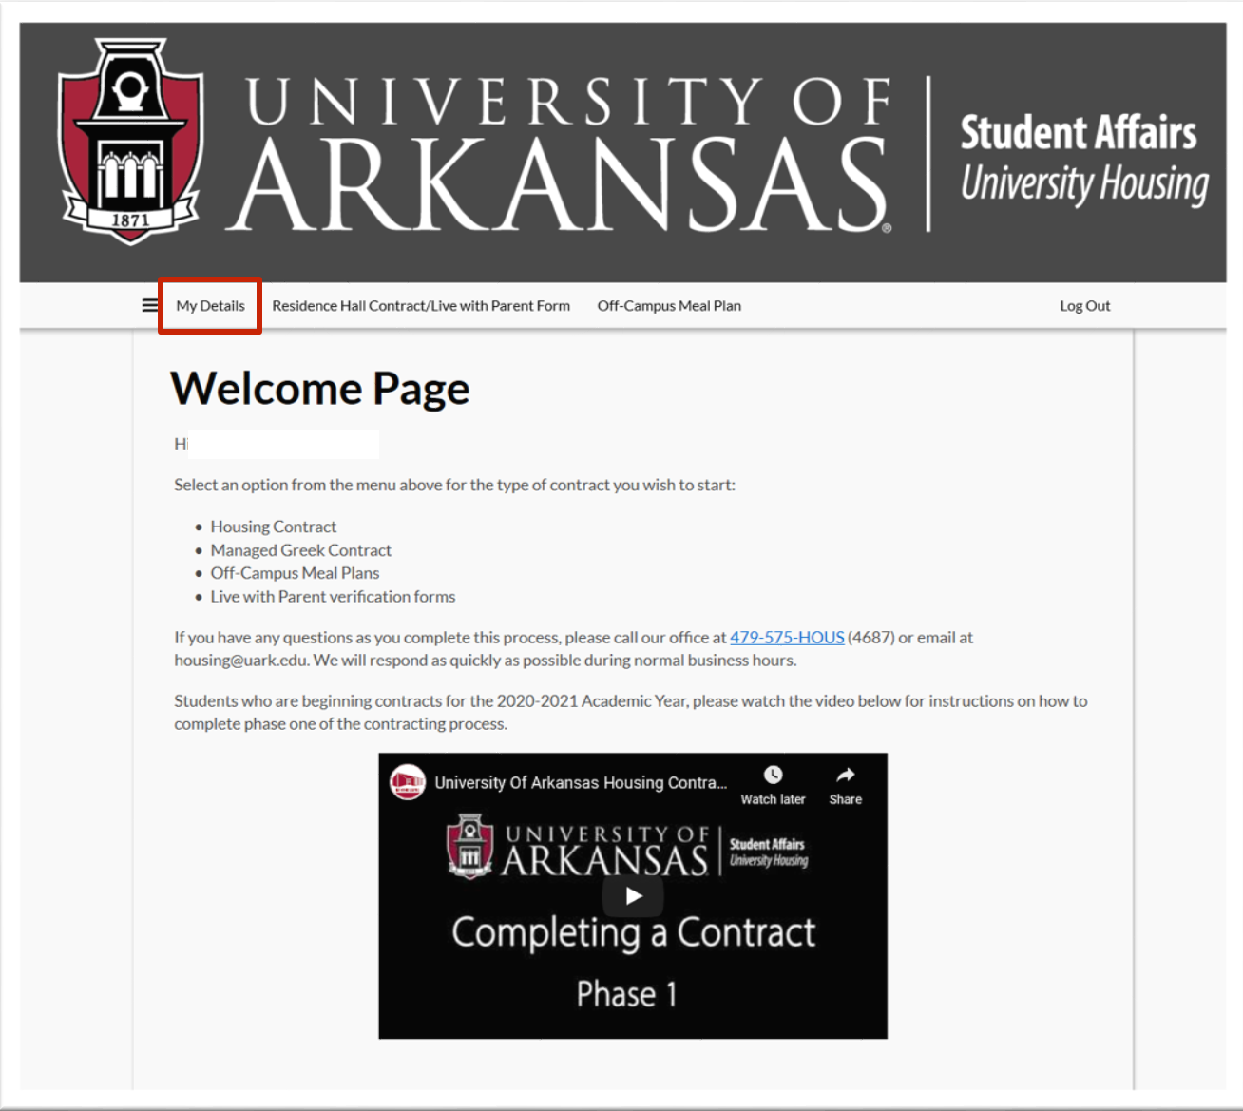
FINDING HOUSING INFORMATION
Students can login to their housing contracting portal and select "My Details" to find the following information:​
Room Assignments​
Roommates​
Meal Plan Information​
Mailing Address/Mailbox Information
Beginning in early August

Slide 7
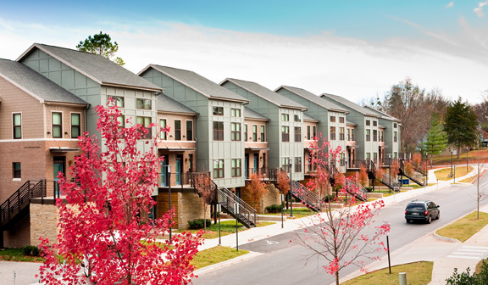
Apartment Communities
First-year students are able to select from Duncan Avenue Apartments (on-campus) and various off-campus apartment options: The Marshall (limited availability) or The Cardinal.
​
These students will have access to Housing staff as well as many of the resources available to other students on campus while living in the apartments. ​
​

Slide 8
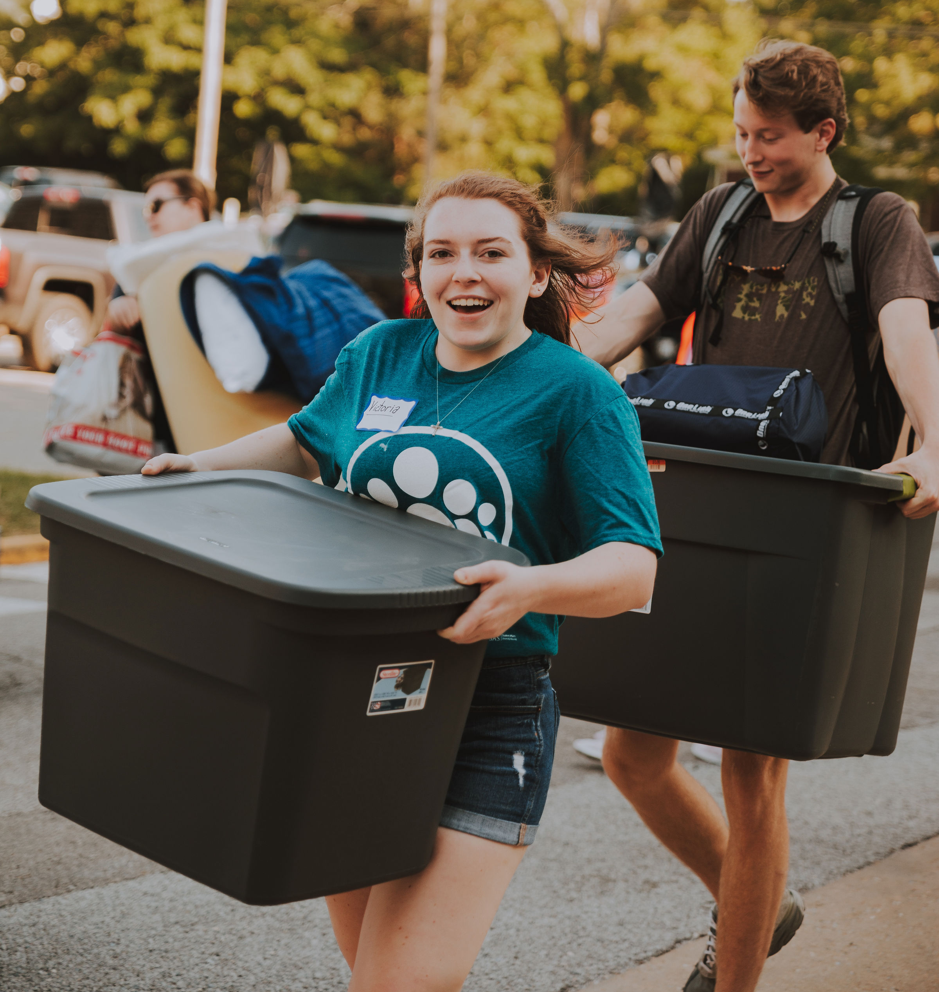
SPECIAL GROUP ARRIVALS
Sorority Recruitment
Wednesday, August 6 (All Campus Move-In)
Thursday, August 7 (Adohi, Futrall, Maples, Cardinal & Reid)
Friday, August 8 (Reid)
Reid Sorority recruitment residents moving in on Friday will complete move-in prior to Sorority Orientation
Lead Hogs & Marching Band
Wednesday, August 6
Residents going through sorority recruitment who move in on August 6
Early arrival rate of $35.00/night
MOVE-IN ARRIVALS

Slide 9
Signing up for an arrival time in the Housing Portal begins June 17th at 10am
General Move-In
Thursday, August 7th to Saturday, August 9th (Limited spots available on Wednesday, August 6th at Hotz, Humphreys, Yocum and Pomfret)
Open Move-In (parking lots not protected!)
Monday, August 11 to Saturday, August 16
MOVE-IN ARRIVALS

Slide 10
GETTING TO BAUM WALKER
Move-in is changing to help greet students better at their buildings!
All students/parents will enter campus off Exit 60 on I-49 and head north toward Baum-Walker Stadium (baseball field).
Students/Parents will park at Baum EAST (Baum West parking is not allowed) and pick up their hangtag, keys, and sign their keycard on the third base concourse of Baum-Walker Stadium.
Students/Parents will then go North on Razorback Road toward campus to their campus residence hall/apartment.
"Football game concepts" parking in designated lots. NO PARKING PASS/NO ENTRY TO LOT!

Slide 11
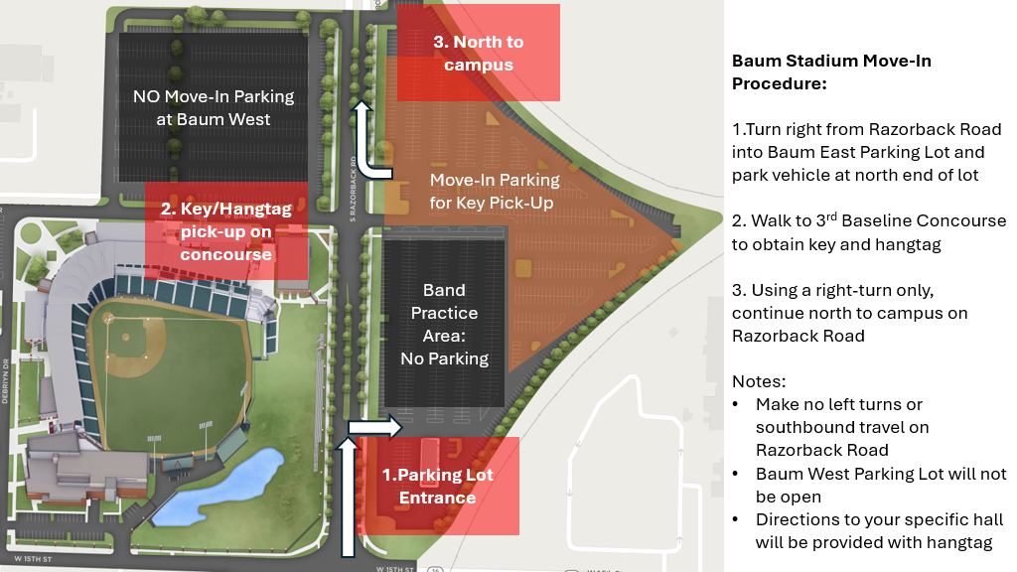
WHAT TO EXPECT @ Baum-Walker Stadium

Slide 12
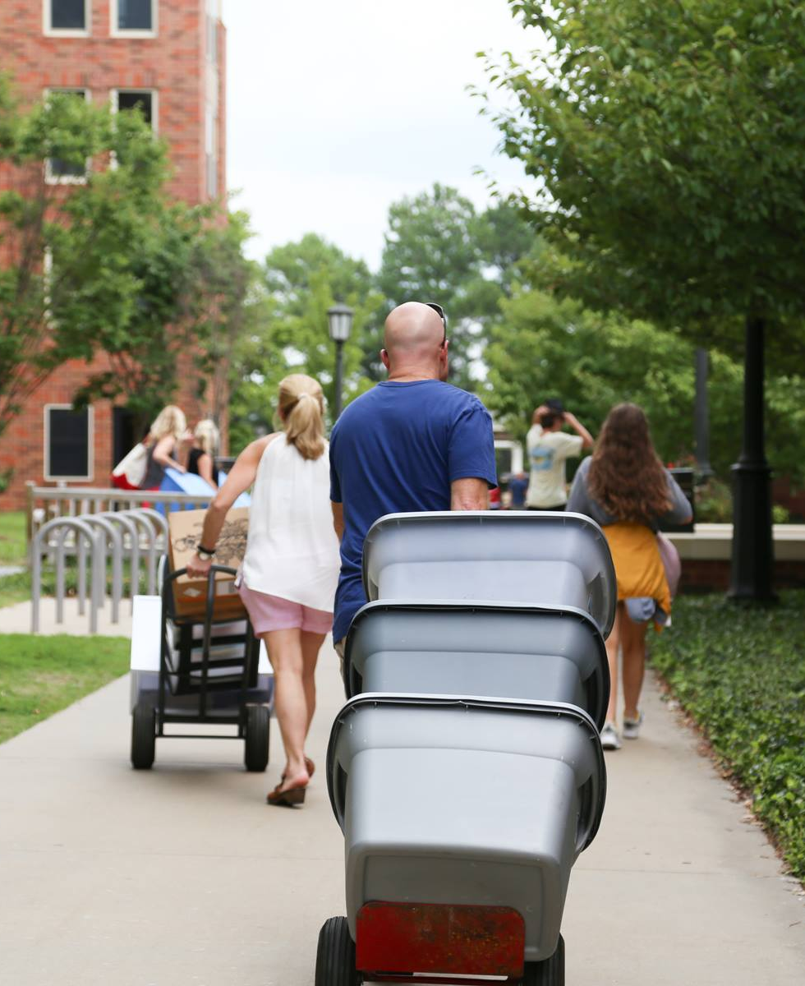
WHAT TO EXPECT
Arrive at your designated time at Baum-Walker Stadium.
Refer to movein.uark.edu for the arrival map for your building ​once you have your keys at Baum-Walker.
You have 30 minutes to unload all items inside your building's parking lot.
U-HAULS AND TRAILERS WILL NOT BE PERMITTED TO ENTER LOTS

Slide 13
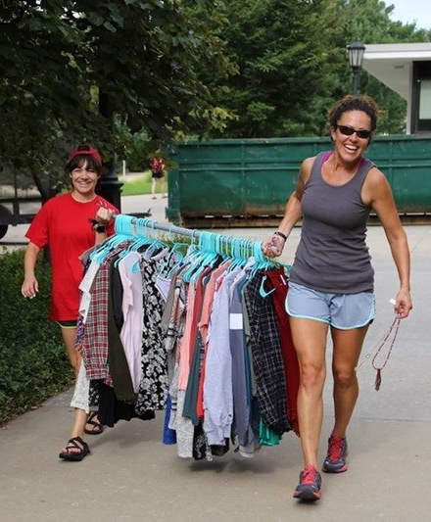
WHAT TO EXPECT
Move your car to the designated lot or garage​ and be prepared to turn in your hangtag while exiting the move in lot.
There will be a QR code on the back of your hangtag to direct you.
There will be transportation available to get you closer to your halls from the garages and parking lots.
Each student is allotted only one timeslot in the move-in lot
Any other shopping trips or unloading must be done from these parking garages and parking lots.

Slide 14
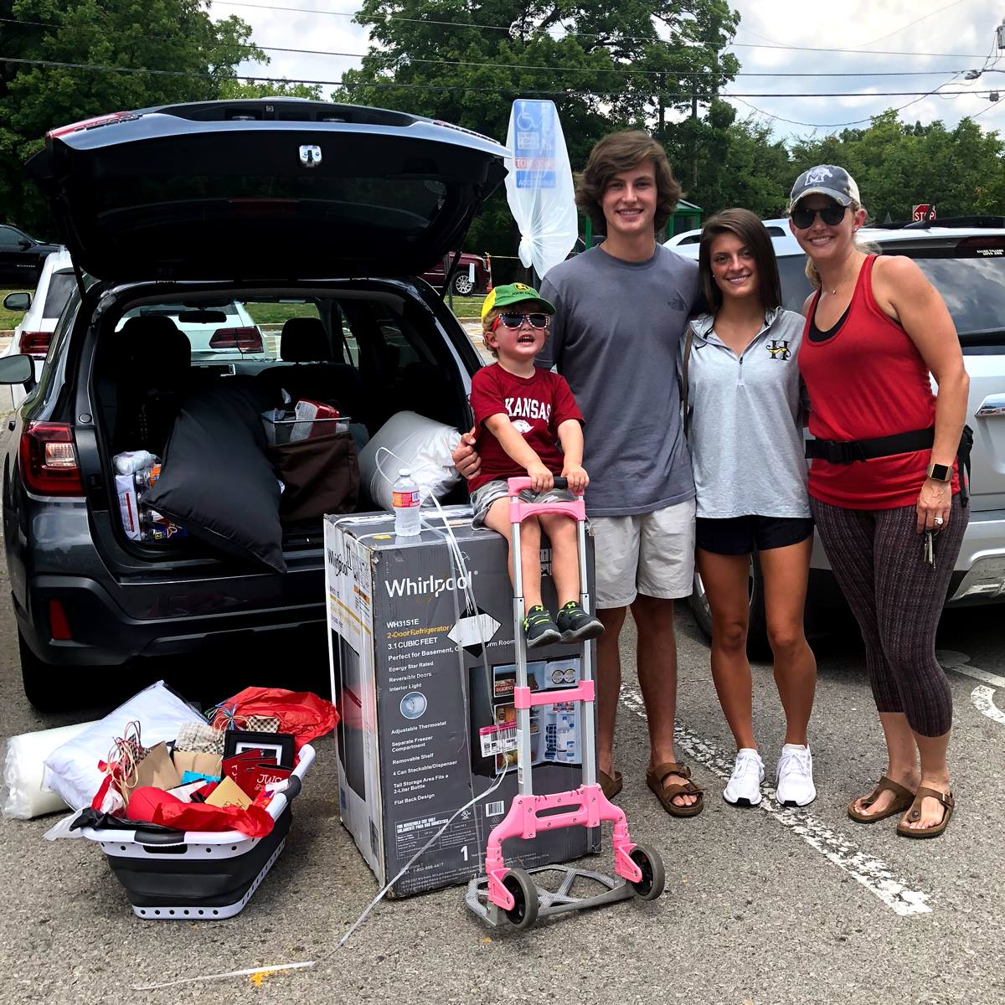
Bring personal or rented moving equipment, if possible ​
Limited departmental moving equipment (dollies and carts) will be available​
Be prepared to participate in your move-in experience! ​We will have some volunteers helping, but volunteers are limited.
Pack belongings in reusable totes and bags if possible.
TIPS FOR MOVE-IN SUCCESS

Slide 15
After check-in at Baum place your hangtag in your mirror. No hangtag/no lot entrance!
Label boxes with name, building & room #​
Drink lots of water​
Wear comfortable clothes and closed-toe shoes.
TIPS FOR MOVE-IN SUCCESS

Slide 16
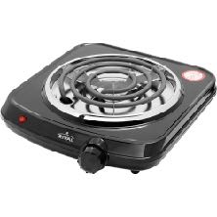
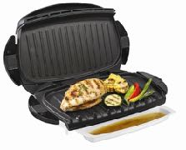
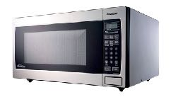
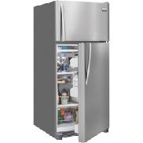
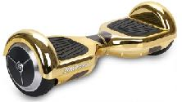
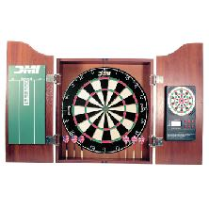
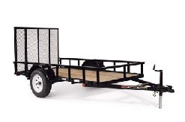
WHAT NOT TO BRING
*Visit housing.uark.edu/handbook
Section 1 – Ready to Arrive for a full list of what not to bring.
Microwaves over 0.7 CF
E-Bikes
Refrigerator over 3.2 CF

Slide 17
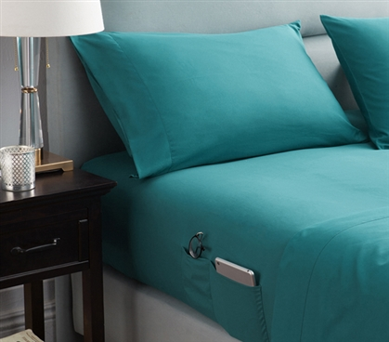
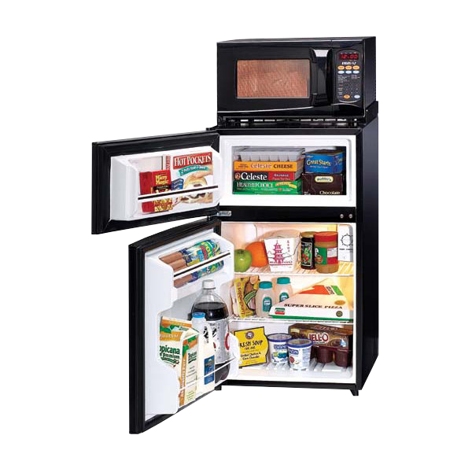
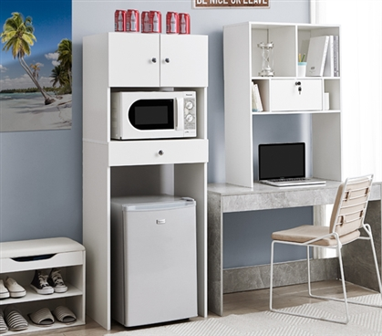
ROOM ESSENTIALS
Student orgs, RIC and NRHH, partner with 2 outside companies to bring you great products that are approved for use specifically in our halls!
Unlike other retailers, a portion of the proceeds from these sales goes to directly benefit YOUR student!

Slide 18
CONNECT ONLINE WITH HOUSING
Tune in from the comfort of your digital device and ask questions of your live tour guide.
#UARKHOME LIVE!
There will be a number of live Instagram broadcasts @uarkhousing this summer where you can ask us questions.
Topics include:
Move In Day Q&A
Student Leadership Opportunities
Housing Tech and Services
Health and Wellness
Visit movein.uark.edu for the dates.
3D TOURS AVAILABLE!​
​
We have fully explorable rooms available on the University Housing website. Go to your hall’s webpage and scroll to the Explore section. You’ll find resident rooms and common spaces rendered as a 3D space where you can move around and measure distances. ​
​
Got a VR set?
Step inside the image!

Slide 19
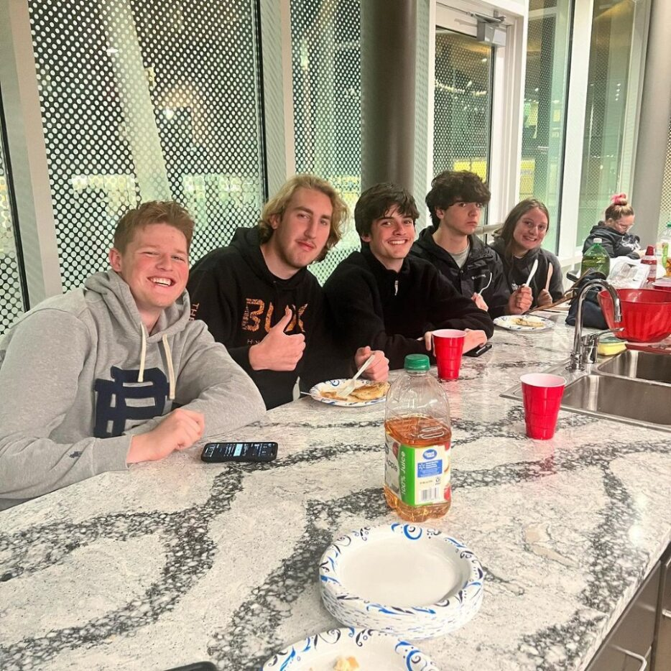
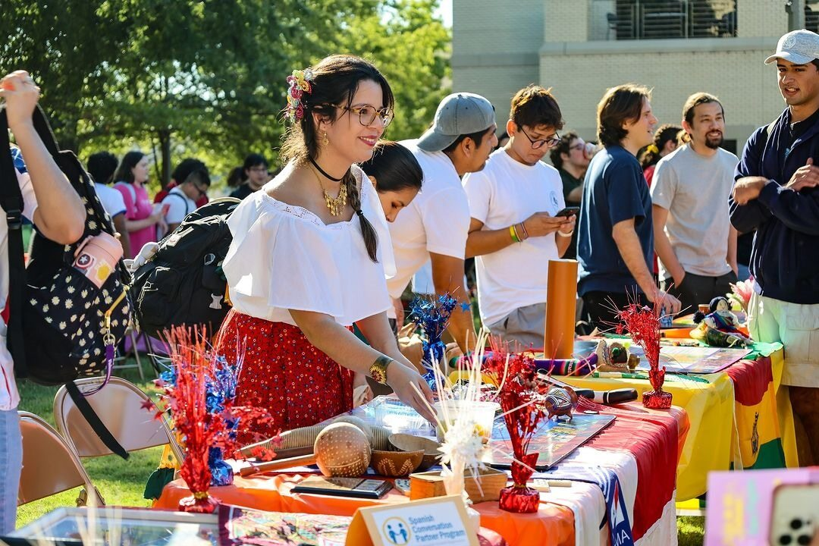
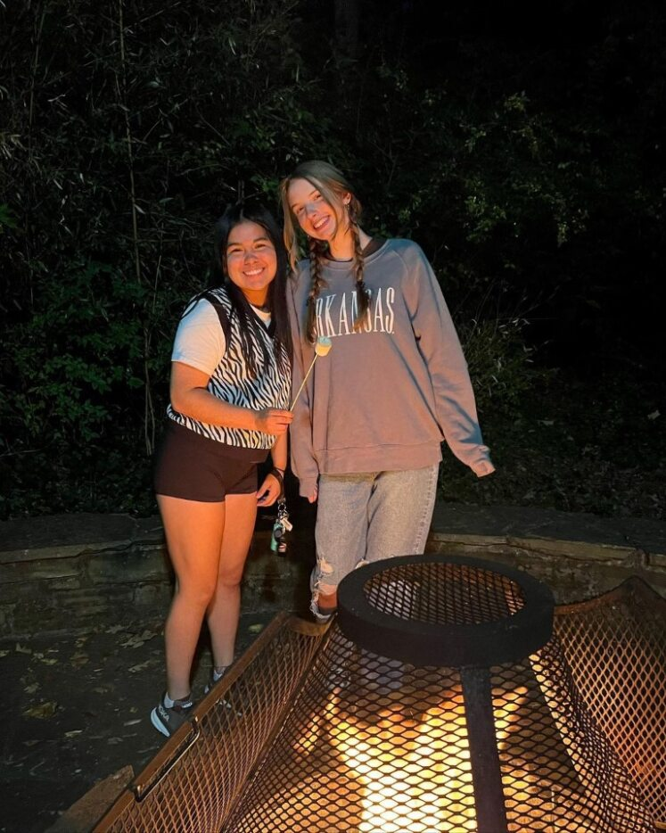
CONNECT ON INSTAGRAM
Follow our main account!
@uarkhousing
Adohi Hall​
@uarkadohi​
​
Duncan Avenue Apartments​
@uarkduncan​
​
Founders Hall ​
@uarkfounders​
​
Holcombe & Futrall Halls​
@uarkholcombefutrall
Maple Hill Halls
South, East & West
@uarkmaplehill
Northwest Quad Halls
Clark, Gatewood, Morgan & Harding @uarkquad
Off Campus Apartments
@uarkoff
Pomfret Hall
@uarkpomfret
Reid Hall
@uarkreid
Walton Hall
@uarkwalton
Yocum Hall
@uarkyocum
Gregson Hall
@uarkgregson
Gibson Hall
@uarkgibson
Hotz Honors Hall
@uarkhotz
Humphreys Hall
@uarkhumphreys

Slide 20
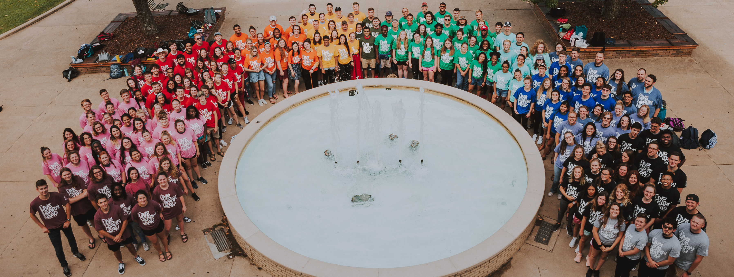
CONNECT WITH US!
CONTACT INFORMATION
SOCIAL MEDIA
housing.uark.edu & movein.uark.edu
housing@uark.edu
479-575-4687
@UARKHousing
#UARKHome

Slide 21
IT SERVICES

Slide 22
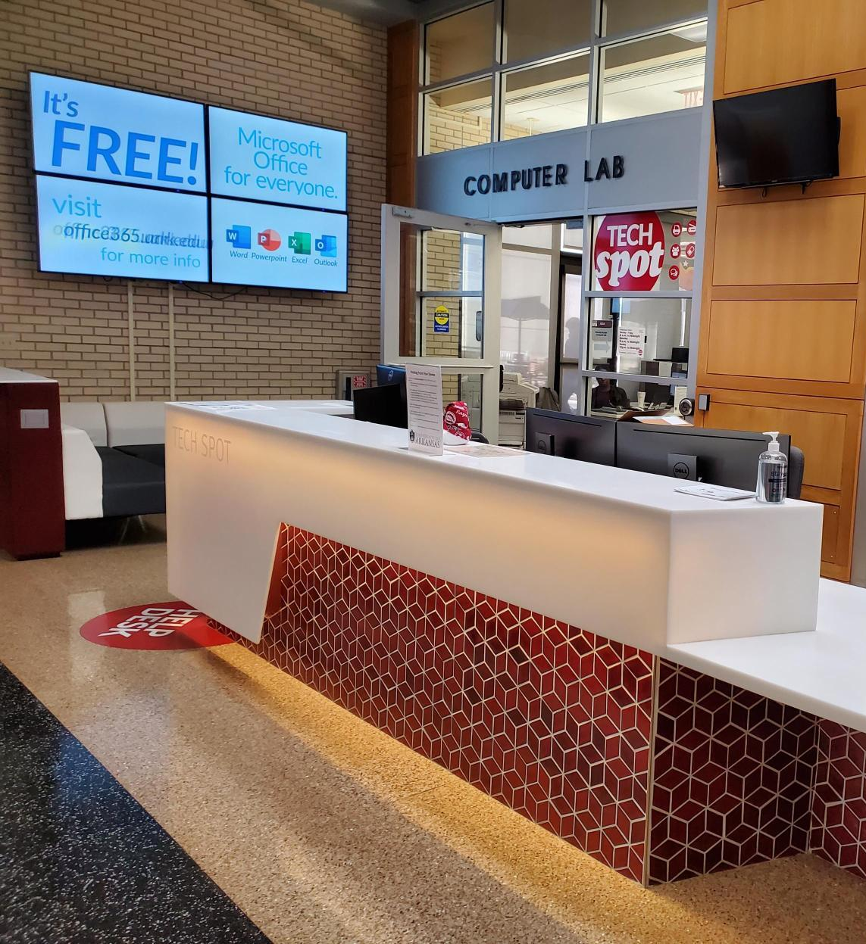
GET HELP
Tech Help is available 7 days a week!
In person at the IT Help Desk in the Union Monday – Friday 8 AM – 5 PM
Online chat at help.uark.edu
Monday –Friday 7 AM – 12 AM and
Saturday –Sunday 11 AM – 12 AM
By phone at 479-575-2905
Visit help.uark.edu to learn more

Slide 23
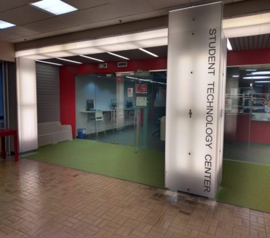
3RD FLOOR ARKANSAS UNION
Monday - Friday 8 a.m. to 10 p.m.
YOU CAN BORROW...
Laptops
Calculators
Cameras
Recorders
Green Screen Kits
Gaming Consoles
Audio Recorders & Microphones
Projectors
YOU CAN RESERVE...
Audio Production Studio
3D Printing
Alienware PC
Console Stations
STUDENT TECHNOLOGY CENTER

Slide 24
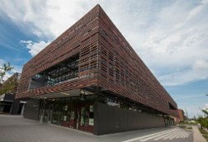
3RD FLOOR ARKANSAS UNION
& THE BOOKSTORE ON GARLAND
SERVICES
Apple & Dell authorized warranty provider​
New Device Set-Up ​
Operating Systems Updates​​
Bios and Driver Updates​​
Install Microsoft 365​​
Ship or In Store Pick-up​​
iPhone Screen and Battery Repair
Smart Bar​​
Accidental Damage Protection​
Not for profit, owned and operated by the U of A
For minimum university standards & other requirements, visit: techstore.uark.edu/student-reccs
TECH STORE & SERVICE CENTER

Slide 25
CONNECT WITH US!
CONTACT INFORMATION
In the Garland Bookstore
Monday - Friday 8 a.m. to 5 p.m.
Sales: 479-575-5414 | comstore@uark.edu
Service: 479-575-3811 | uasc@uark.edu
In the Union, room 381
by the bus depot entrance
Monday - Friday 8 a.m. to 5 p.m.
Sales: 479-718-3320 | comstore@uark.edu
Online
techstore.uark.edu

Slide 26
FOOD ON THE HILL
Notes:
When this session starts, send a message to the Ols so they can give Francesca or whoever else is doing the Off Campus presentation a 5 minute warning so everyone can get back up to the ballroom in a timely manner for the next segment.

Slide 27
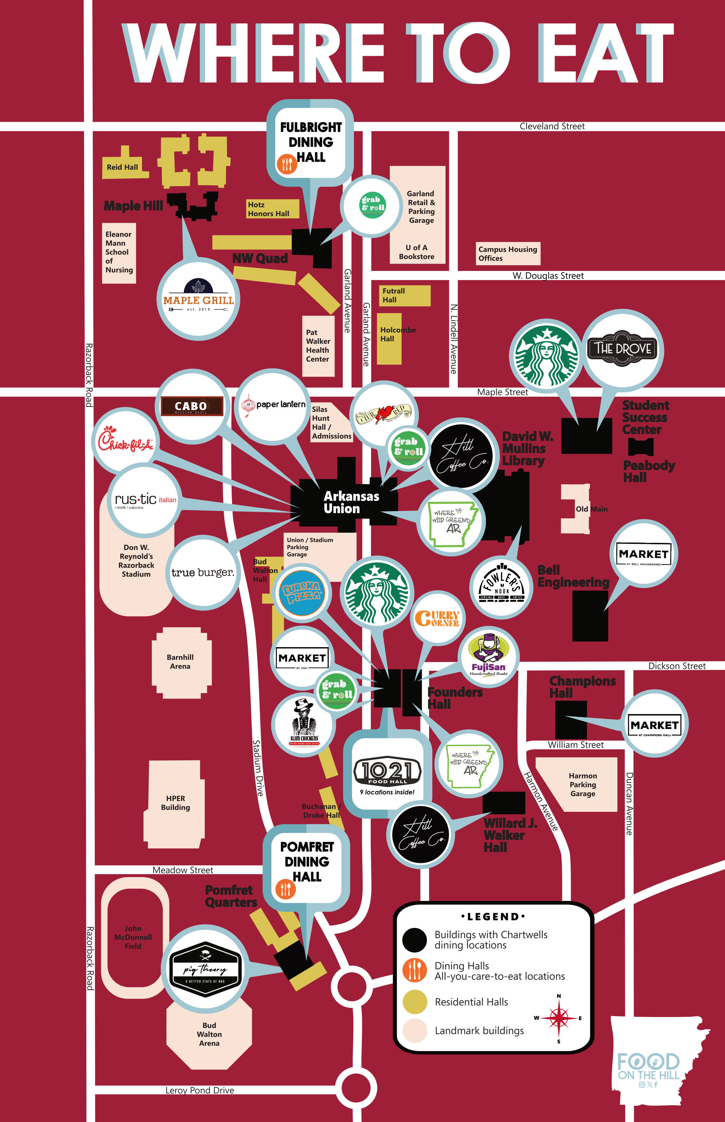
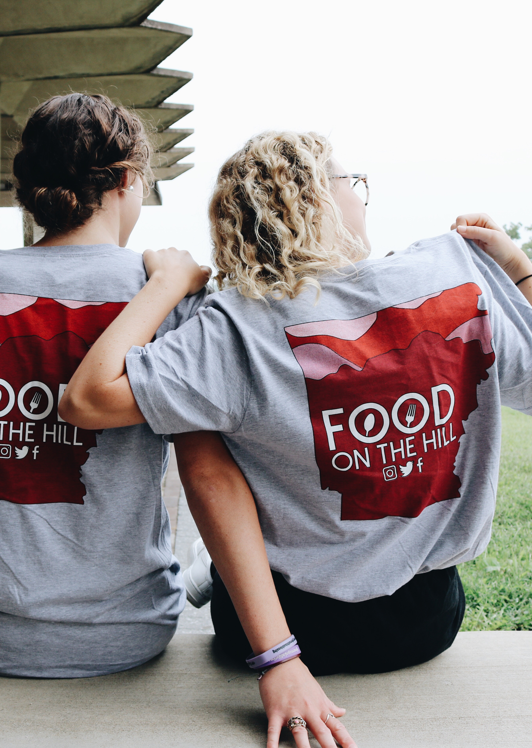
CHARTWELLS ON-CAMPUS DINING
CHARTWELLS = YOUR FOOD, ON THE HILL!

Slide 28
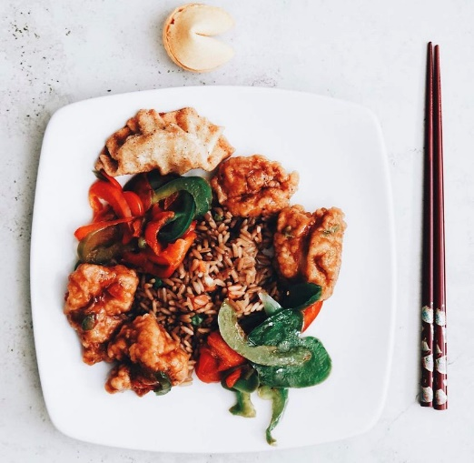
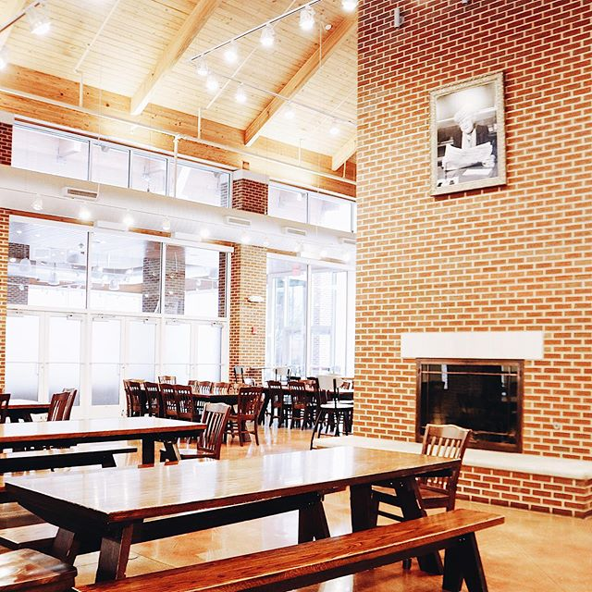
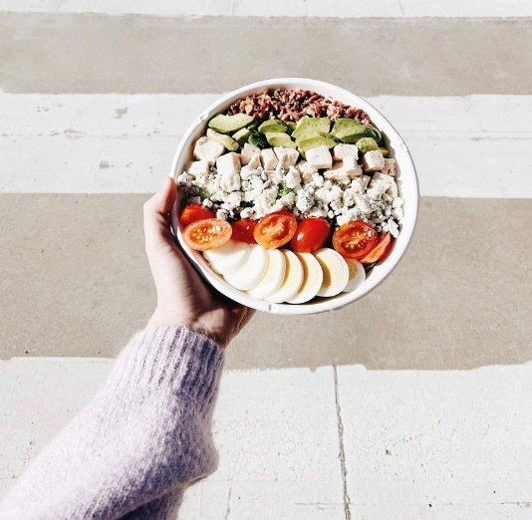
Meal plans begin on Thursday, August 7th!
Changes to meal plans must be made by the 11th day of class each semester. Changes can be made by emailing housing@uark.edu.
MEAL PLAN INFORMATION

Slide 29
TRADITIONAL PLANS
MEAL SWIPES
Plan 10
10 meals + $135 DD
Plan 15
15 meals + $85 DD
Plan 15 Plus
15 meals + $185 DD
Unlimited
No limit on meal swipes + $60 DD
Unlimited Plus
No limit on meal swipes + $160 DD
Per week​
Do not roll over to the next week​
Reset every Sunday Morning ​
Used at 20+ restaurants on campus
MOST POPULAR
DINING DOLLARS
Per semester​, do not roll over
Tax-free​
Work just like cash in all Chartwell’s locations.​
Reloadable in increments of $50, $75 or $100​
MOST POPULAR
BE SURE TO GRAB OUR CAMPUS DINING GUIDE!
* The above Dining Dollar rates reflect the 2023-2024 academic year. They are subject to increase.​
MEAL PLAN INFORMATION

Slide 30
MEAL SWIPES
Meal Swipes are used at the 2 all-you-care-to-eat​ dining halls Pomfret Dining Hall and Fulbright Dining​ Hall, our 1021 Food Hall (with 9 locations inside), and at our restaurants across campus during specified time frames.​
​
When using Meal Swipes at our restaurants like​ Chick-Fil-A®, Paper Lantern and more, you can Meal​ Swipe once per meal period during the specified​ Meal Swipe time. You can Meal Swipe at our participating restaurants (during the specified time frame)​ once at breakfast, once at lunch,​ and once at dinner.
BE SURE TO LOOK FOR THIS STICKER WHEN YOU GET TO CAMPUS!
MEAL PLAN INFORMATION

Slide 31
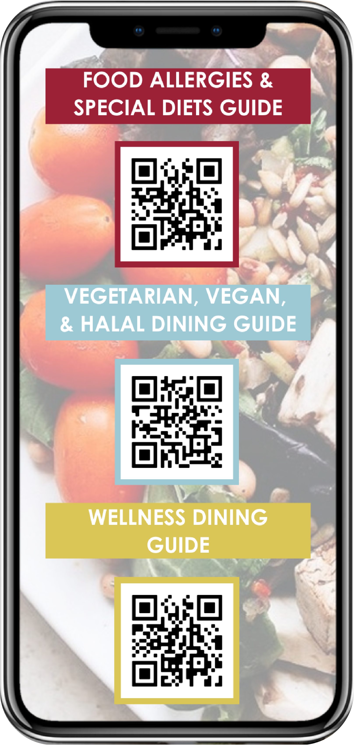
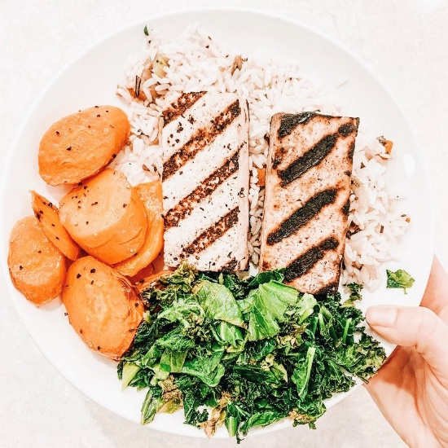
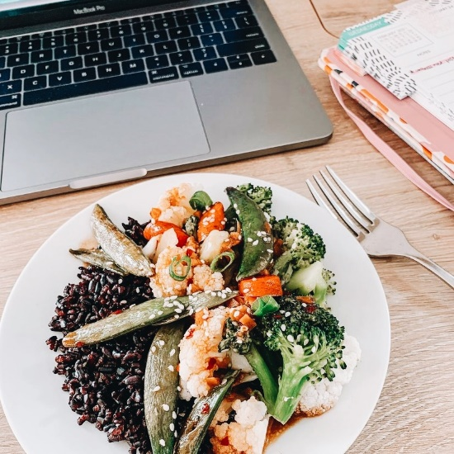
Have special diet or food allergies questions? Email our Registered Dietitian at: diet@uark.edu. ​
MEAL PLAN INFORMATION

Slide 32
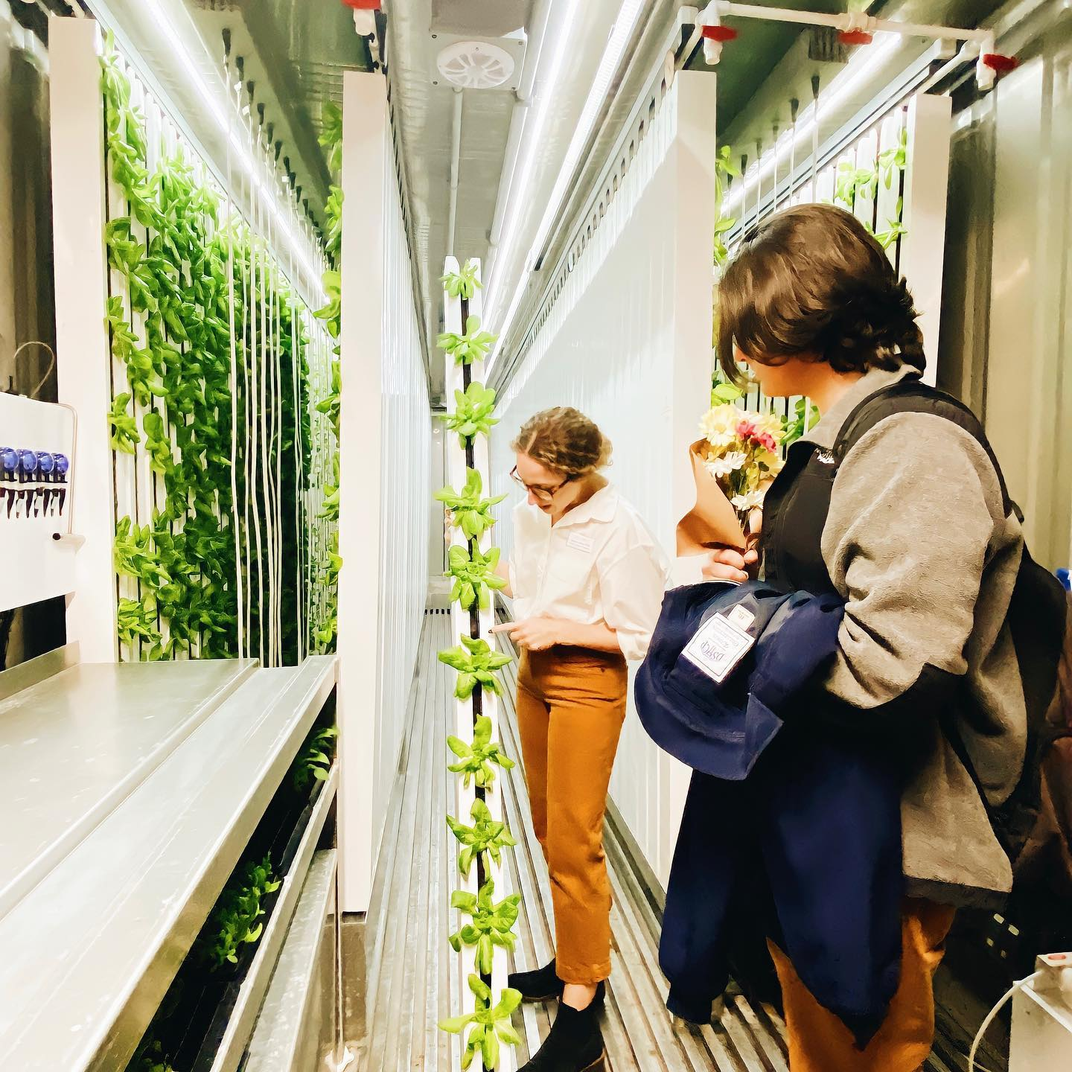
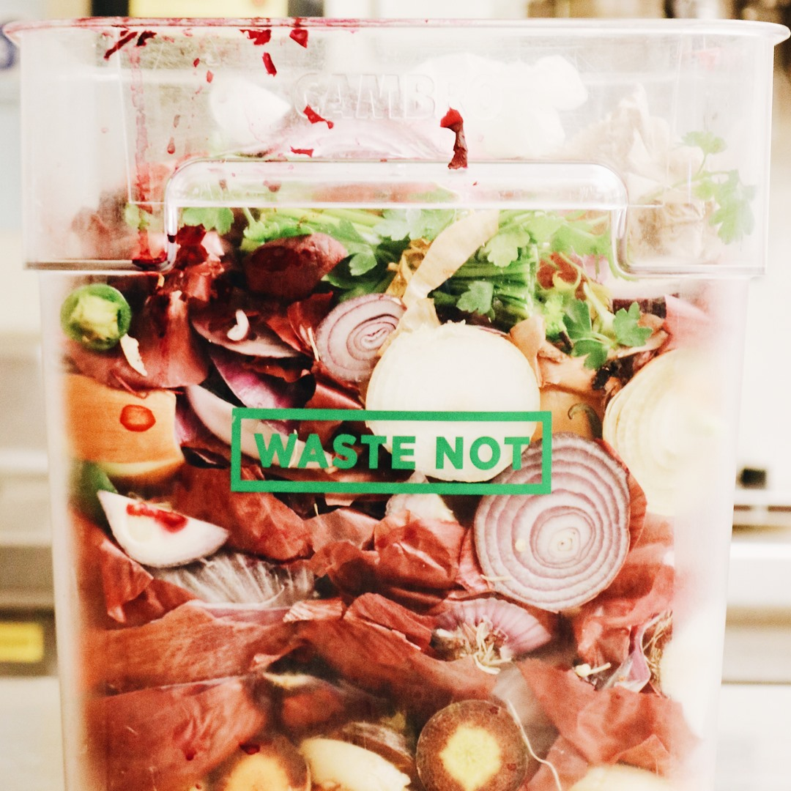
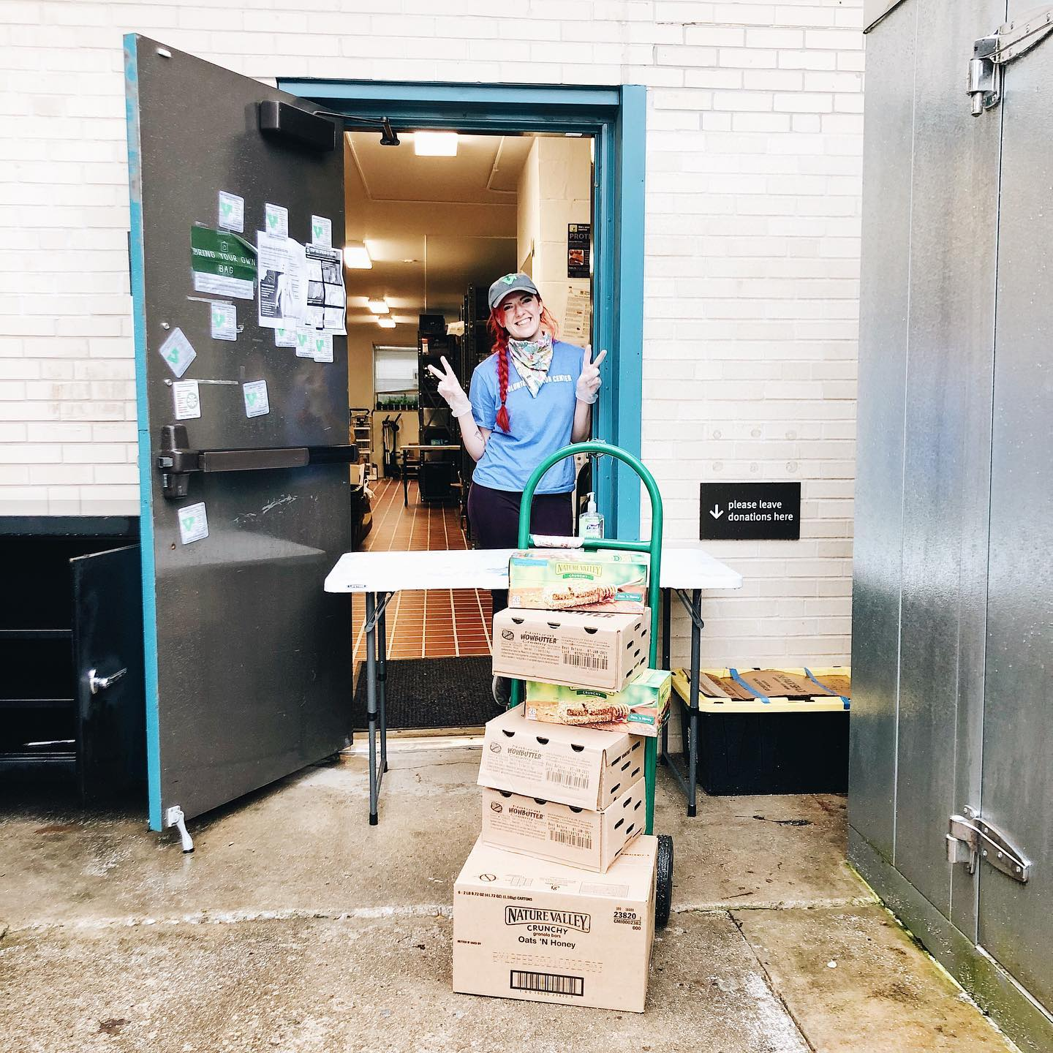
SUSTAINABILITY
We have a Hydroponic Freight Farm where we’ve harvested over 150,000 heads of butterhead lettuce for our Where the Wild Greens AR location​
Since 2016, we’ve composted all of our food scraps and leftovers from plates in our partnership with the
City of Fayetteville ​
We donate our overproduced food to Razorback Food Recovery and to date have donated over 300,000 lbs​
Notes:
Off Campus students should be arriving back in the ballroom at this time.

Slide 33
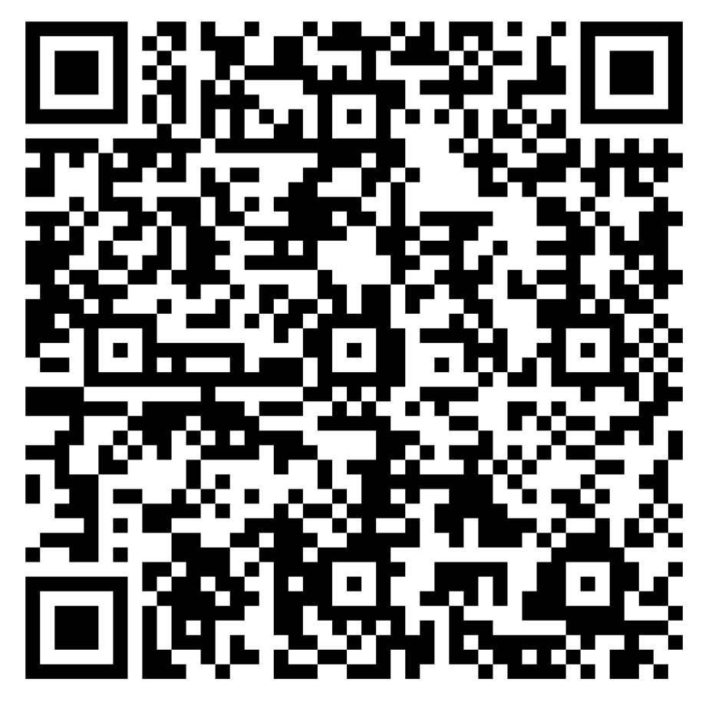
JOIN THE FUN!
Sign up for the monthly
Food on the Hill student newsletter

Slide 34
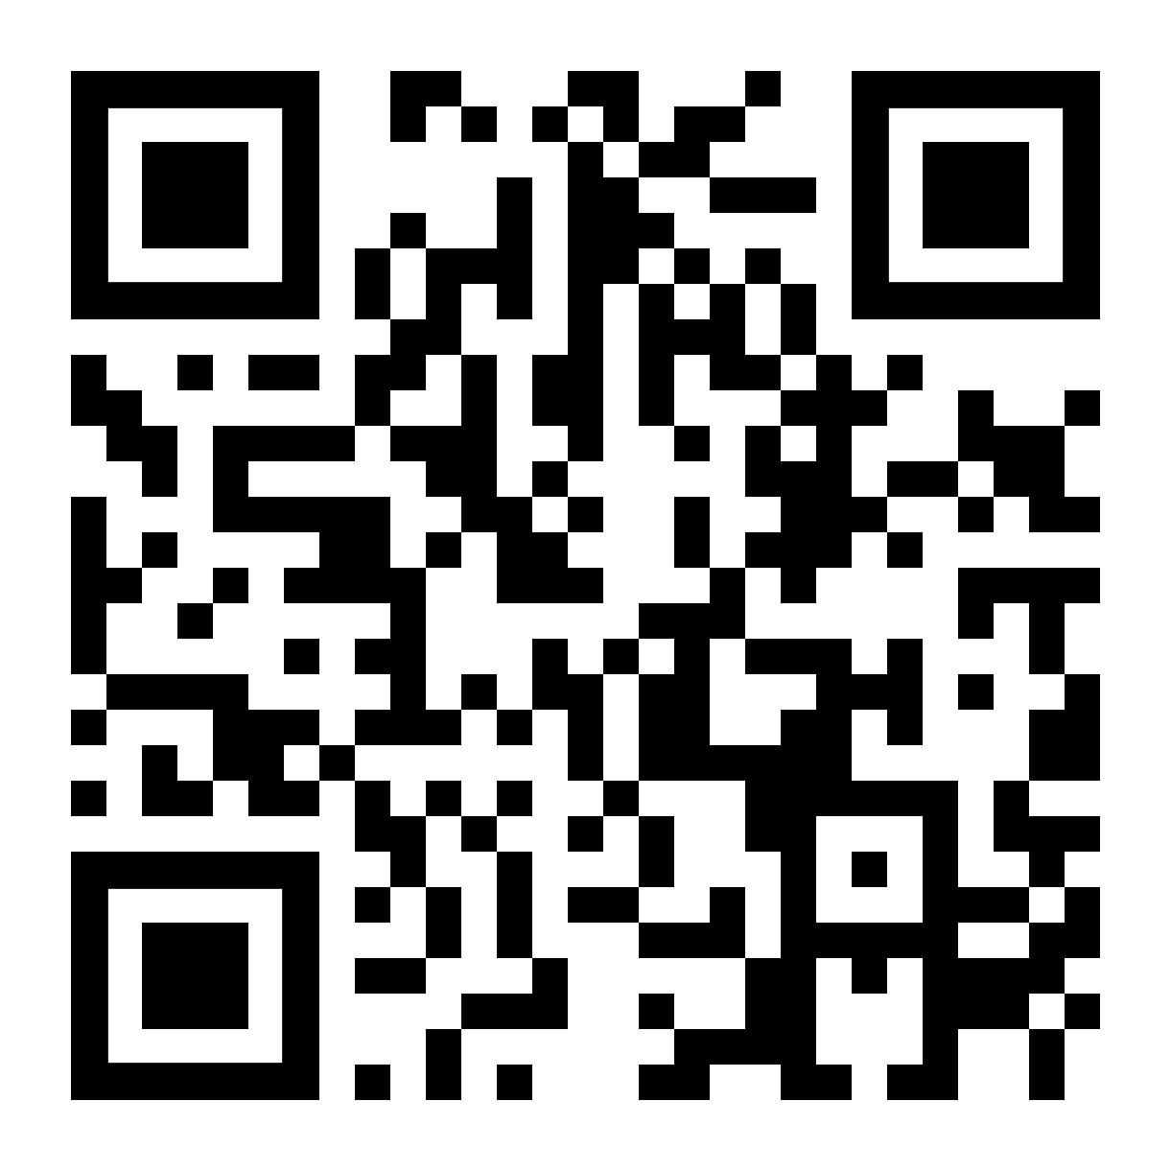
FOLLOW YOUR FOOD
SCAN ME!
CONNECT WITH US!
@foodonthehill_ar
Giveaways | Events | Specials | More
LOOKING FOR A JOB?
We're hiring! Visit our website or links in our bio for more information.
Learn more about campus dining on our website! Daily menus, nutritional information, hours, campus dining map and more!

Slide 35
LUNCH TODAY
1 TICKET = 1 COMBO MEAL AT
​Debbie’s | Ark-N-Style | Root For You | Talegate
El Cerdo | Herbimore | Passport to Pasta
Loaf + Pickles | The Green Table (allergen friendly)
& 3 FREEBIE STATIONS
The Pantry | Dessert Bar | Salads & Fruit Bar​

