Slide 1

The Honors College
Created in 2002 with the help of a donation from the Walton Family Foundation
Our goals:
  To make for a more fulfilling college experience, both inside and outside the classroom
  To prepare our students for the next steps in life

Slide 2

The Honors Programs
As a student in the Honors College, you are a member of your academic college's honors program
Honors degree requirements vary across academic colleges, so make sure to pay attention to the honors information your college provides

Slide 3


Learn More About Your Honors Program and Degree Requirements
  Scan to visit the Academics tab on the HC website and click on your College's Honors Program

Slide 4
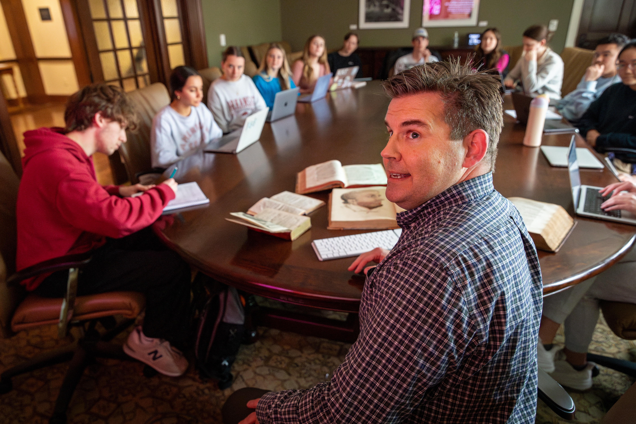
Honors Courses
Regardless of the field, honors courses are distinguished by:
  Innovative courses that focus on classroom discussion and collaboration
  Increased interaction between honors faculty members and students
  Designed to be rigorous, yet rewarding
Notes:
Pictured: Dr. Scott Jackson, a local dermatologist in private practice, who taught a special honors forum on the history of dermatology.
Make sure to emphasize how this is the “best of both worlds:” small college experience with all of the opportunities at a research-one university.
Honors course requirements vary widely across academic college, but you will not be taking all honors courses, all the time
You won’t need to pay extra fees or a higher tuition rate
Also mention advanced academic registration
Some classes you could highlight:
Wrongful Convictions with Professor Tiffany Murphy, J.D. in the Law School
Inspired with Dean Lynda Coon and Sandy Edwards from Crystal Bridges
Bad Medicine with Dr. Trish Starks
Catapult with Dr. Suzanne McCray
Also feature courses on contemporary topics, such as Blockchain, Bioethics, and Gene Editing

Slide 5
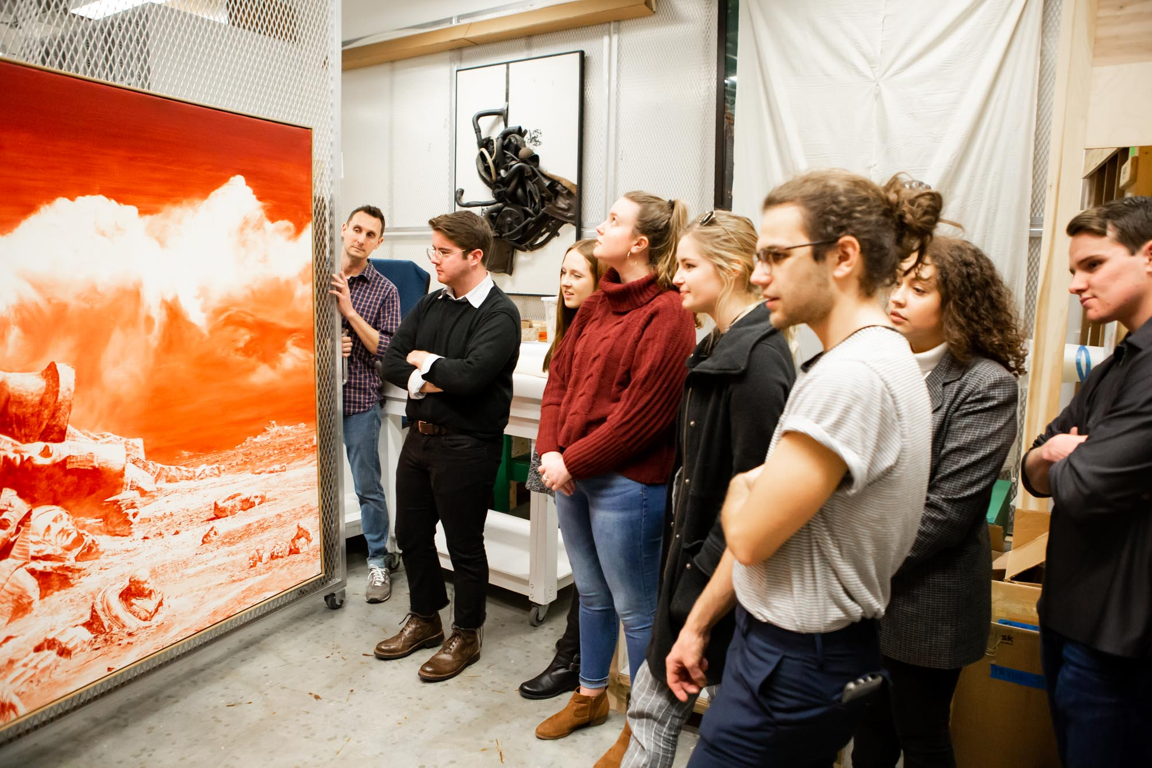
Examples of Honors Courses
Traditional “intro” honors courses
  General education requirements taken during freshman and sophomore years
Team-taught, interdisciplinary courses
  Example: Honors Humanities Project (H2P)
Colloquia & Signature Seminars
  Very focused upper-level courses in a discipline
  Signature seminars typically require an application
Honors College Forums & Retro Readings
  One-hour topics courses offered to all honors students
Notes:
Pictured: Students in the Museum class get to tour the vault at Crystal Bridges Museum of American Art.
Need to emphasize students will be taking courses both within the major and as part of graduation requirements
Our current enrollment is about 3800 students in the Honors College, spread out across all academic majors.

Slide 6
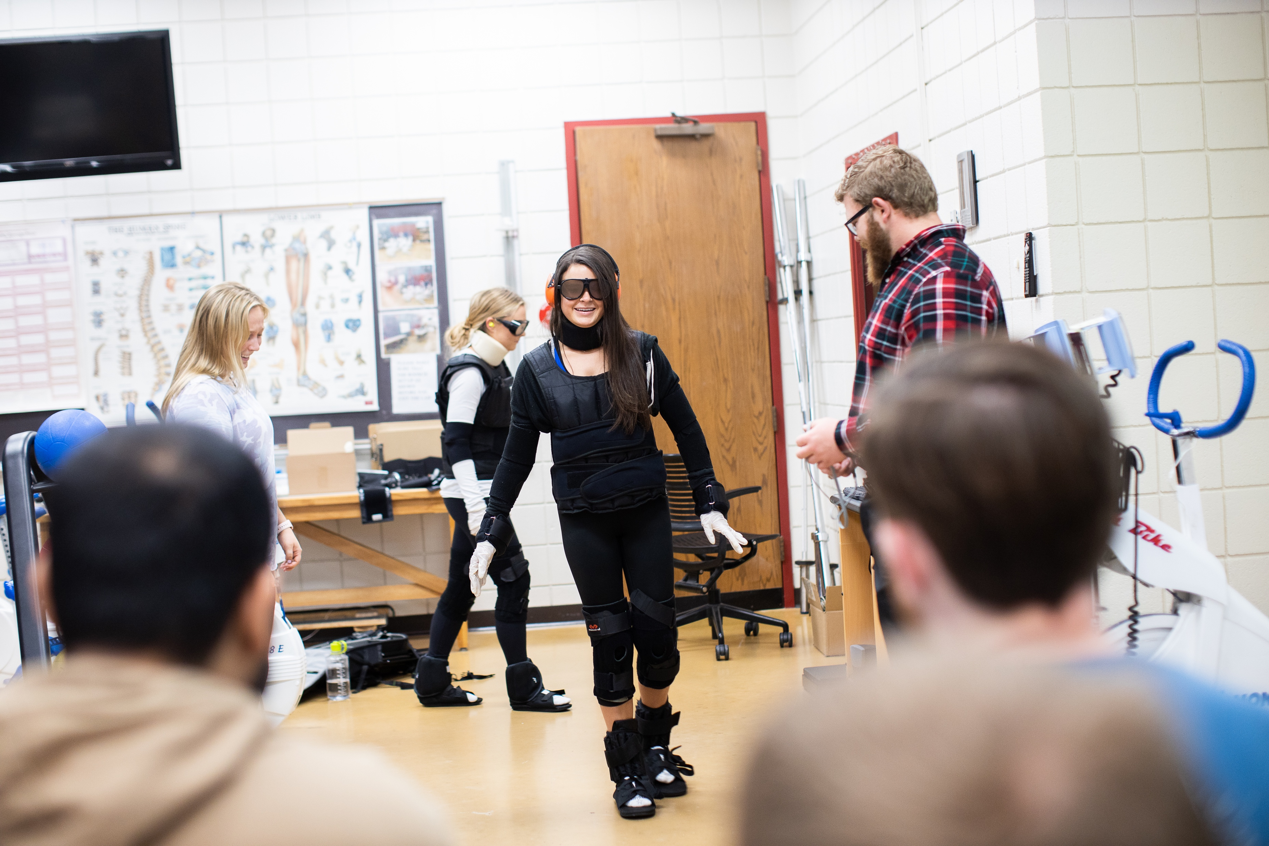
Tips for Honors Courses
You don’t have to be in an honors class every semester!
  Discuss requirements with your academic advisor
Consider taking your Honors Program's recommended number of honors courses this semester
  Pay attention to honors credit requirements for grants
Still waiting on AP scores?
  Let your academic advisor know what scores you are waiting on
  They may recommend you still sign up for that class
Notes:
Pictured: Students in Dr. Michelle Gray’s Aging Signature Seminar where suits that mimic the experience of being old/having aged.

Slide 7

Tips for Pre-Health/Pre-Law Students
Scan here to visit our Honors College pre-professional resources landing page
Access our Sharepoint for more detailed information, including recommended classes and tips for building your résumé
Look for pre-professional programming during A-Week

Slide 8

Study Abroad
UA offers over 40 programs led by UA faculty along with hundreds of program options outside UA
Since 2005, Honors College students have studied abroad in all seven continents
Programs range from highly structured and guided to independent and adventurous
Notes:
Make sure to not just give examples, but reference 1) study abroad brochure in the folder and 2) HonorsTV, which has videos from a number of study abroad locations

Slide 9
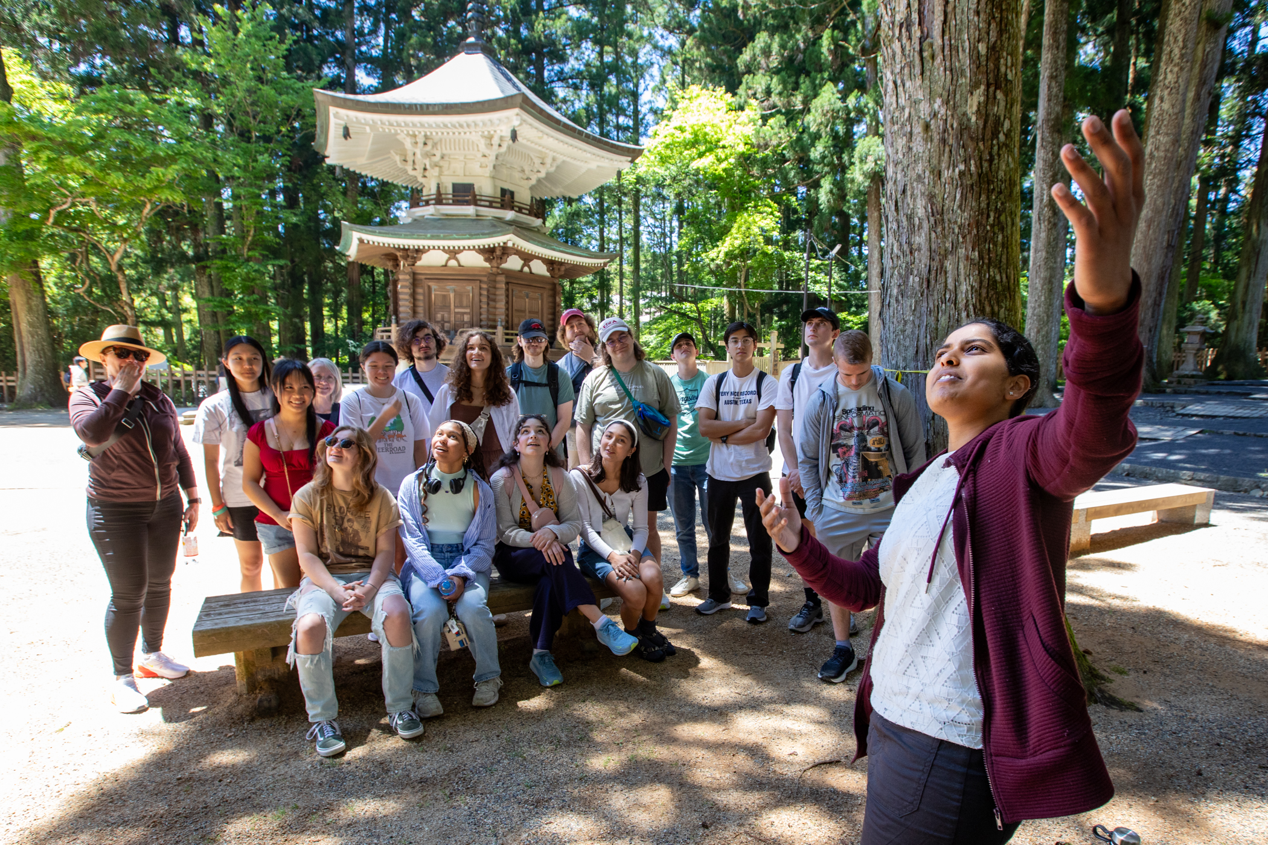
Study Abroad Grants
Competitive grants are available to participate in study abroad programs that take place for
  a few weeks
  a semester or summer
  an academic year
Want to apply as a freshman? Be sure to sign up for one to three credits of honors your first semester!
Notes:
Pictured: Honors students in Japan, as part of the Honors Passport study abroad program.
Make sure to not just give examples, but reference 1) study abroad brochure in the folder and 2) HonorsTV, which has videos from a number of study abroad locations

Slide 10

Planning for Study Abroad
Plan early!
  Visit the Study Abroad website: studyabroad.uark.edu
  Meet with the Office of Study Abroad
Know the honors course requirements for each grant
Use Honors College resources
  Honors College website
  Grants Manager: Chelsea Hodge, cew003@uark.edu

Slide 11
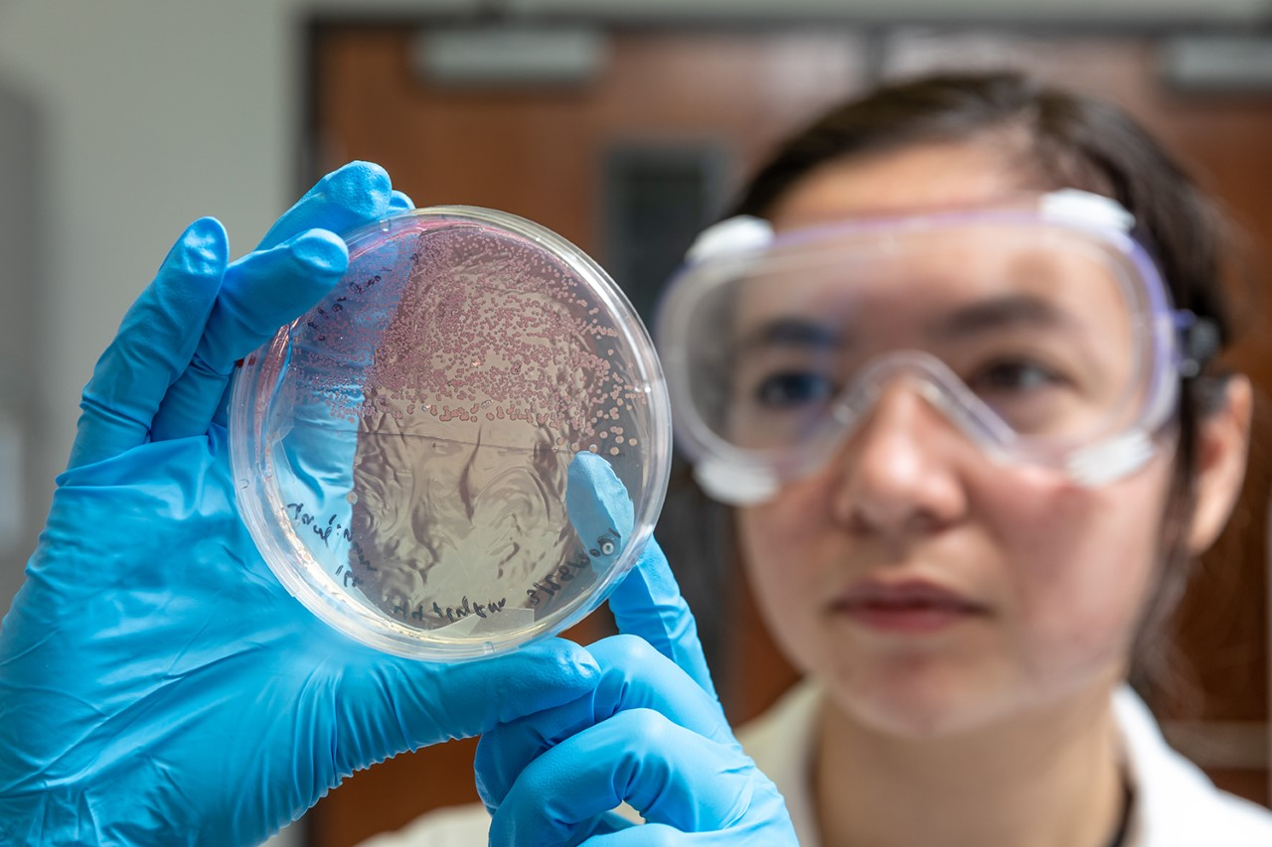
Undergraduate Research
All honors students are required to complete a faculty-led, undergraduate research project or creative activity in their academic field
  Grant funding is available to support your project
This project serves as fantastic preparation for either graduate school or the workplace
Notes:
Pictured: Biomedical engineering major Mary Jia is the first undergraduate to conduct research in Chris Nelson’s gene editing lab. She is working with cutting-edge CRISPR techniques to develop therapies for a rare genetic disease. Mary was awarded the Goldwater Scholarship this year and would like to use gene editing to tackle other critical diseases, such as cancer.
Fun facts: Chris Nelson is an honors alumnus/former Honors College fellow, and Mary is a Bodenhamer Fellow.

Slide 12

Tips for Undergraduate Research
During your first year, learn about research in your discipline
Attend workshops in the Honors College to learn more about research
Students typically start research at the end of sophomore year
Notes:
Pictured: Ethan Batey with his research mentor, Dr. Bin Dong (chemistry and biochemistry), studying optical microscopy. Batey was published as a first author multiple times as an undergrad and won the Goldwater scholarship to pursue a PhD. ​​

Slide 13

The Futures Hub
Staff members in our Futures Hub help honors students explore opportunities on campus and in the community to prepare them for life after college
What's next for you? The Hub helps you plan a great future.
  Global Experiences
  Research
  Engagement
  Academics
  Trajectory
Notes:
Pictured: Elijah Conley, first-gen honors Path Scholar, ARSC, political science/journalism from Melbourne, AR. As an undergrad, he interned with the Congressional Black Caucus. He recently graduated from Georgetown Law and is moving to eastern Arkansas to clerk for a federal judge.
Really emphasize that this is to help honors students take advantages of all of the resources we have just outlined in the Honors College in a way that will prepare them for the next step in life.
Global Experiences – Where will you explore?
Research – What will you investigate?
Engagement – How will you get involved?
Academics – How will you expand your knowledge?
Trajectory – How will you prepare for the next phase of your journey?

Slide 14
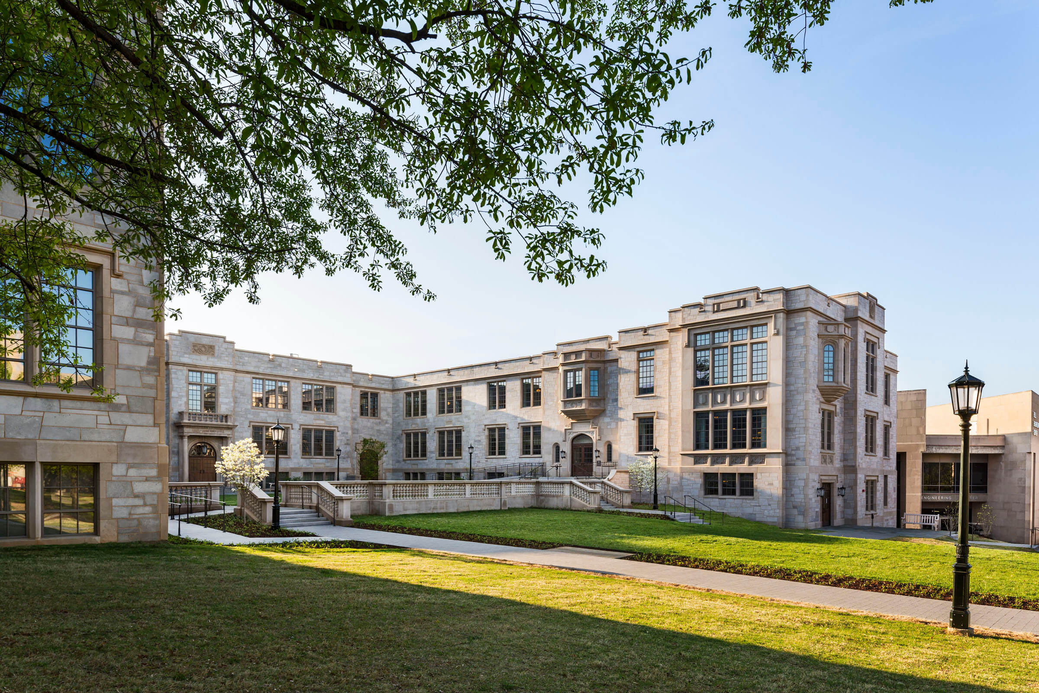
Gearhart Hall
Home of the Honors College
Located between Old Main and Bell Engineering
Includes two wonderful student lounges along with Honors College staff offices
Stop by when you get a chance!

Slide 15
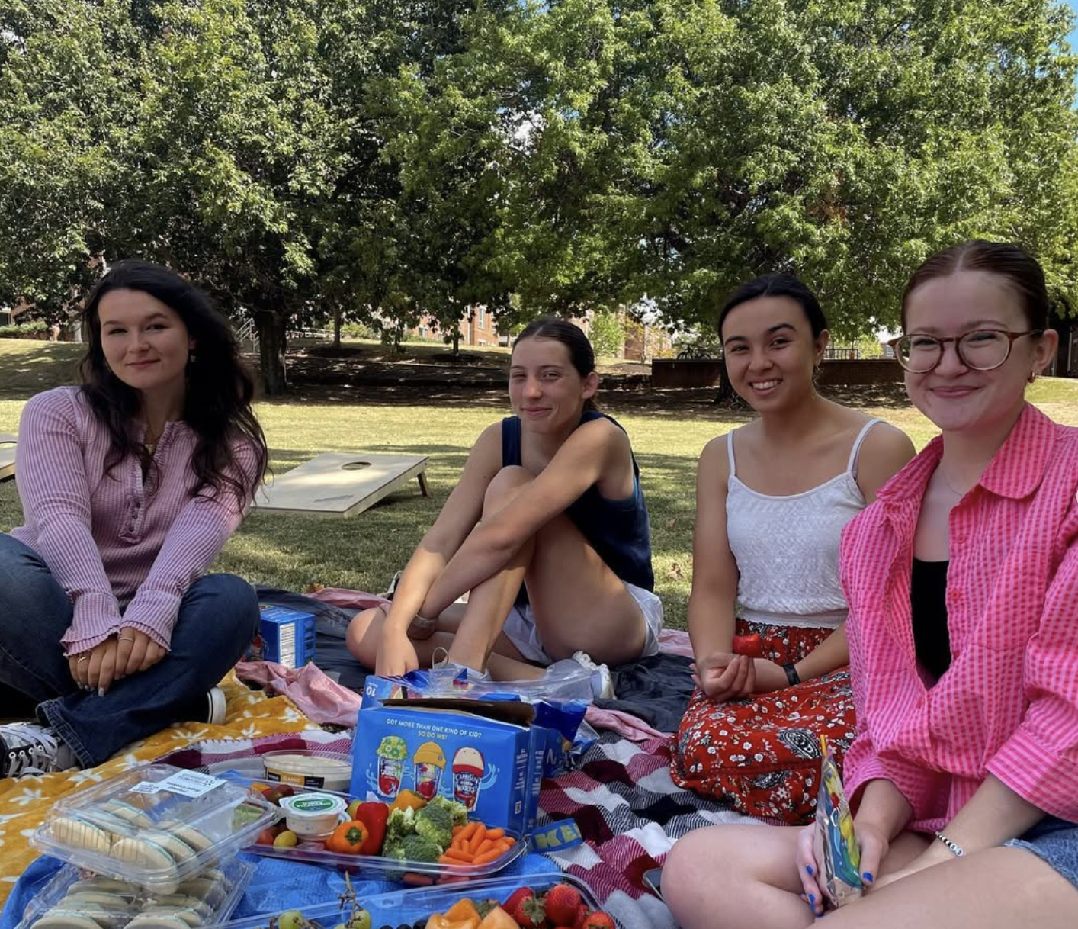
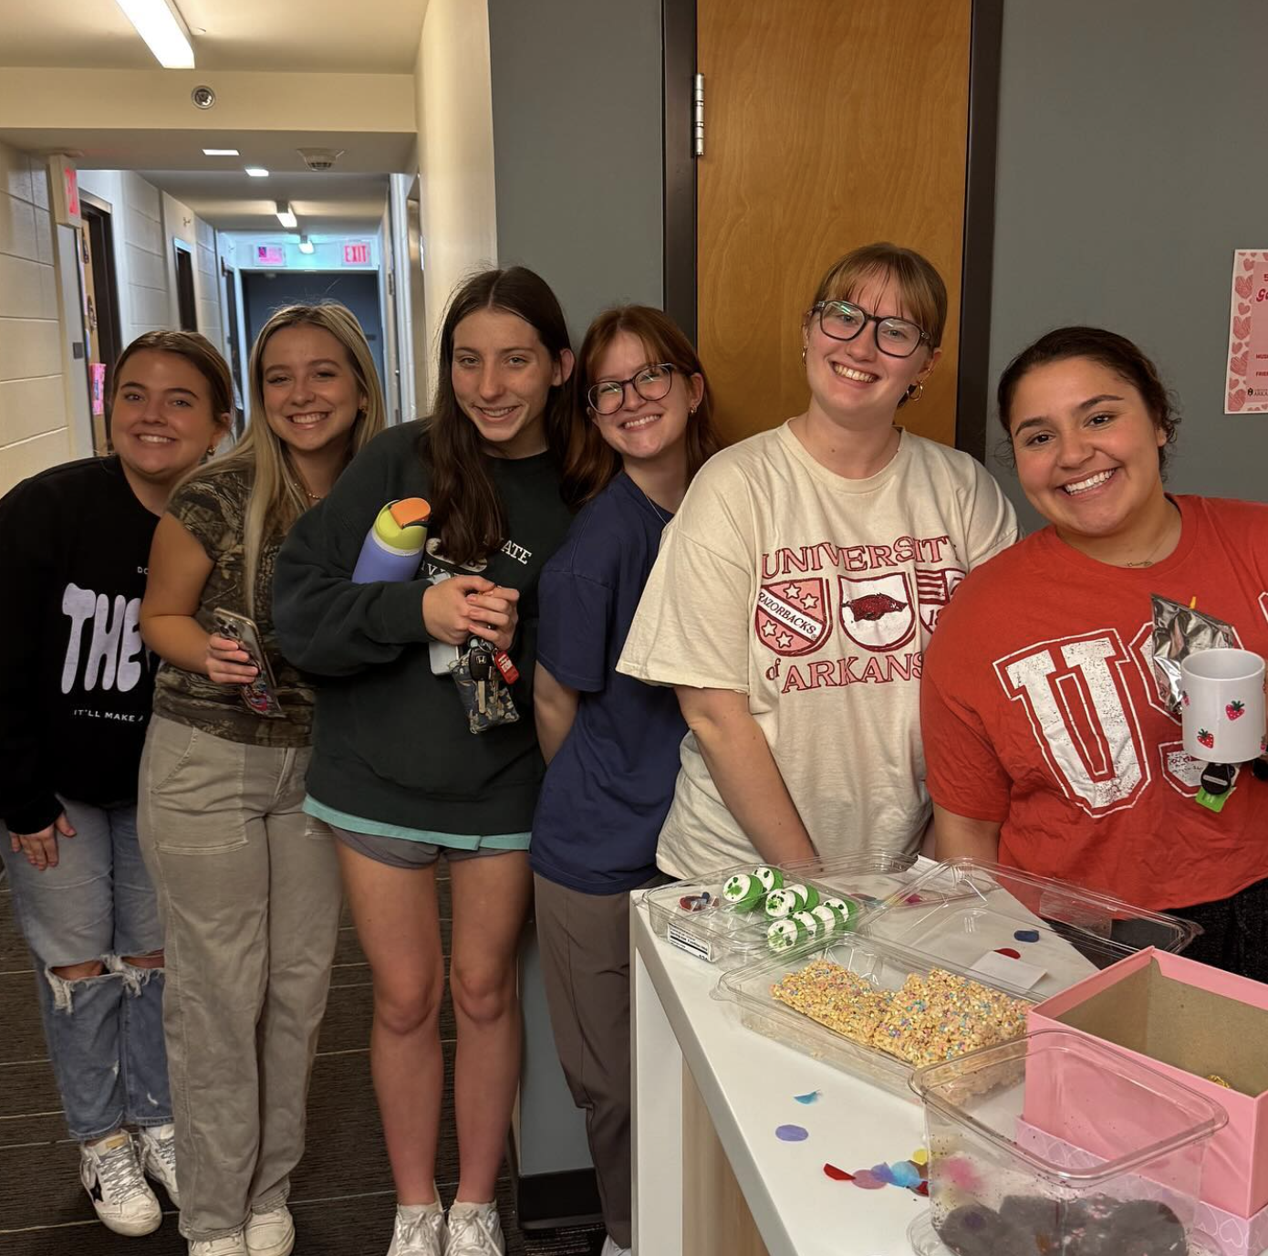
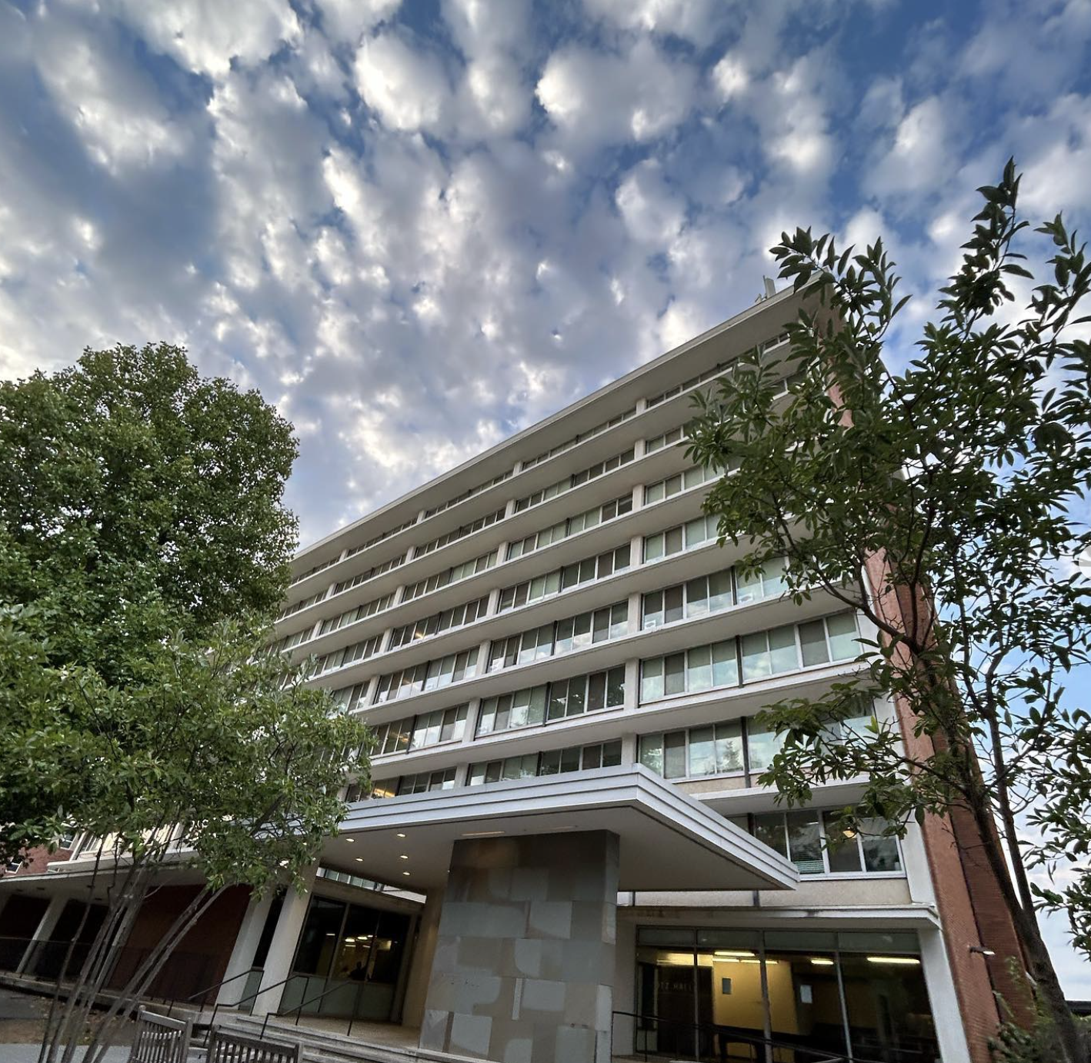
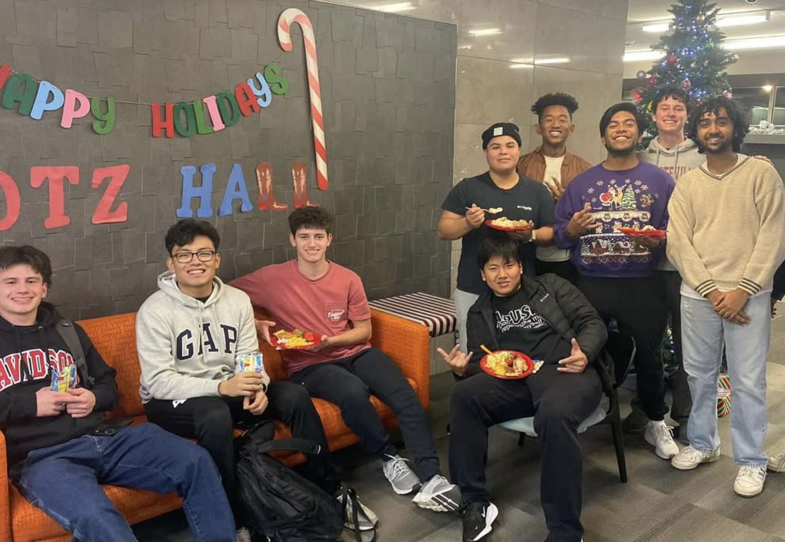
Hotz Honors Hall
Option to live in Hotz Honors Hall during first year of college
Fantastic facility that includes a small theater room, a music practice room, and a gym equipment room for residents
Video tour of the building available on HonorsTV section of the website

Slide 16

Graduating with Honors
All students who complete the honors requirements get a Latin distinction on their diploma that is also noted on their transcript
All graduates become members of our Senior Common Room, which comes with our Audax at Sapiens pin
Most important? A life-long plus on your resume
Notes:
Pictured: Dean Coon leads the students in our Senior Common Room ceremony, which takes place each year before spring commencement.

Slide 17
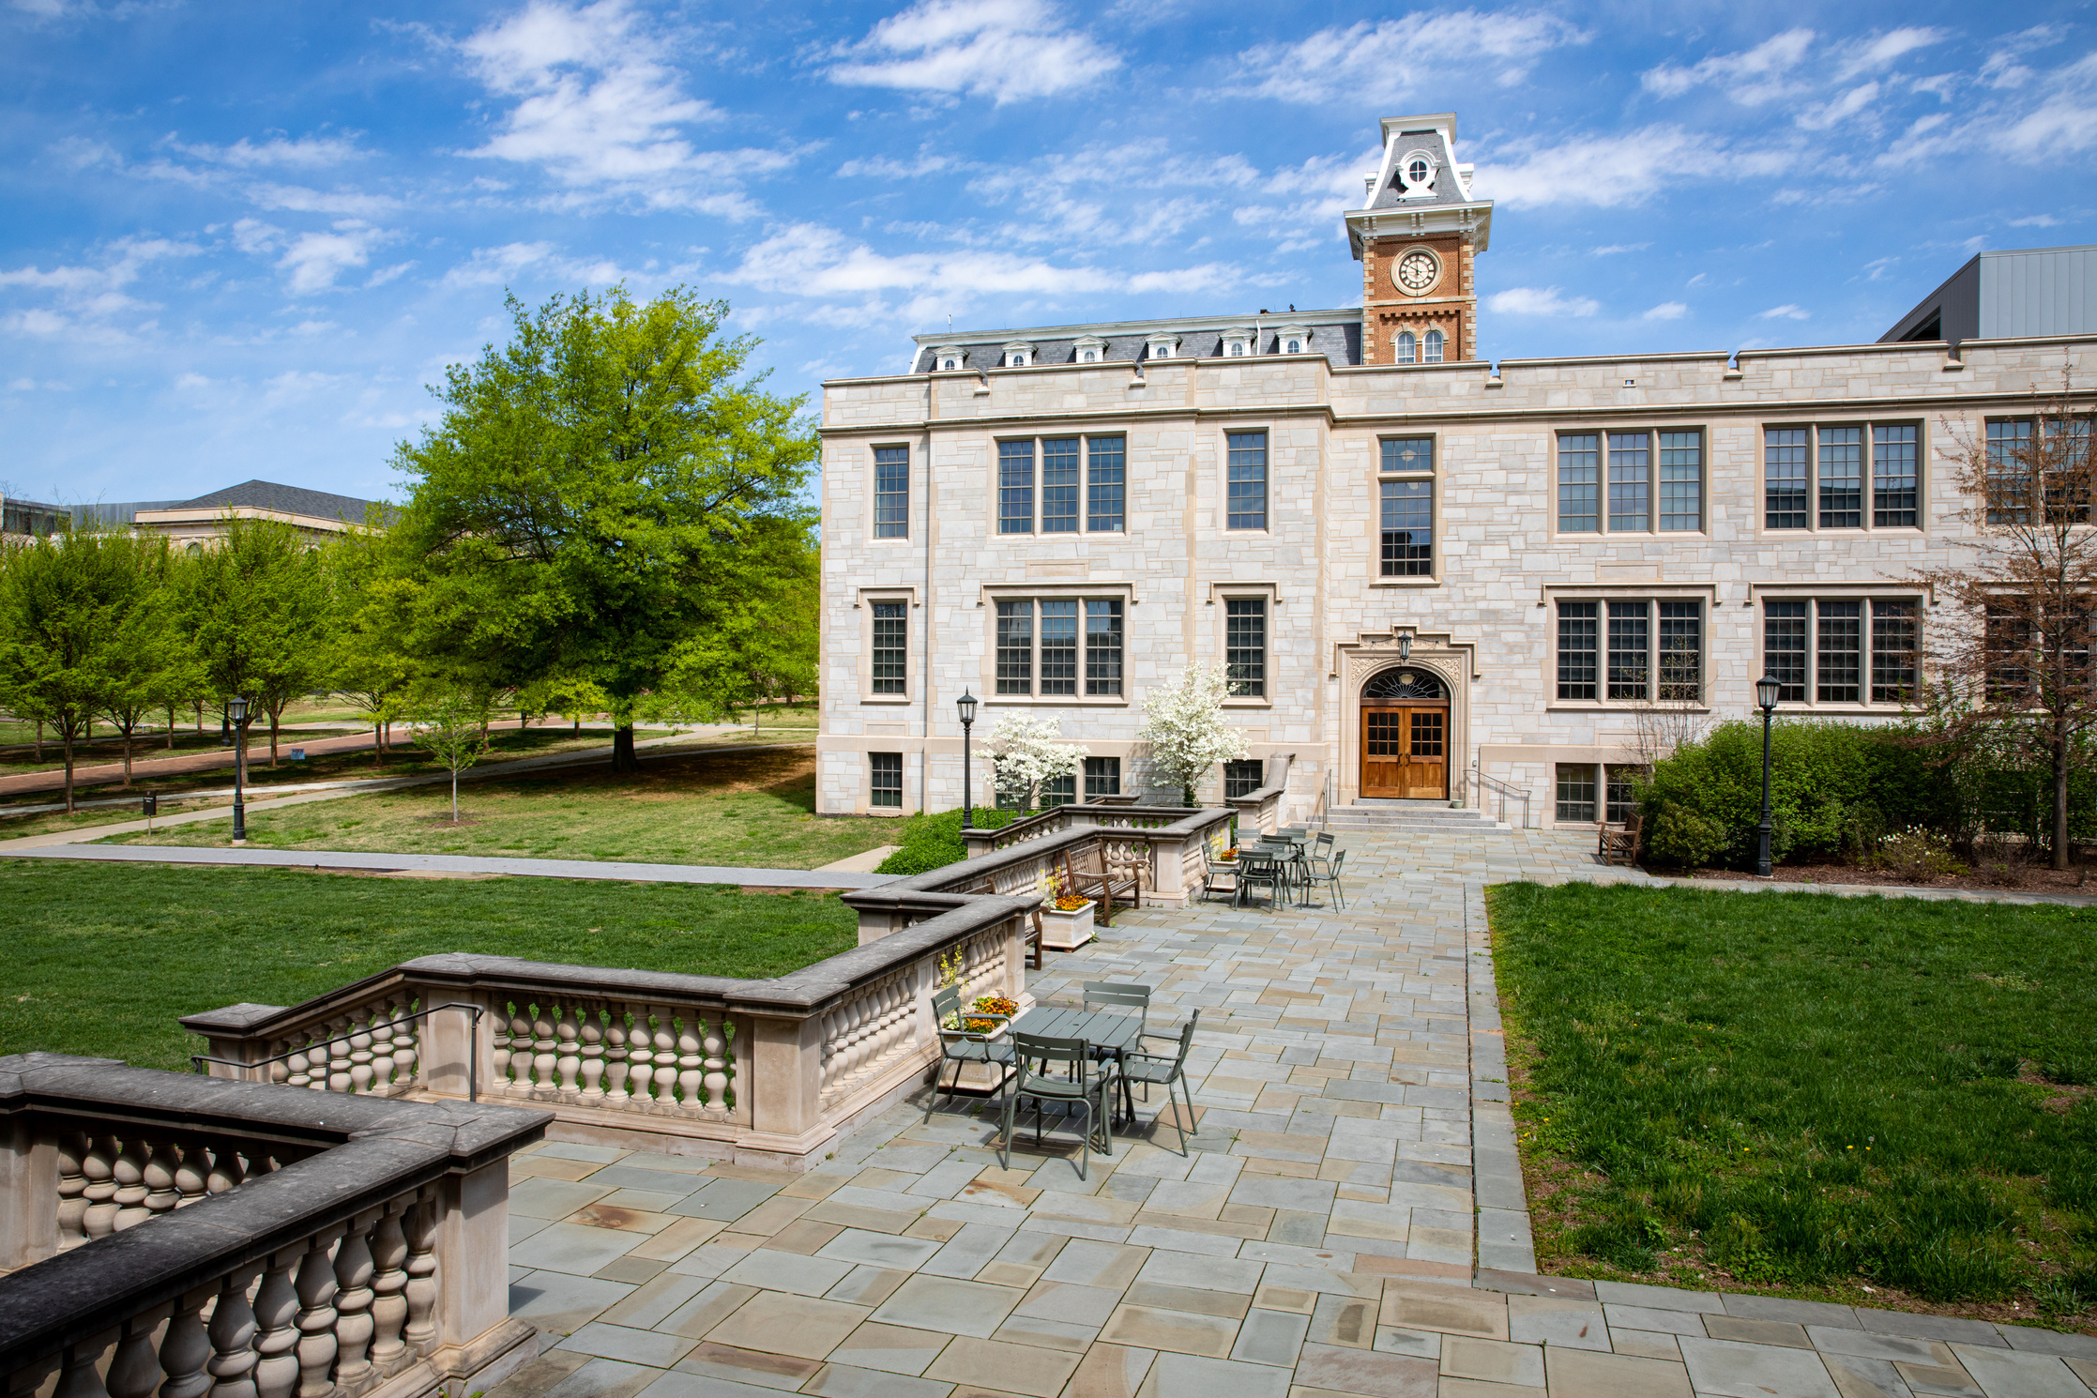

Honors College Contact Information
Learn More
479.575.7678
honors@uark.edu
www.honors.uark.edu
@uarkhonors

