Slide 1
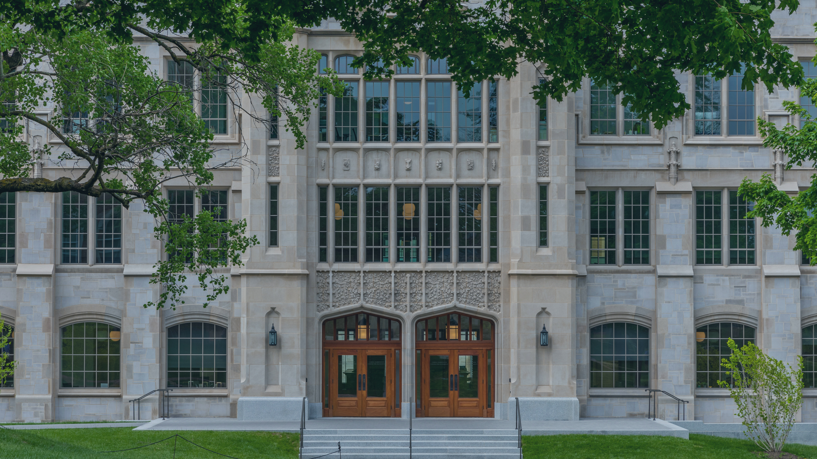

STUDENT SUCCESS
AT THE CORD

Slide 2




First-Year Seminar Courses (UNIV, FBC, ENGR)
An introduction to building blocks of student success to help with academic and social confidence.
An introduction to campus partners and resources.
A safe space to ask questions and connect with students, faculty, and staff in a small class setting.

Slide 3


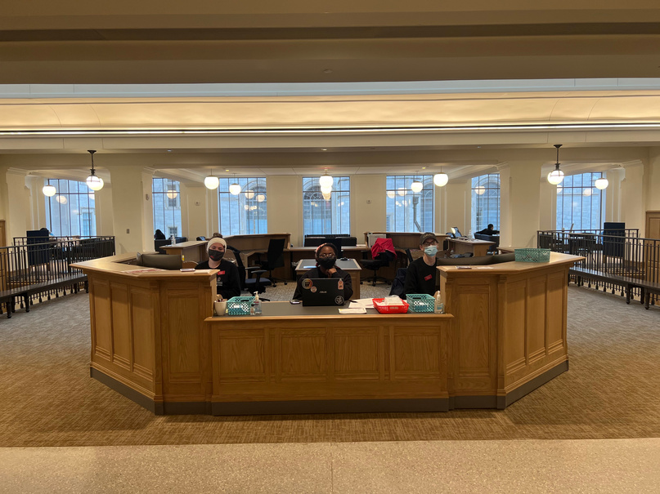

CLASS+
Supplemental Instruction
Tutoring
Writing Studio
Connection Desk
Tutors clarify course content, demonstrate how to solve problems, and provide an individualized experience to students in over 150 university courses through appointments, drop-ins, and Study Halls.
Writing Studio consultants offer feedback on students' writing at any stage in the writing process and help students improve their academic writing skills.
Student ambassadors are always ready to help with campus navigation, course enrollment, Blackboard support, and more.
For select historically challenging courses, SI offers weekly, collaborative study sessions facilitated by students who have excelled in the course and want to share their expertise.

Slide 4



OTHER CORD RESOURCES
Financial Empowerment
Exploration Coaching
Academic Coaching
Provides personalized coaching, and workshops to empower students to build a strong foundation for lifelong financial stability. Students will gain confidence in understanding their college costs - including tuition, fees, and financial aid - so they can make informed financial and educational decisions
Exploration Coaches offer holistic major exploration support in one centralized location, so students don’t have to visit multiple offices to get the guidance they need.
Academic coaching helps students elevate their academic performance by identifying and developing academic skills and strategies for learning efficiently and effectively.

Slide 5



WHAT ELSE IS IN THE CORD?
Career Studio
Starbucks & The Drove
Academic Advising
The Career Studio provides one-on-one and group advising/coaching for some of the Office of Career Connections’ most popular services, including resume and cover letter reviews, interview tips and mock interviews.
The Drove serves quesadillas, smoothie bowls, and ramen to fuel you while you study! There is also a Starbucks to keep you caffeinated. Both are located on the ground level of the CORD.
All academic advisors for COEHP & Fulbright are housed at the CORD, providing a centralized location for academic advising appointments and support.

Slide 6




ACTION STEPS FOR SUCCESS
Find your space
Learn about academic integrity
DABA
Build your support network early
Visit the libraries, the CORD, the Union and more to discover a space you love for designated studying!
Engage with DABA (Destination Arkansas Blackboard Assignment) on Blackboard!
Connect with tutors, success staff, advisors, and mental health resources in the first few weeks of the semester!
Familiarize yourself with academic integrity policies and commit early to doing your best work!

Slide 7
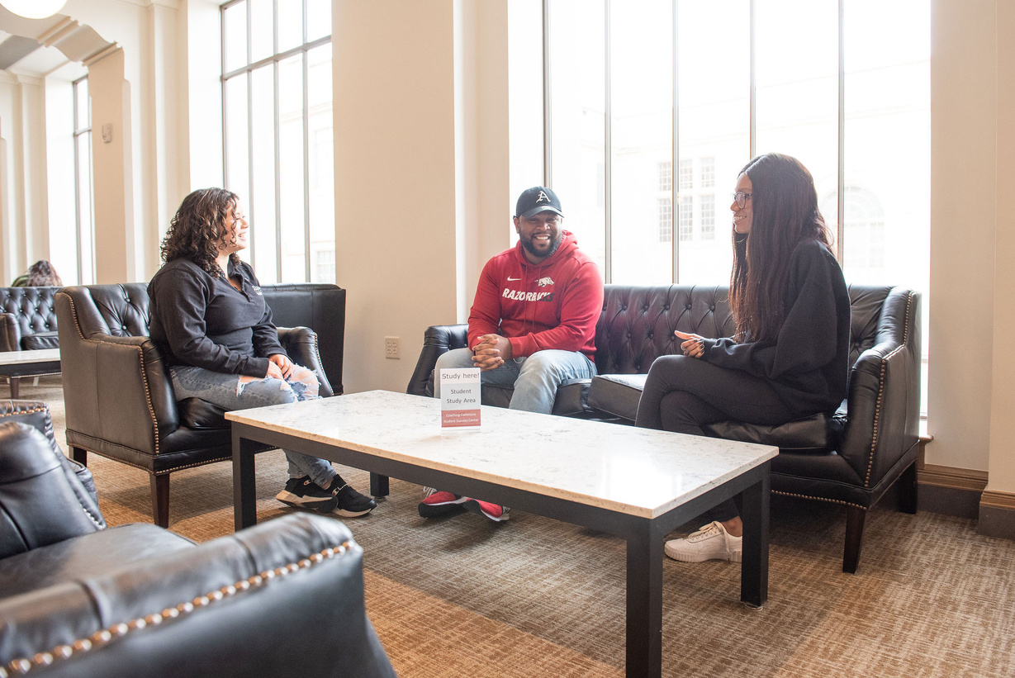
CONNECT @ the CORD!
CONTACT INFORMATION
success.uark.edu
success@uark.edu
479-575-3174
@UARKSuccess
Visit the CORD

