Slide 1


TRANSITIONS
FOR STUDENTS & SUPPORTERS
Notes:
There is no dismissal to the small groups game during a 1-day program!!!

Slide 2
FIRST-YEAR STUDENT ENGAGEMENT

Slide 3



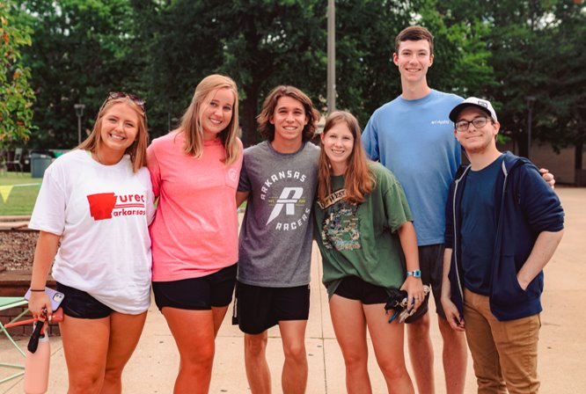
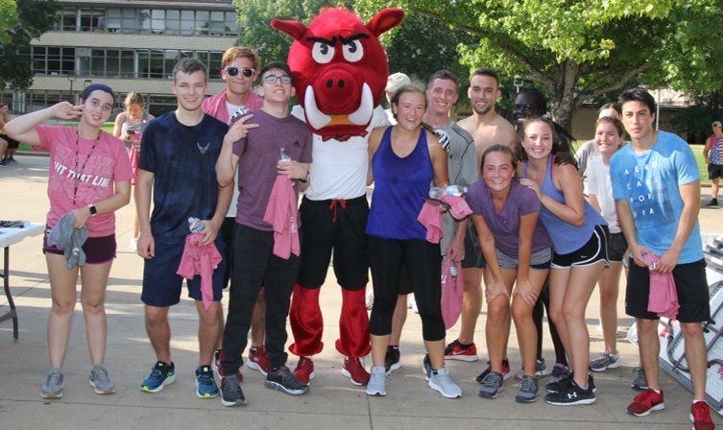
PICK ONE
pickone.uark.edu
Pick One is a first-year student involvement initiative that supports and encourages incoming students to get involved in campus life prior to arriving on campus. ​

Slide 4
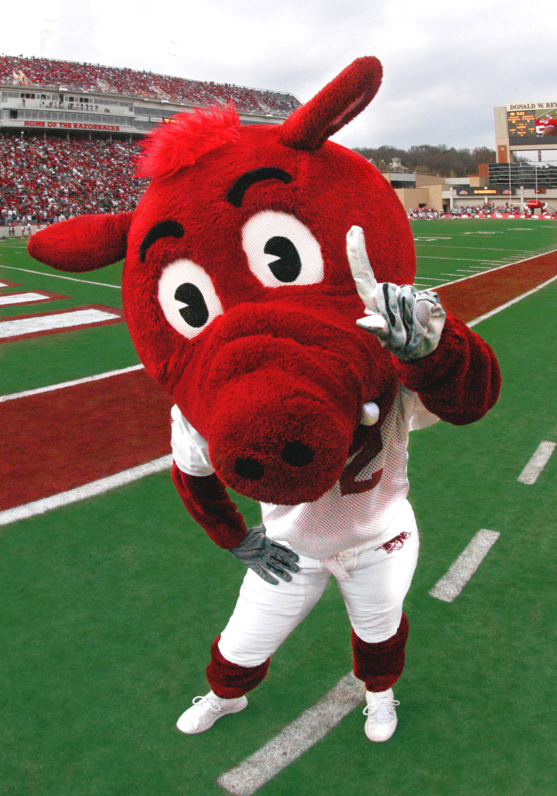

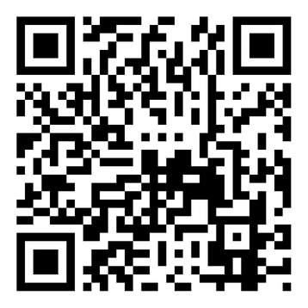
HILL BOUND 2026
transitions.uark.edu
Austin, TX
Dallas / Ft. Worth, TX
Houston, TX
Kansas City, MO
St. Louis, MO
Denver, CO
New Orleans, LA

Slide 5

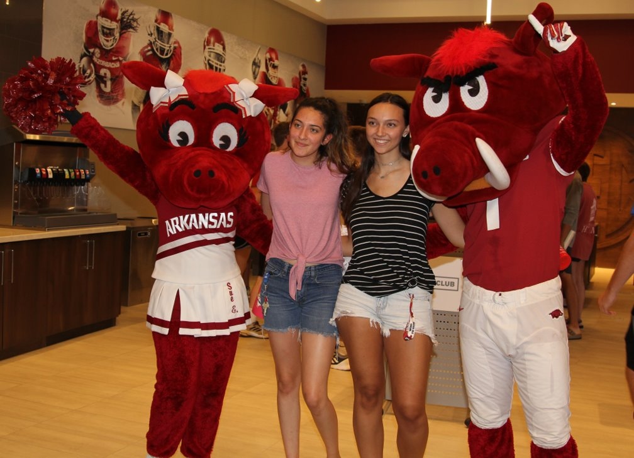
A-WEEK
A-Week is designed to support incoming first-year students in their transition from high school to college. It offers events and programs that promote success inside and outside of the classroom.
​
A-Week begins right after students move-in and is filled with events each day leading to the start of fall classes. A-Week focuses on key themes that are important for success, including academic achievement, belonging, wellness, history/traditions, and involvement.
transitions.uark.edu

Slide 6
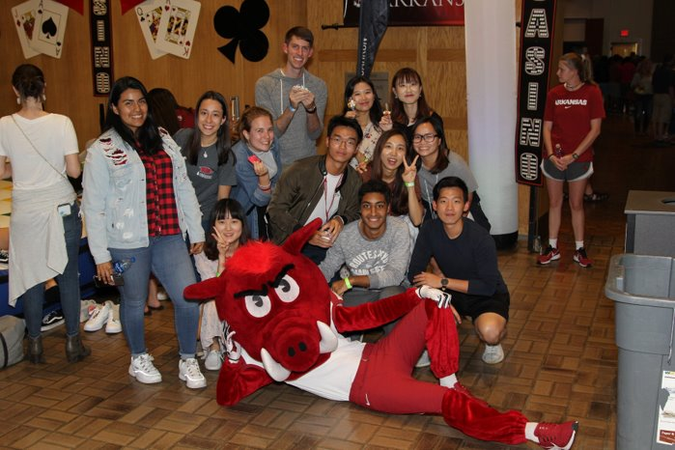
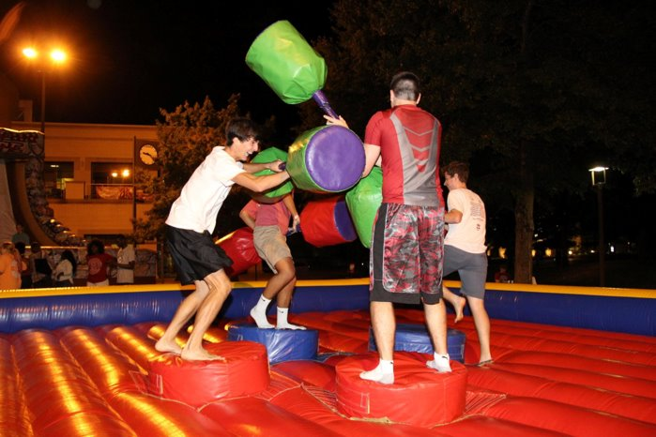
Student Engagement Opportunities
UARK Cardinal Nights ​
Hog W.I.L.D. Welcome Weeks​
​Volunteer Action Center – Community Engagement
Student Media
Multicultural Center
Pick-One
Registered Student Organizations (RSO’s)
Student Leadership Programs
transitions.uark.edu

Slide 7
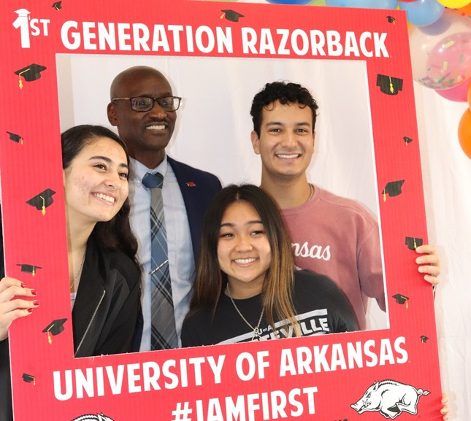
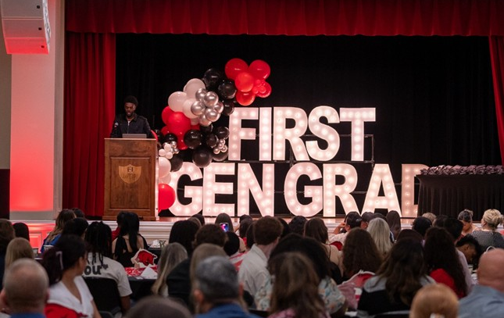
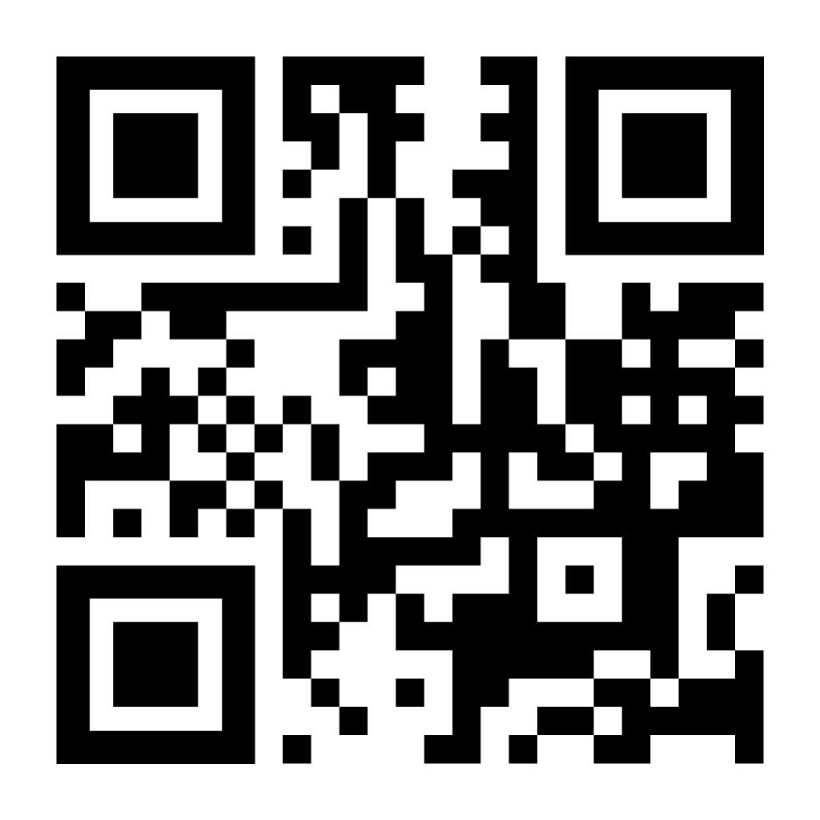
First-Gen Student Initiatives
Year-Round Programming
  A-Week
  Welcome Weeks
  National First-Generation Student Week
Peer Mentor Program
Tri-Alpha First-Gen Honor Society
First-Gen Lounge
Graduating First-Gen Student Celebration
firstgen.uark.edu

Slide 8
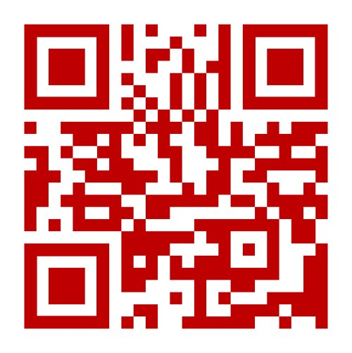
CONNECT WITH US!
CONTACT INFORMATION
VISIT OUR WEBSITE!
Transitions.uark.edu
transitions@uark.edu
479-575-5002
@uarktpi

Slide 9
PARENT & FAMILY PROGRAMS

Slide 10
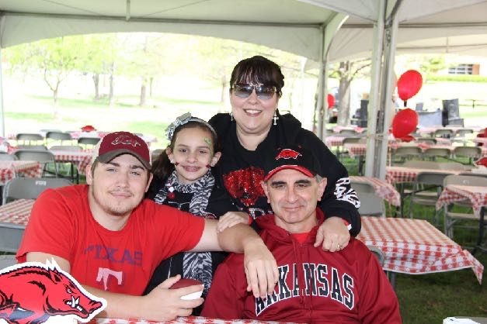

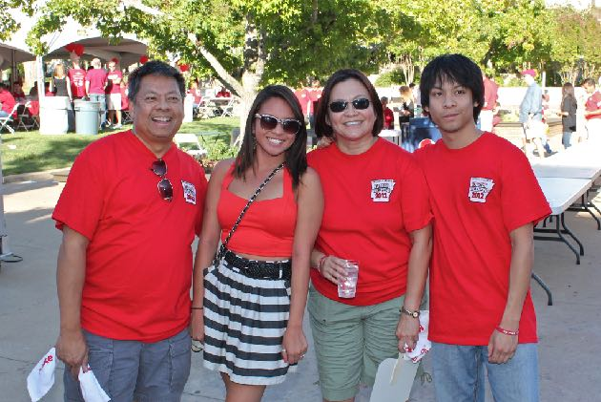
PARENT & FAMILY PROGRAMS (continued)
We work to provide you the resources needed to help you and your student succeed throughout the first year and beyond.
Communication
Partnership
Events & Programming
family.uark.edu

Slide 11
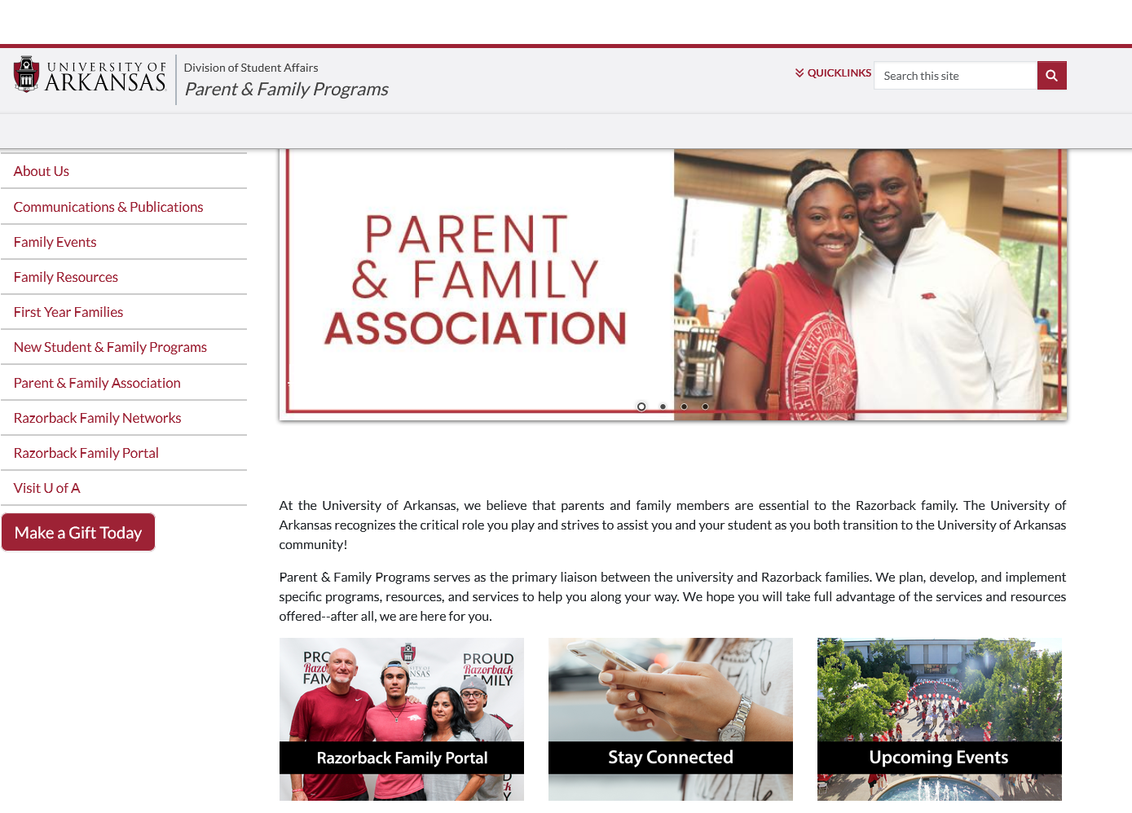
COMMUNICATION
First-Year Families ​
  After Orientation Checklist​
  Expectations Guide ​
Family Resources​
  General FAQs ​
  Academic Calendar​
  Budget Sheet​
  Recommended Readings ​
Upcoming Events ​
Visit U of A
family.uark.edu

Slide 12
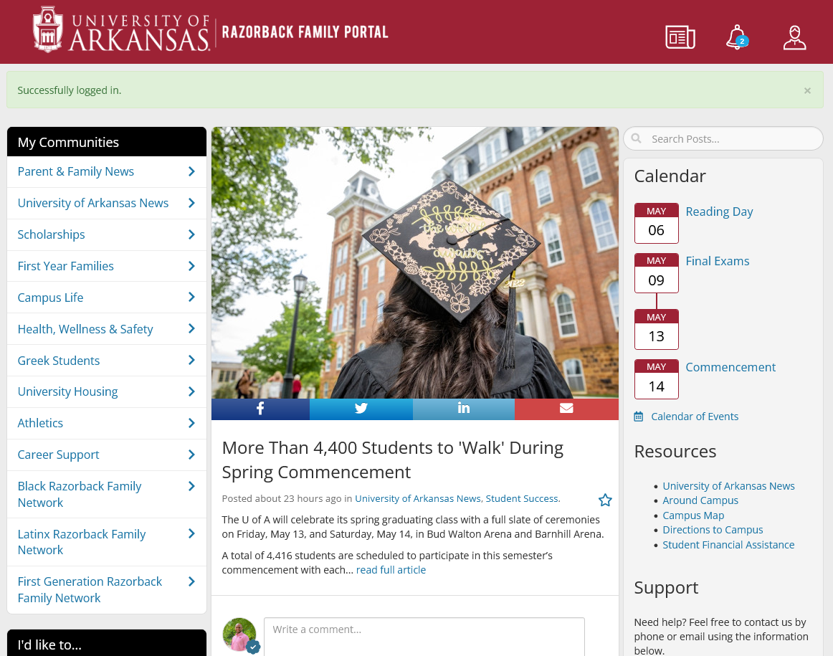
COMMUNICATION (continued)
The Razorback Family Portal is designed to enhance your experience by providing you with customized newsletters and 24/7 access to information, news, and resources curated just for family members of UARK students.
uark.campusesp.com

Slide 13
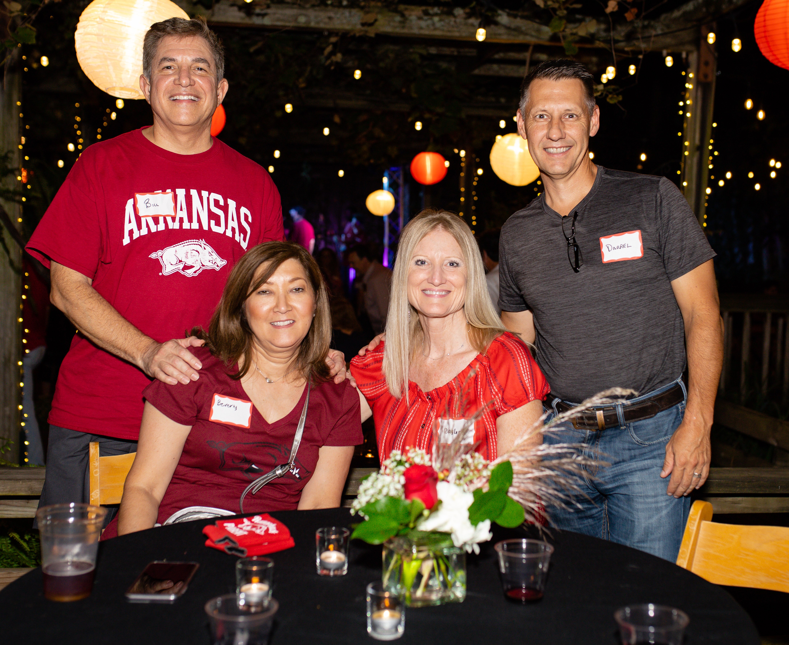
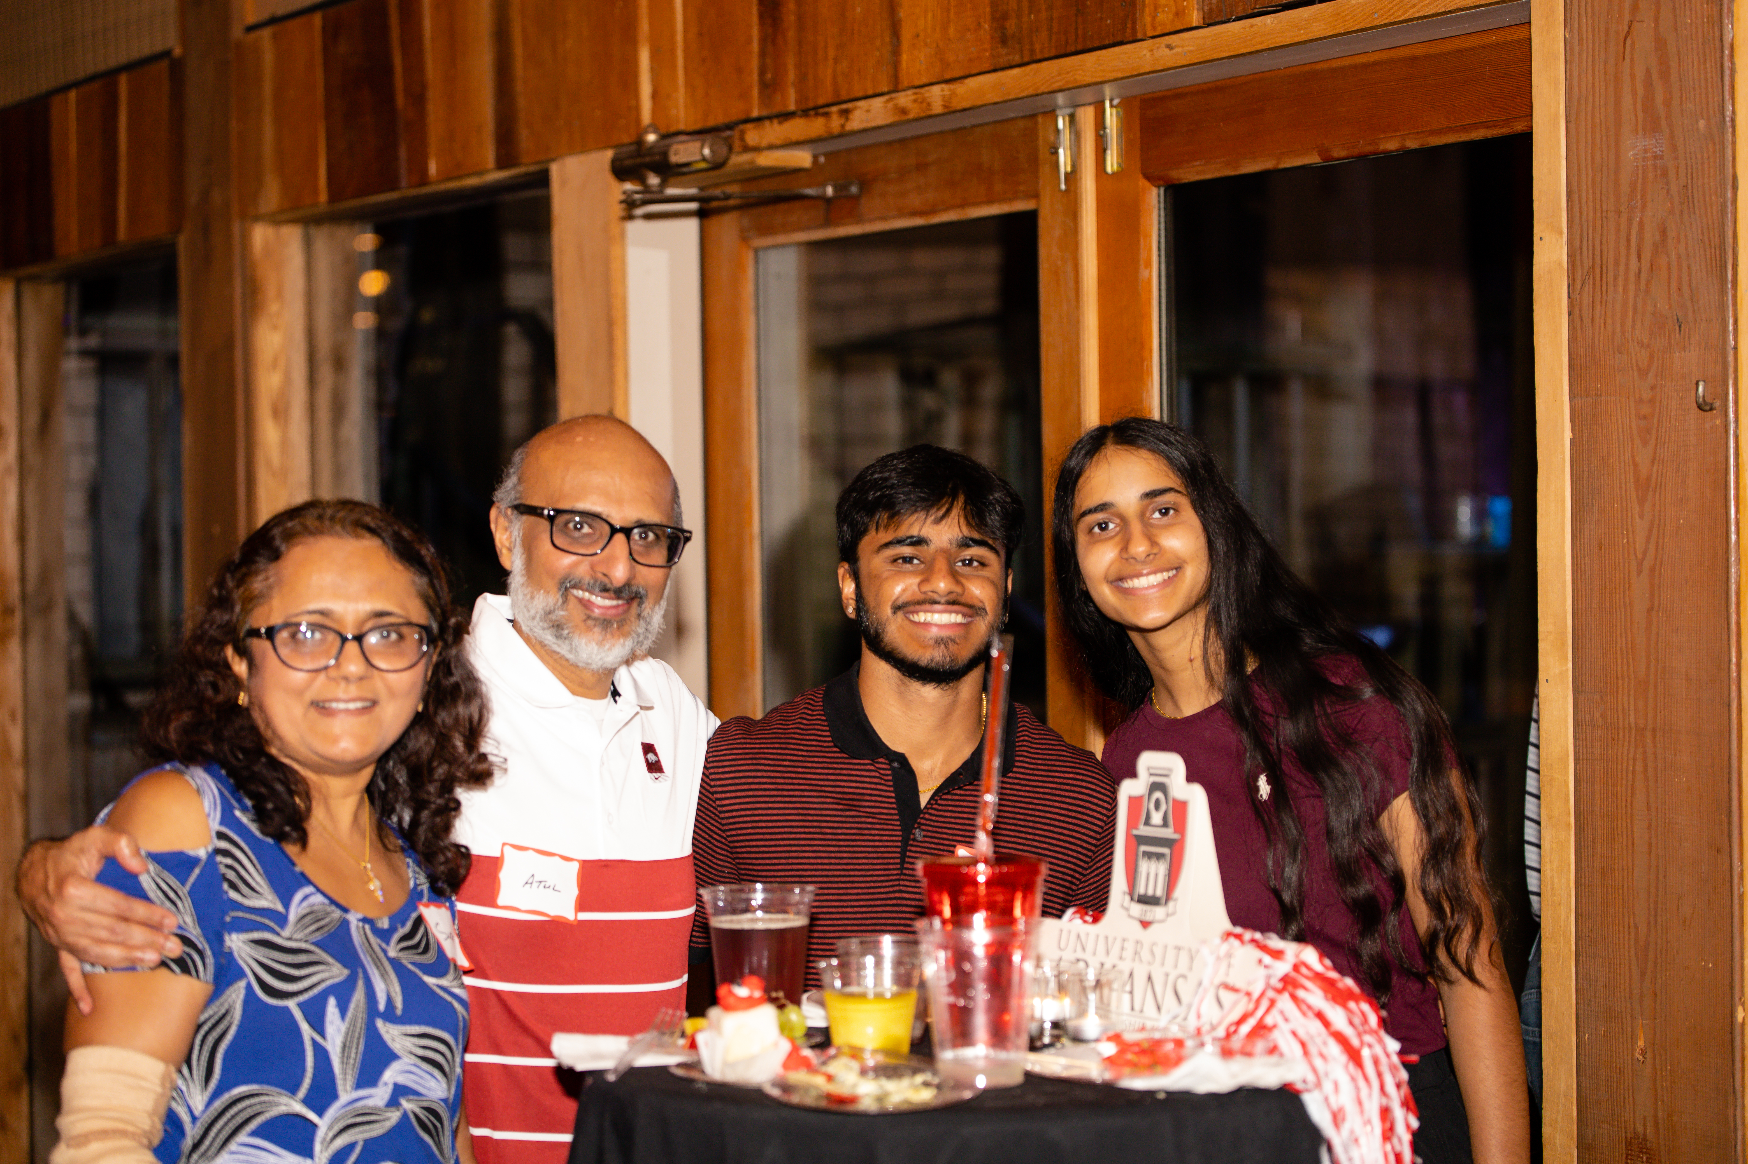
PARTNERSHIP
family.uark.edu
The Parent & Family Association is an organization dedicated to helping parents and guardians support their student’s success at the U of A.​
General Membership:​
  Razorback Family Portal ​
  Access to events including​
  Family Weekend​
  Family Events
  Razorback Family Networks

Slide 14

PARTNERSHIP (continued)
family.uark.edu
PFA CARDINAL MEMBERSHIP:
$75 – 1 Year or $225 – 4 Years
  PFA Book Scholarship opportunity for your student​
  10% Discount on Family Weekend​
  Early Registration for Family Weekend ​
  Discount at the University Bookstore (excludes textbooks)​
  “PFA - Razorback Family” Car Decal​
  Parent ID Card​
  PFA Discount Card (Local and National Discounts – car rental, hotel, stores)​
  Student Discount Card

Slide 15

PARTNERSHIP (continued)
family.uark.edu

Slide 16
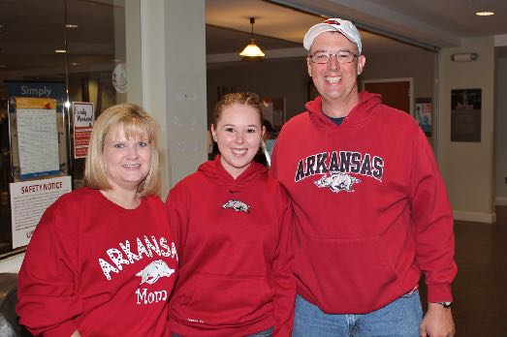
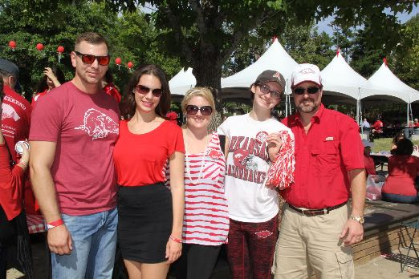
EVENTS & PROGRAMMING
Family Weekend 2026
  September 25 – 27
  Packages available July
Fall Football Tailgates
Regional Meet & Greets
Networking Events
Family & Alumni Socials
family.uark.edu

Slide 17
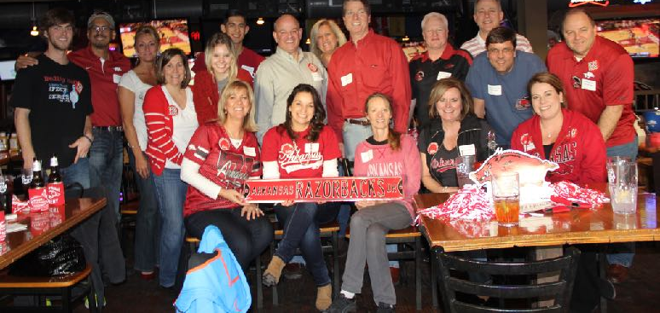

EVENTS & PROGRAMMING (continued)
Razorback Family Networks provide an opportunity for parents to connect with each other and build a support system through social, school, and service-based events hosted near their homes.​
  Austin, TX​
  Dallas - Ft. Worth, TX​
  Houston, TX​
  Kansas City, MO​
  Little Rock, AR​
  Memphis, TN​
  New Orleans, LA
  Northeast Arkansas ​
  Northwest Arkansas ​
  San Antonio, TX​
  St. Louis, MO​
  Tulsa, OK
  Shreveport, LA
  Baton Rouge, LA
family.uark.edu

Slide 18

STAY CONNECTED
Letters From Home is a program that gives you the opportunity to send your student words of encouragement at the beginning of the semester​
Visit family.uark.edu and write your student a letter! ​
Include the following information:​
  Student’s full name (First, Middle, Last)​
  Residence Hall Address (PMB ####)​
  Student ID Number (##########
(Letters will be sent out during the first 2 weeks of class)​

Slide 19
STAY CONNECTED (continued)
VIRTUAL TOWN HALL​
FAMILY TRANSITION WORKSHOPS​
VIRTUAL MEET & GREETS

Slide 20
CONTACT INFORMATION
CONNECT WITH US!
family.uark.edu
parents@uark.edu
479-575-5002
@RazorbackParent

