Slide 1


MONEY MATTERS

Slide 2
FINANCIAL AID & SCHOLARSHIPS

Slide 3

CONNECT WITH US!
OFFICE OF FINANCIAL AID
OFFICE OF ACADEMIC SCHOLARSHIPS
finaid.uark.edu
finaid@uark.edu
479-575-3806
scholarships.uark.edu
scholars@uark.edu
479-575-4464
Check To Do items in Workday, UARK email account, and our websites for information and requirements for scholarships, loans, and other aid.
114 Silas H. Hunt Hall | 8 a.m. to 5 p.m.
Virtual & Walk-in Appointments Available

Slide 4
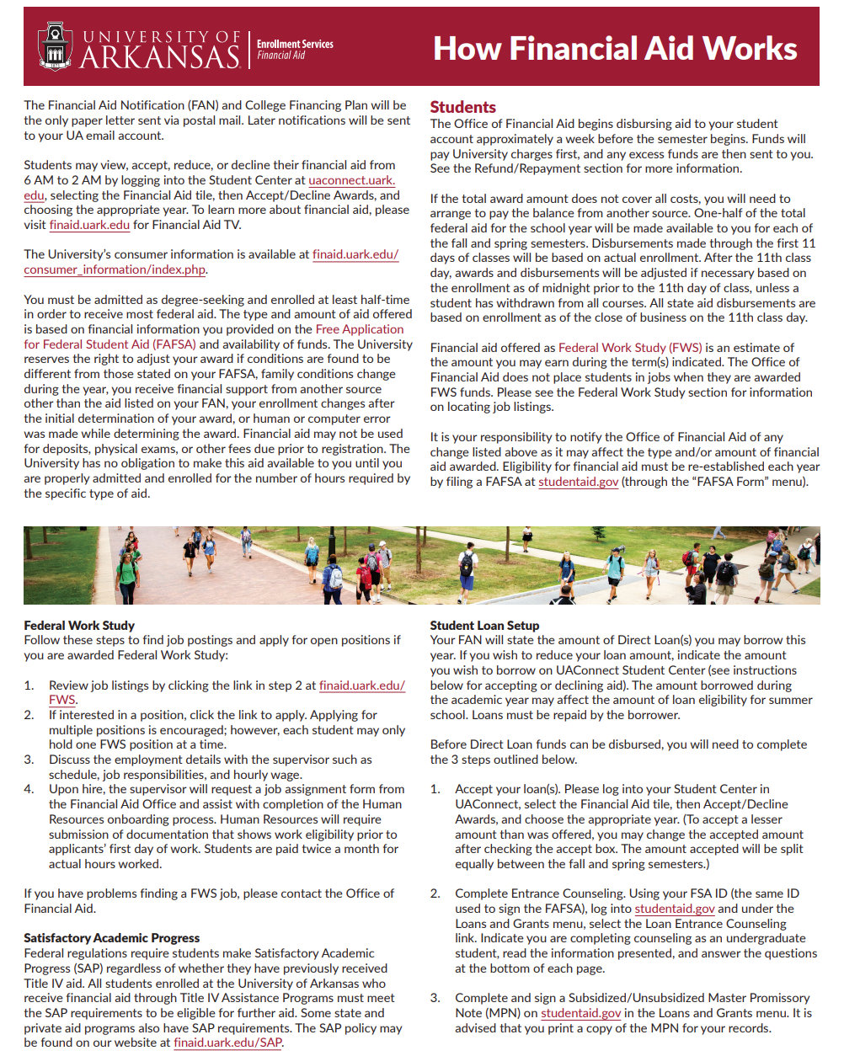
FINANCIAL AID NOTICE & NEXT STEPS
Direct Loan is $5500 for freshmen
Most outside scholarships will be on Workday after the first week of classes
NRTA will have two tuition charges on the invoice, one for tuition and the other for the percentage of non-resident costs not waived by the scholarship
“How It All Works” brochure is available at finaid.uark.edu and includes information about eligibility, NRTA, Work Study, student loan setup instructions, and PLUS Loan application instructions

Slide 5
DISBURSEMENT & RENEWAL
ENROLLMENT REQUIREMENTS MUST BE MET EACH SEMESTER.
Minimum 6 hours for undergraduate students using loans, prorated for less than full time
Minimum 15 hours for Arkansas Academic Challenge and Governor’s Scholarships, 30 hours to renew. GPA requirements differ, refer to ADHE rules
Chancellor’s, Silas Hunt, and other University Scholarships require a minimum of 12 hours per semester for disbursement. Renewal requires 30 hours per year and 2.75 GPA
No minimum hours for Non-Resident Tuition and Alumni Legacy, but renewal requires completion of 24 hours per year and a 2.75 GPA
Concurrent and AP credits from high school do not count for disbursement or renewal requirements for Challenge or Governor’s Scholarships but may count for UA and other scholarships
Notes:
Around here, give the speaker the 5 minute warning.

Slide 6
ADDITIONAL AID OPTIONS
PARENT PLUS LOAN
PRIVATE ALTERNATIVE LOAN
Federal Student Aid program, fees and interest rates same for every borrower
Apply at studentaid.gov after bill is generated
Parent completes application and is responsible for repayment
Up to $20,000 yearly & $65,000 lifetime maximum per student
Credit-based lending companies
Fees, terms, and interest rates differ between lenders and dependent on credit of borrower
Research before applying
Borrower and/or co-signer could be student, parent, or other
Ask school for list of lending institutions

Slide 7
ADDITIONAL AID OPTIONS
VETERAN’S BENEFITS
THIRD PARTY SOURCES
Chapter 30 GI Bill
Chapter 33 Post 9/11
Contact the Veteran and Military-Affiliated Student Center (VMSC) or visit vmsc.uark.edu
529 plans and prepaid tuition and college savings plans
AR Vocational Rehabilitation funds
Employee dependent discounts
Contact Treasurer’s/Student Accounts Office or visit treasurer.uark.edu
Notes:
Give the speaker the 2 minute warning around here.

Slide 8
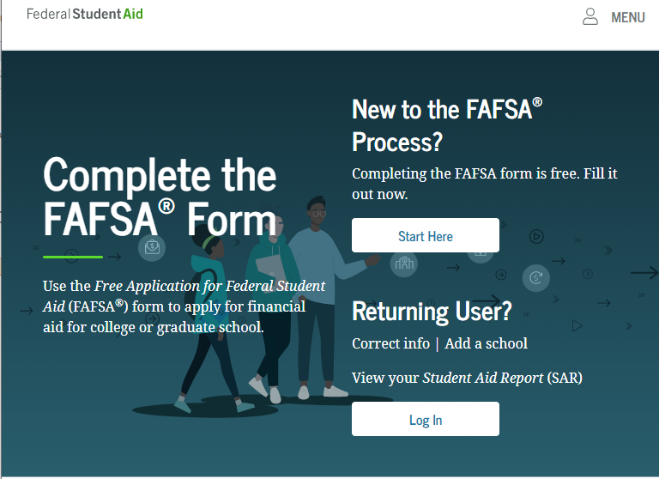
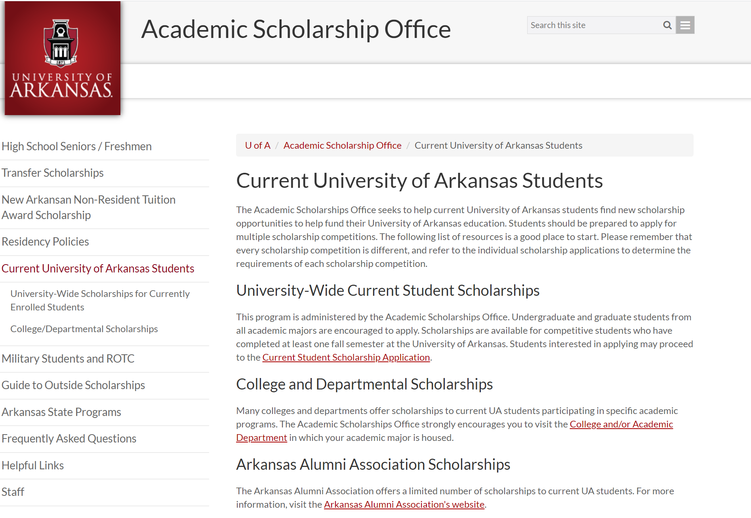
APPLY EACH YEAR
LOANS, GRANTS, & WORK STUDY
SCHOLARSHIPS
A FAFSA is required each year. Applications are available at studentaid.gov
Current student scholarship application open January 1 at scholarships.uark.edu

Slide 9
TREASURER’S OFFICE

Slide 10
TREASURER'S OFFICE & STUDENT ACCOUNTS
WHAT WE DO
CONNECT WITH US!
treasurer.uark.edu
treainfo@uark.edu
479-575-5651
640 N. Garland Ave. Ste. 108
  Student Invoices
  Cashiering
  Account Inquiries
  Tuition Waivers
  3rd Party Billing
  Collections
Monday - Friday 8 a.m. to 5 p.m.

Slide 11
HOW MUCH WILL IT COST
COSTS VARY EACH SEMESTER BASED ON
  Credit Hours
  College
  Residency Status
  Student Career Level
  Type of Program
TUITION AND FEES ARE CHARGED
  Per Credit Hour
MANDATORY STUDENT FEES
  Network/Data Systems Fee
  Library Fee
  Health Fee
  Student Media Fee
  Transit Fee
  Student Activity Fee
  Facilities Fee
COLLEGE FEES
  Arts & Sciences
  Architecture
  Engineering
  Agriculture, Food & Life Sciences
  Education & Health Professions
  Business
  Nursing
Housing and meal plan costs also vary based on student selection. Please visit housing.uark.edu.

Slide 12
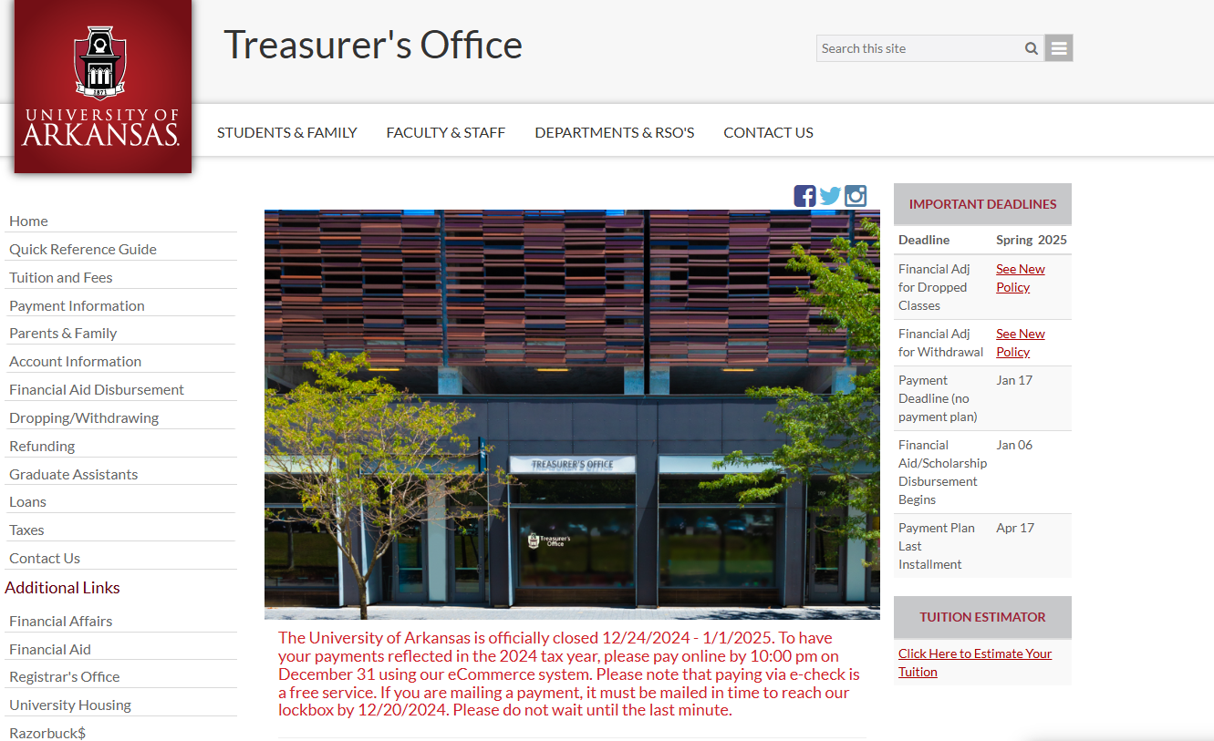
OUR WEBSITE
Notes:
Around here, give the speaker the 5 minute warning.

Slide 13
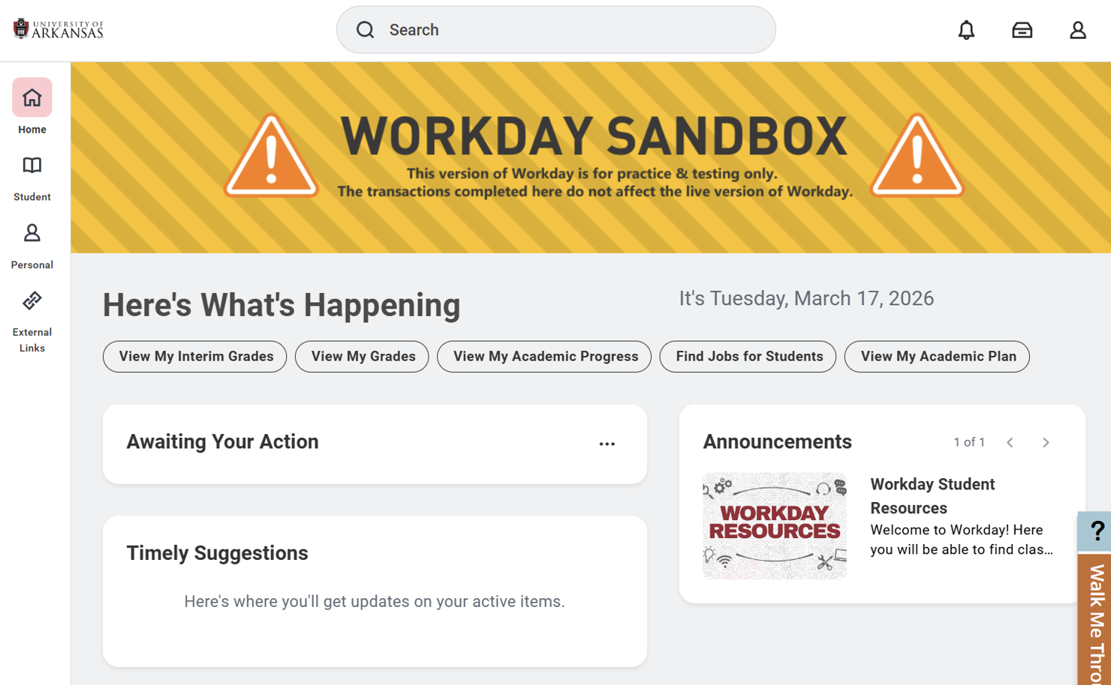


Slide 14

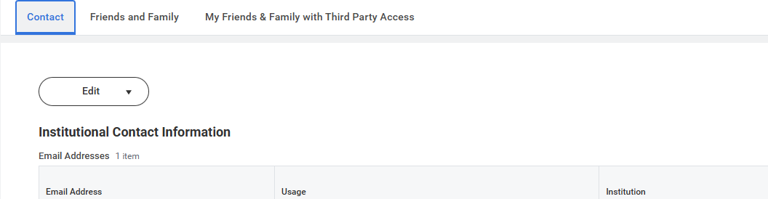
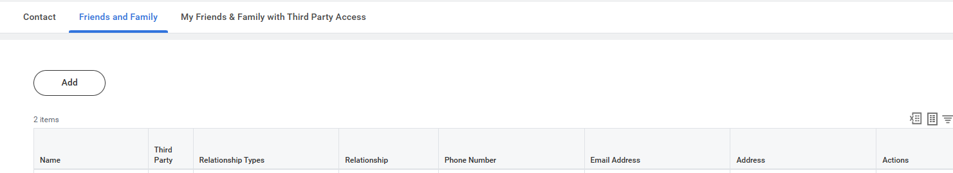
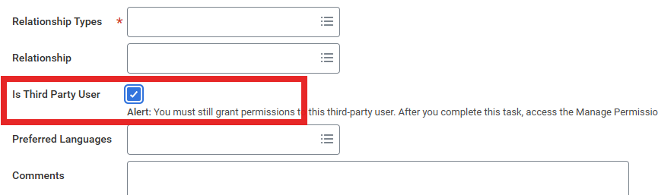
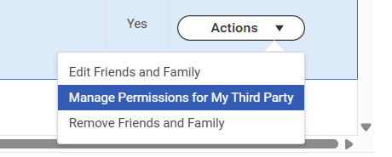

Slide 15
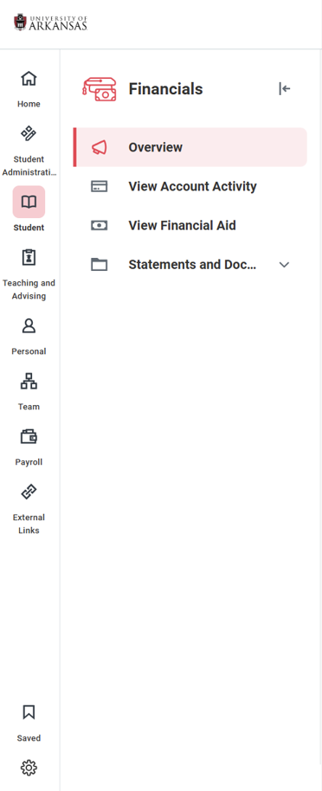

Slide 16

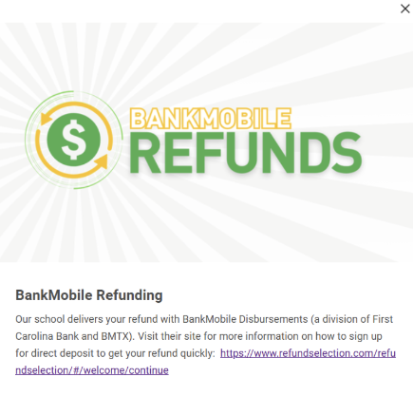


If a refund preference has not been selected, your refund can be delayed up to four weeks. Even if you are not expecting to receive a refund, please set up a refunding preference.
Workday Student
  -Financials Hub
  -BankMobile Refunding
  -Click the banner
  -Follow the instructions for signing in and selecting your preference
Your money, delivered your way!
Your school has partnered with BankMobile to deposit your money or refund quickly and securely.
You will have two electronic options to deposit your money. To avoid delays in accessing your money, you must select a refund option. The BankMobile Vibe Checking Account is one of you refund options but you are not required to open this account to receive your refund.
Visit refundselection.com for more information.
REFUNDS

Slide 17



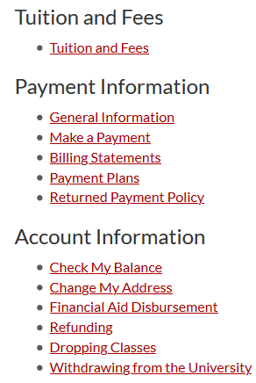

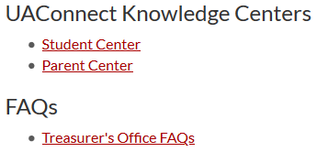
HELP CENTERS
TUTORIALS WITH STEP-BY-STEP ILLUSTRATIONS & HOW TOS
  Make a Payment
  Set Up Parent Authorizations
  Add Authorizations
  Set Refund Preferences
  ... and More!
Workday Student Knowledge Centers
Visit treasurer.uark.edu/student_family for more information

Slide 18
The Registrar’s Office determines drop and withdrawal deadlines. Before dropping classes or withdrawing, refer to this calendar to be sure you understand the financial implications it could cause. When in doubt, contact us!
The academic semester calendar can be found on the Registrar’s website. The Fall 2026 calendar is available now.
THERE IS A $45.00 WITHDRAWAL FEE
DROPPING & WITHDRAWING ARE DIFFERENT
KNOW THE FINANCIAL RELATED DEADLINES
WITHDRAWING CAN AFFECT FINANCIAL AID ELIGIBILITY
DROPPING & WITHDRAWING
Notes:
Around here give the speaker the 2 minute warning.

Slide 19
CHECKLIST
REQUIRED
Financial Agreement ​
(Workday Student – My Tasks - Onboarding)
Student Permissions for Title IV Aid​
(Workday Student – My Tasks - Onboarding)
IRS 1098-T E-Consent Form​
(Workday Student – My Tasks - Onboarding)
HIGHLY RECOMMENDED
Select Refunding Preference​
(Workday Student – Financials Hub – BankMobile)​
FERPA 3rd Party Release​
(Workday Student – Profile – Contacts – Friends and Family – Add –Done ​
– Actions – Manage My Permissions for My Third Party)
Parent/Family Workday Student Authorizations​
(Workday Student – Profile – Contacts – Friends and Family – Add –Done ​– Actions – Manage My Permissions for My Third Party)​
E-Commerce Payment Authorizations
(Workday Student – Financials Hub – Make a Payment – Ecommerce Login – My Account – Payers – Send a payer Invitation)

Slide 20
CONNECT WITH US!
CONTACT INFORMATION
ON SOCIAL MEDIA
treasurer.uark.edu
University of Arkansas-Fayetteville
Treasurer's Office
@UofATreasurer
& via chat online
treainfo@uark.edu
479-575-5651
640 N. Garland Ave. Ste. 108
Monday - Friday 8 a.m. to 5 p.m.

