Slide 1
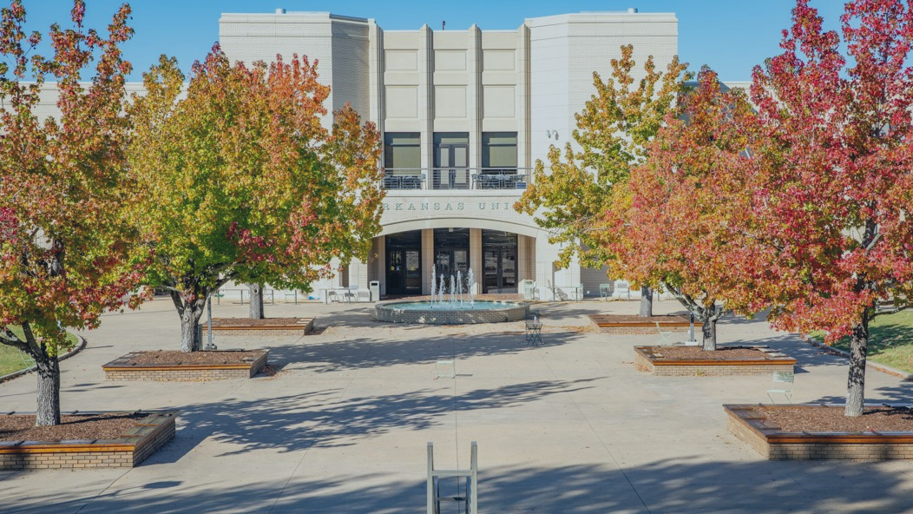

MONEY MATTERS
& TECHNOLOGY NEEDS

Slide 2
TREASURER’S OFFICE

Slide 3

TREASURER'S OFFICE & STUDENT ACCOUNTS
WHAT WE DO
CONNECT WITH US!
treasurer.uark.edu
treainfo@uark.edu
479-575-5651
640 N. Garland Ave. Ste. 108
  Student Invoices
  Cashiering
  Account Inquiries
  Tuition Waivers
  3rd Party Billing
  Payroll Deductions for Employees
  Collections
Monday - Friday 8 a.m. to 5 p.m.

Slide 4

TODAY’S AGENDA
Tuition & Fee Costs
Navigating Workday Student
Parent Authorizations
Refunds
Help Centers
Withdrawing vs. Dropping
FAQs
Treasurer’s Office Checklist

Slide 5
HOW MUCH WILL IT COST
COSTS VARY EACH SEMESTER BASED ON
  Credit Hours
  College
  Residency Status
  Student Career Level
  Type of Program
TUITION AND FEES ARE CHARGED
  Per Credit Hour
MANDATORY STUDENT FEES
  Network/Data Systems Fee
  Library Fee
  Health Fee
  Student Media Fee
  Transit Fee
  Student Activity Fee
  Facilities Fee
COLLEGE FEES
  Arts & Sciences
  Architecture
  Engineering
  Agriculture, Food & Life Sciences
  Education & Health Professions
  Business
  Nursing
Housing and meal plan costs also vary based on student selection. Please visit housing.uark.edu.

Slide 6
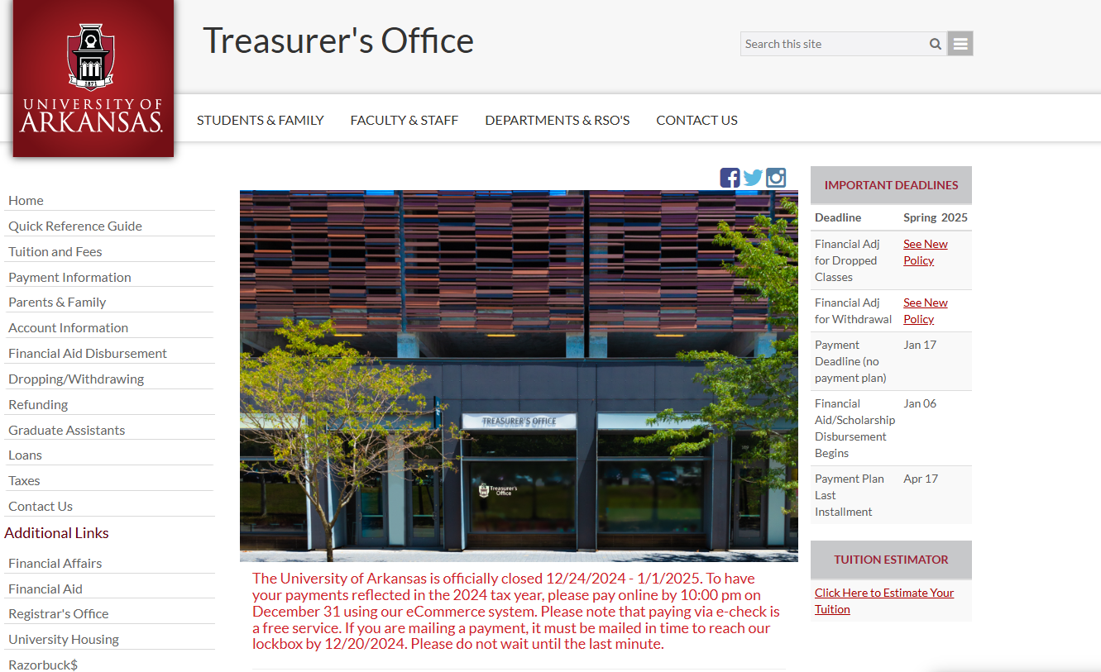
OUR WEBSITE

Slide 7
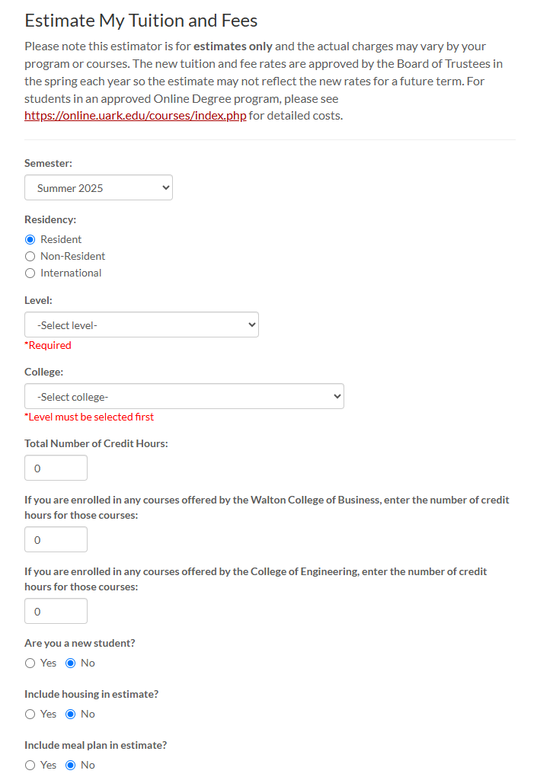

Visit treasure.uark.edu/estimator
TUITION CALCULATOR

Slide 8
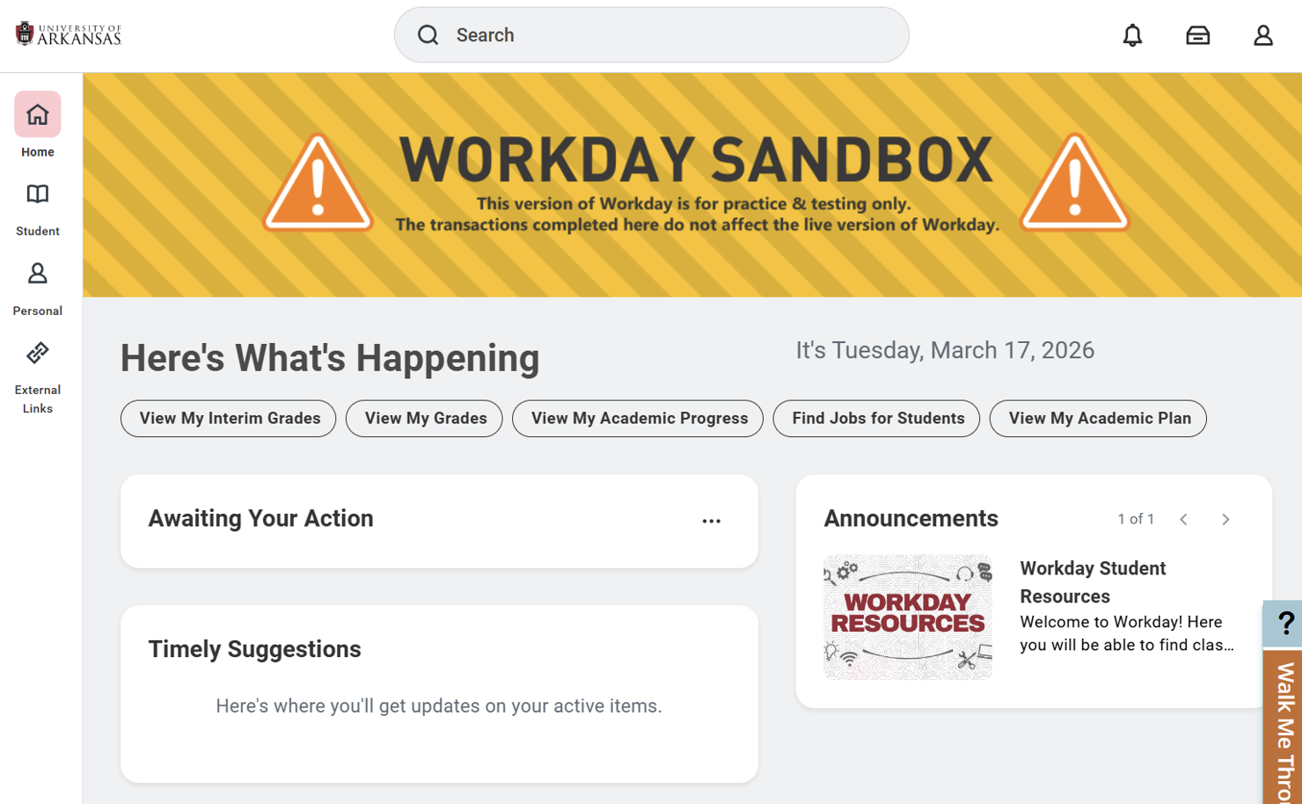


Slide 9
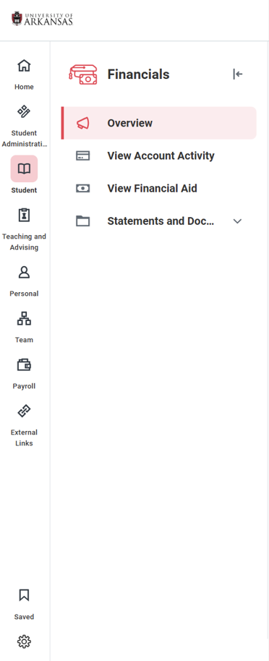

Slide 10



NAVIGATING WORKDAY STUDENT (CONT)
Financials Hub
Account Balance
Recent Payments
Make a Payment
Payment Plans
Refunding Option
My Tasks
Active Holds
Action Items
Profile
Your Contact Information
FERPA 3rd Party Release
Parent/Family Access

Slide 11
E-Commerce Payment Authorizations
(Workday Student– Profile – Contacts – Friends and
Family – Add –Done – Actions – Manage My
Permissions for My Third Party – Make a Payment)
FERPA/3rd Party Release and Parent/Family Workday Student Access
(Workday Student – Profile – Contacts – Friends and
Family – Add –Done – Actions – Manage My
Permissions for My Third Party)
PARENT AUTHORIZATIONS

Slide 12
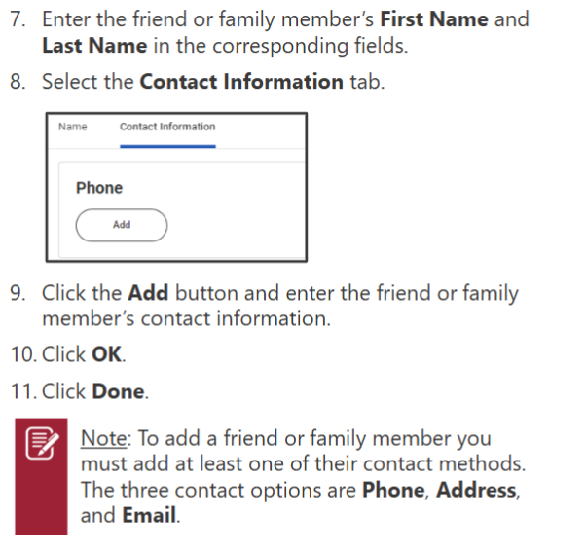
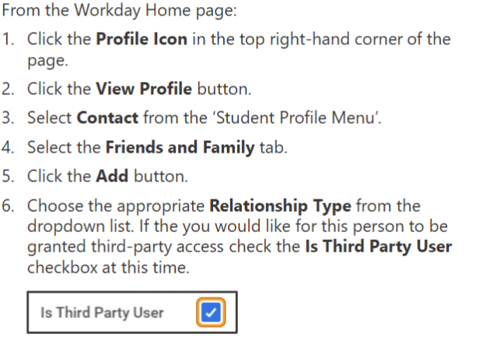
Configure My Friends and Family
Add if no contacts, edit for existing friends and family under actions

Slide 13
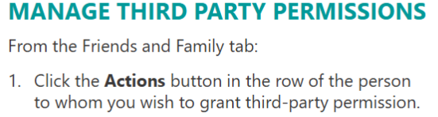
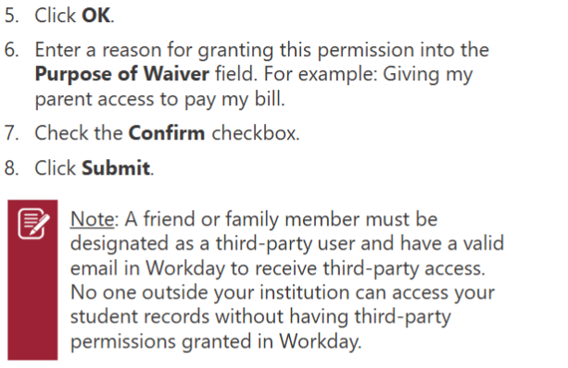
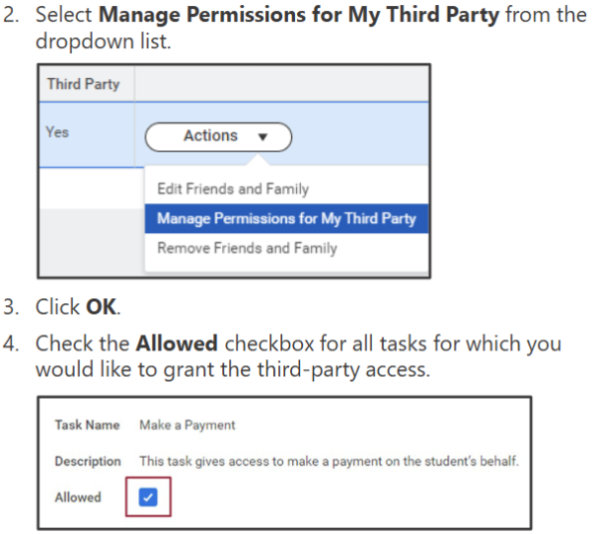
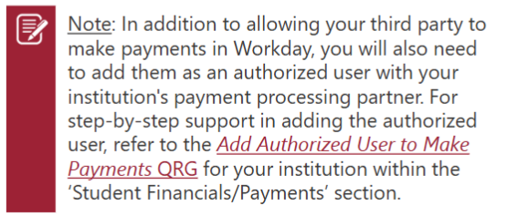
FERPA: Family Educational Rights & Privacy Act

Slide 14

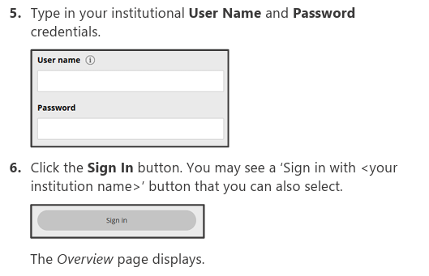
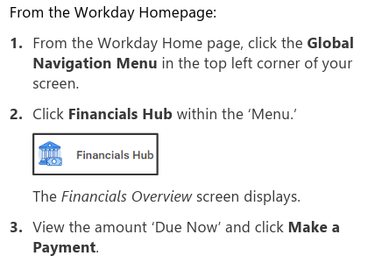
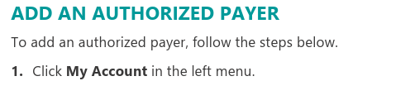
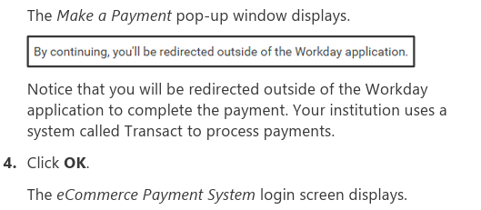
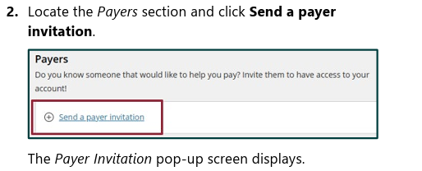
Add an Authorized Party to make a payment: Ecommerce

Slide 15
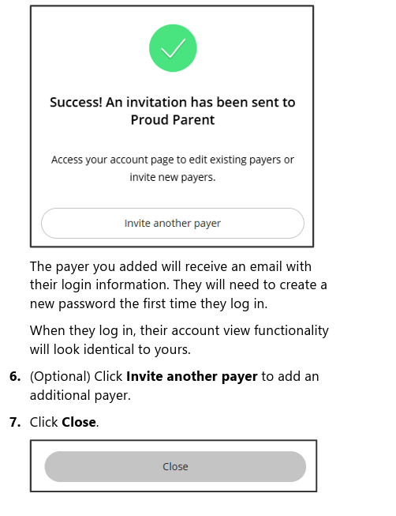

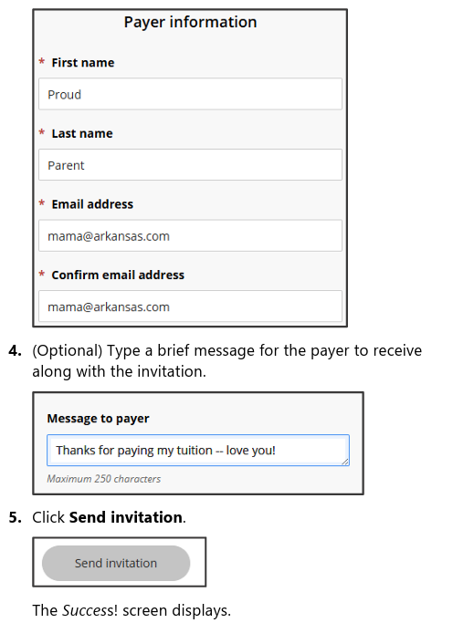
Add an Authorized Party to make a payment: Ecommerce (Cont)

Slide 16

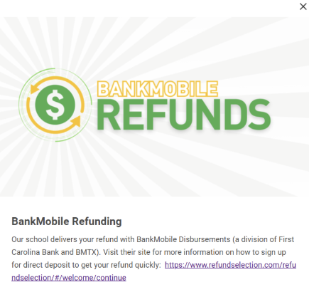


If a refund preference has not been selected, your refund can be delayed up to four weeks. Even if you are not expecting to receive a refund, please set up a refunding preference.
Workday Student
  -Financials Hub
  -BankMobile Refunding
  -Click the banner
  -Follow the instructions for signing in and selecting your preference
Your money, delivered your way!
Your school has partnered with BankMobile to deposit your money or refund quickly and securely.
You will have two electronic options to deposit your money. To avoid delays in accessing your money, you must select a refund option. The BankMobile Vibe Checking Account is one of you refund options but you are not required to open this account to receive your refund.
Visit refundselection.com for more information.
REFUNDS

Slide 17



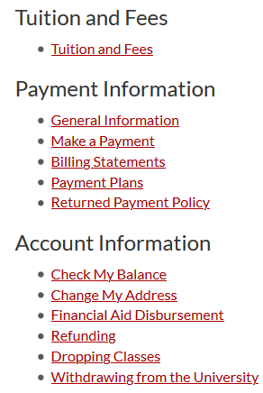

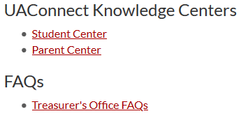
HELP CENTERS
TUTORIALS WITH STEP-BY-STEP ILLUSTRATIONS & HOW TOS
  Make a Payment
  Set Up Parent Authorizations
  Add Authorizations
  Set Refund Preferences
  ... and More!
Workday Student Knowledge Centers
Workday Student Knowledge Centers
Visit treasurer.uark.edu/student_family for more information

Slide 18
The Registrar’s Office determines drop and withdrawal deadlines. Before dropping classes or withdrawing, refer to the academic calendar to be sure you understand the financial implications it could cause.
When in doubt, contact us!
The academic semester calendar can be found on the Registrar’s website. The Fall 2026 -Spring 2027 calendar is available now.
THERE IS A $45.00 WITHDRAWAL FEE
DROPPING & WITHDRAWING ARE DIFFERENT
KNOW THE FINANCIAL RELATED DEADLINES
WITHDRAWING CAN AFFECT FINANCIAL AID ELIGIBILITY
DROPPING & WITHDRAWING

Slide 19
FREQUENTLY ASKED QUESTIONS
When will I know how much I owe?
When is the payment deadline?
Will I get a late fee?
Why do I have a hold?
What types of payments do you take?
Be sure to check your account frequently for additional charges throughout the term.
Fall 2026:
Mid to Late July
Spring 2027:
Early to Mid December
August 21st , 2026
Tuition and Fees are typically due on the 5th class day. You can review your due dates on Workday Student:
~Home Page/Timely
Suggestions or
~View Account Activity
~Due Now Details
YES! Pay your balance on time!
Late fees are applied twice per semester. You can avoid late fees by paying in full or enrolling into a payment plan and making payments as scheduled.
Auto-pay is also an option.
Various Reasons
You can find what type of hold/s you have on Workday Student:
~Profile
~Action Items and Holds
~Active Holds
*Some holds require you to complete a task. You can find tasks under “My Tasks”.
*Some holds will prevent future registration and your ability to get a transcript.
Online Payments
Preferred:
Electronic check (Free)
Credit card (1.93% Fee)
Also:
Paper check mailed to Lockbox
No Payments are accepted in our office!
Phone payments are not accepted!
*Beginning Spring 2021, payments will not be accepted in-office.

Slide 20
FREQUENTLY ASKED QUESTIONS
Where do I mail a personal check?
Where do I mail a 529 college savings payment?
Where do I mail an outside scholarship?
How do I enroll into a payment plan?
When are payment plan installments due?
University of Arkansas
Department 1238
Oklahoma City, OK.
73196
Please include student’s name and student’s ID# on the
memo line!
University of Arkansas
Department 1238
Oklahoma City, OK.
73196
Please have them include the student’s name and ID# on the check, stub or other documentation.
University of Arkansas
Treasurer’s Office
640 N Garland Ave
Suite #108
Fayetteville, AR
72701
Please have them include the student’s name and ID# along with a scholarship letter.
On Workday Student
~Financials Hub
~Make a payment
~ Payment Plan
~ Follow all directions
~ Auto-pay is optional
Payment plans are optional. You must enroll every semester and there is a flat fee of $40.00 per semester.
4 Month Plan
Balance divided into 4 equal installments
(Due Aug, Sep, Oct, & Nov)
Please see Treasurer's Office Website for exact date for final enrollment in this plan.
3 Month Plan
Balance divided into 3 equal installments
(Due Sep, Oct, & Nov)
Please see Treasurer's Office Website for exact date for final enrollment in this plan.

Slide 21
FREQUENTLY ASKED QUESTIONS
When will my federal aid disburse?
When will my scholarships disburse?
What about my outside scholarships?
How do I get the NRTA applied to my account?
Will I get a refund?
Grants and Loans
These typically disburse approx. 10 days before classes start.
The Treasurer’s Office disburses aid according to instructions from the Financial Aid Office.
Scholarships
These typically disburse approx. 10 days before classes start including AR Challenge.
Tuition waivers, 3rd party deferments and some state scholarships will not post until after census date which is the 11th class day.
Scholarships from organizations -
These can take longer to process. Please allow two weeks for processing beginning from the date the funds are received.
(Examples: high schools, churches, clubs, etc.)
New Arkansan Non-Resident Tuition Award
Will display the percentage of the non-resident tuition you are responsible for.
The NRTA is awarded through the scholarship office and is system calculated.
Perhaps!
If your account is overpaid by financial aid, scholarships, other types of payments or adjustments, you may get a refund. Be prepared & set up your refund preference in advance!
Office of Financial Aid
finaid@uark.edu | 479-575-3806
Office of Academic Scholarships
scholars@uark.edu | 479-575-4464
Bank Mobile Refunds
refundselection.com

Slide 22
CHECKLIST
REQUIRED
Financial Agreement ​
(Workday Student – My Tasks - Onboarding)
Student Permissions for Title IV Aid​
(Workday Student – My Tasks - Onboarding)
IRS 1098-T E-Consent Form​
(Workday Student – My Tasks - Onboarding)
HIGHLY RECOMMENDED
Select Refunding Preference​
(Workday Student – Financials Hub – BankMobile)​
FERPA 3rd Party Release​
(Workday Student – Profile – Contacts – Friends and Family – Add –Done ​
– Actions – Manage My Permissions for My Third Party)
Parent/Family Workday Student Authorizations​
(Workday Student – Profile – Contacts – Friends and Family – Add –Done ​– Actions – Manage My Permissions for My Third Party)​
E-Commerce Payment Authorizations
(Workday Student – Financials Hub – Make a Payment – Ecommerce Login – My Account – Payers – Send a payer Invitation)

Slide 23
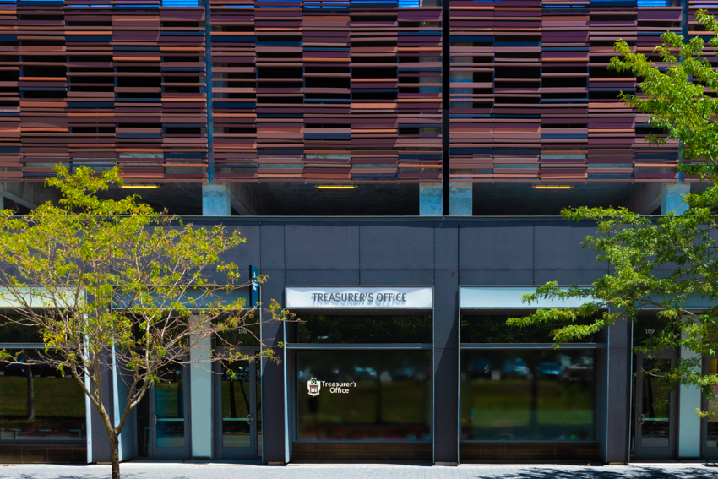
CONNECT WITH US!
CONTACT INFORMATION
treasurer.uark.edu
treainfo@uark.edu
479-575-5651
640 N. Garland Ave. Ste. 108
Monday - Friday 8 a.m. to 5 p.m.

Slide 24
INFORMATION & TECHONOLOGY SERVICES

Slide 25
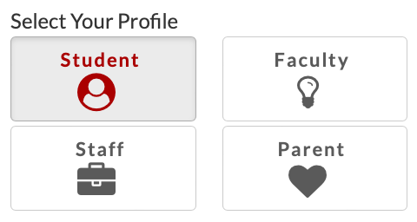
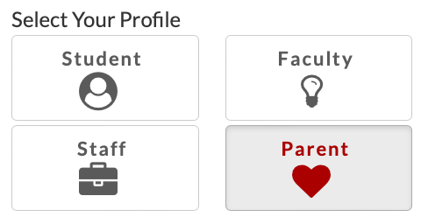
GET STARTED WITH TECH
VISIT TECH.UARK.EDU
  UARK Account
  Wi-Fi
  Email
  Workday Student
  Blackboard
  Software
  Printing

Slide 26
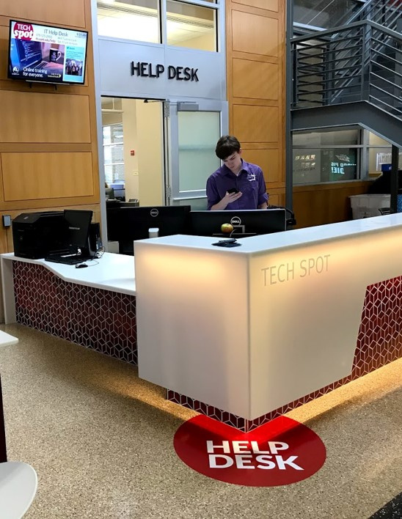
DON’T GET FRUSTRATED, GET HELP!
Tech Help is available 24/7
  In person at the IT Help Desk in the Union
  Online chat at help.uark.edu
  By phone at 479-575-HELP (2905)
  Blackboard support at bbhelp@uark.edu
  Computer labs are available at multiple locations across campus

Slide 27
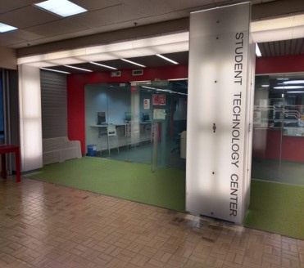
3RD FLOOR ARKANSAS UNION
Monday - Friday 8 a.m. to 10 p.m.
YOU CAN PLAY:
YOU CAN BORROW:
  Alienware gaming PCs available for walk-in use
  Reservable Console Stations
  Green Screen Kits
  Gaming Consoles
  Audio Recorders & Microphones
  Projectors
  Laptops
  Calculators
  Cameras
  Recorders
YOU CAN CREATE:
  Digital Media Lab
  Audio and Video Production
  Photography
  Graphics & Animation
STUDENT TECHNOLOGY CENTER

Slide 28

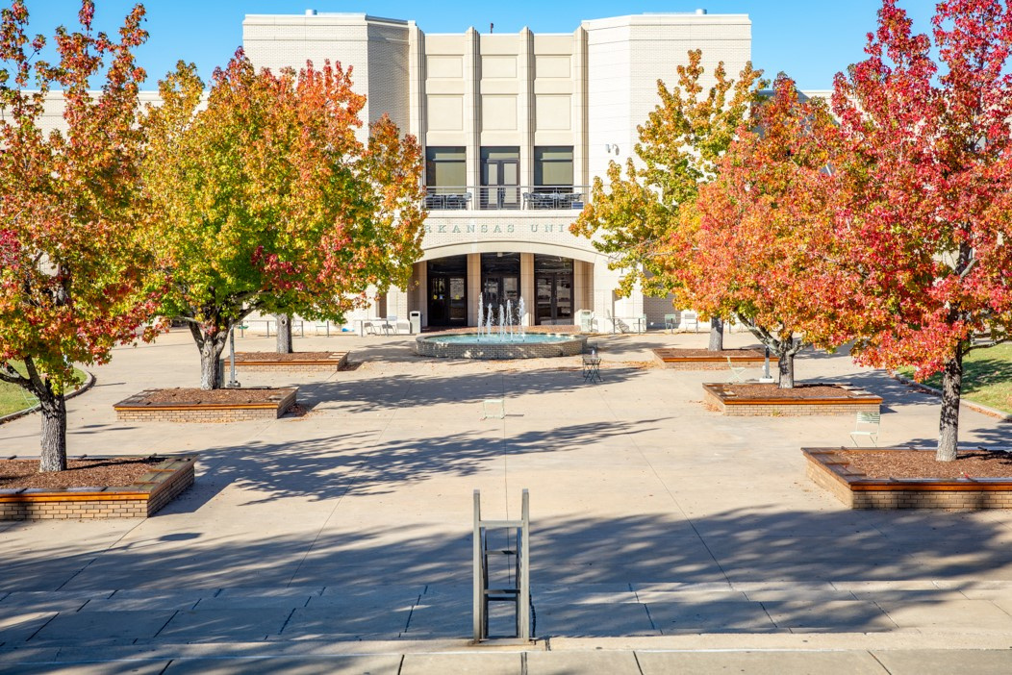
CYBERSECURITY
IMPORTANT THINGS TO KNOW
  Do not share your login credentials
  Be wary of email and text scams
  Do not click on suspicious links or attachments
  Use strong passwords / password manager
  Keep your operating systems, browsers, and software updated
  Enable the built-in antivirus tool Windows Defender on Windows devices
  Do not leave devices unattended in public spaces
  Limit the personal information you post online

Slide 29
MINIMUM UNIVERSITY TECHNOLOGY RECOMMENDATIONS
  Processor: U5+ or M2+
  Memory/RAM: 16GB
  Hard Drive/Storage: 256GB
  Webcam
  3-Year Accidental Damage Warranty
  Microsoft Office
  Note: Chromebooks are not recommended
Colleges recommending the minimum:
  Fulbright College of Arts and Sciences
  Sam M. Walton College of Business
  School of Law

Slide 30
WHAT TECH TO BUY FOR YOUR MAJOR
Recommends a Mac:
Requires a Mac:
  School of Journalism & Strategic Media
  School of Art
  Music
  Bachelor of Science in Data Science
  Bachelor of Fine Arts in Graphic Design
Requires Windows:
  Fay Jones School of Architecture & Design
  College of Engineering
Recommends Windows
  College of Education and Health Professions
  Walton College of Business
  Dale Bumpers College of Agriculture, Food & Life Sciences
Mac or Windows is Acceptable:
Law School
Fulbright College of Arts and Sciences

Slide 31
COLLEGE SPECIFIC REQUIREMENTS
Fay Jones School of Architecture & Design
College of Engineering: Biomedical, Biological, Mechanical and Chemical
  Intel U series, XEON or AMD Ryzen +​ 2.5GHZ+
  32GB RAM min/64GB​ RAM
  Nvidia GeForce RTX 500 Ada 4GB/8GB other GPU options: 3070/4070Ti or AMD Radeon RX 6800/7900 video card​
  512GB solid state drive​
  1920x1200 or higher non-touch display​
  64-bit Windows 11 Pro​
  802.11ac or later standard​
  Software requirements: Office 365, Rhino, Lumion, Revit, Grasshopper
  Intel U5 series, Xeon or AMD series +​
  16GB of RAM​
  Integrated Video card +​
  1TB solid state drive​
  1920x1200 or higher non-touch display​
  64- bit Windows​ 11
  802.11ac or later standard​
  USB A port or adapter​
  USB C port

Slide 32
DEGREE SPECIFIC REQUIREMENTS
Bachelor of Science in Data Science
Bachelor of Fine Arts in Graphic Design
  MAC M3 or M4 processor
  32GB​ of RAM​
  Integrated video card +
  2TB solid state hard drive​
  1920x1200 or higher non-touch display​ 14” or 16”
  Mac Operating System
  802.11ac or later standard​
  External Display
  MAC M3 or M4 processor
  32GB​ of RAM​
  Integrated video card +
  512GB solid state hard drive​
  MacBook Air or MacBook Pro 14-inch, 15-inch or 16-inch
  Mac Operating System
  802.11ac or later standard​
  Adobe Creative Cloud

Slide 33
CONNECT WITH US!
CONTACT INFORMATION
Student Technology Center
Monday - Friday 8 a.m. to 10 p.m.
479-575-8602 | stc@uark.edu
Online Technology Support
help.uark.edu
Blackboard Support
bbhelp@uark.edu
Information Technology Services
its@uark.edu

